Slide 1
Mastering 4-Wheeled Tractor Driving
Tractor driving is essential for any large-scale agricultural operation. By following these tips, you can learn to control your 4-wheeled tractor safely and effectively.

Slide 2
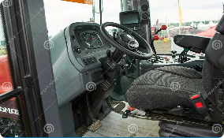
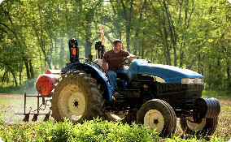
Understanding the Basics
Getting to Know Your Tractor
The Physics of Tractor Driving
The Importance of Ground Preparation
Before You Begin
You need to understand the impact that weight and momentum can have on your tractor's stability and performance.
Good preparation is key to achieving the maximum performance from your tractor.
Make sure you inspect your tractor and your field, check weather conditions, and ensure you have appropriate safety gear.
Before you start, make sure you understand the primary controls and gauges.

Slide 3
Safety Precautions and Regulations
Driver Safety
Field Safety
Always wear safety gear and never let non-operators ride alongside you.
Ensure that there is no one in the operating area before you start driving. Avoid driving near embankments or steep slopes.
Environmental Safety
Emergency Safety
Make sure to familiarize yourself with rules and regulations in your area and follow all guidelines when operating your tractor.
A well-practiced emergency plan and first aid kit are crucial to your success as a driver.

Slide 4
Proper Handling and Control Techniques
1
Mastering Steering
Learn to use your steering wheel properly, and avoid over-correcting which can result in losing control.
2
Using Gears Effectively
Knowing which gears to use in different conditions will give you optimal control over your tractor.
3
Creating a Proper Seating Position
A comfortable and stable seating position will ensure the best driving performance and operator alertness.

Slide 5
Operating Controls and Equipment Functions
Controlling the Hydraulic Arms
Learning to adjust the height and motion of the hydraulic arms will enable you to operate a wider range of farm equipment.
Using PTO Safely
Make sure that the PTO is safeguarded and only engaged/disengaged when the gearbox is stopped.
Using Different Types of Implements
Understand which implement to use for each job and make sure you attach and detach them correctly.

Slide 6
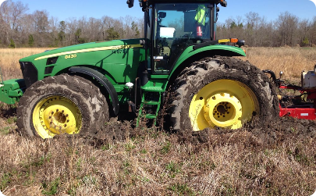
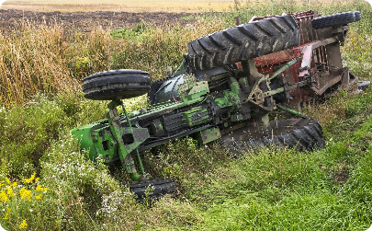
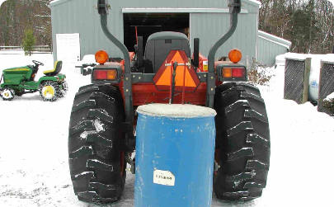
Common Mistakes and How to Avoid Them
Getting Stuck in Mud or Soft Ground
Overloading and Unstable Loads
Lack of Counterweight
Operate your tractor in a safe and controlled manner to avoid accidents caused by the lack of counterweight.
Use proper techniques to prevent your tractor tires from slipping and getting stuck.
Improperly balanced and overloaded loads can cause your tractor to tip over.

Slide 7
Maintenance and Care for Optimal Performance
1
Regular Machine Inspection
2
Oil and Fluid Maintenance
3
Battery Care
Regular maintenance of your tractor's battery can prevent unexpected downtime.
Inspecting your tractor regularly can help you identify problems before they become serious.
Ensure that your tractor has the correct oil and fluid levels for optimal performance.

Slide 8
Conclusion and Key Points
Conclusion
Key Takeaways
Operate your tractor in a safe, controlled, and aware manner, and take necessary safeguards to prevent accidents.
Ensure that you learn to control your tractor properly, familiarize yourself with safety regulations, adhere to maintenance schedules, and handle common mistakes with care.

