Slide 1
Let’s Learn FreeCAD
Topic 3
3D Model

Slide 2
Topic 3
Course Content
Topic 3
3D Model
Topic 3 has three subtopics including
Introduction, Create 3D Model & Assembly.
Introduction
Create 3D Model
Assembly

Slide 3
Topic 3
Course Content
3D Model.
In FreeCAD, the Part Design Workbench is the perfect tool to build 3D model or part/product design.
Introduction
Create 3D Model
Assembly

Slide 4
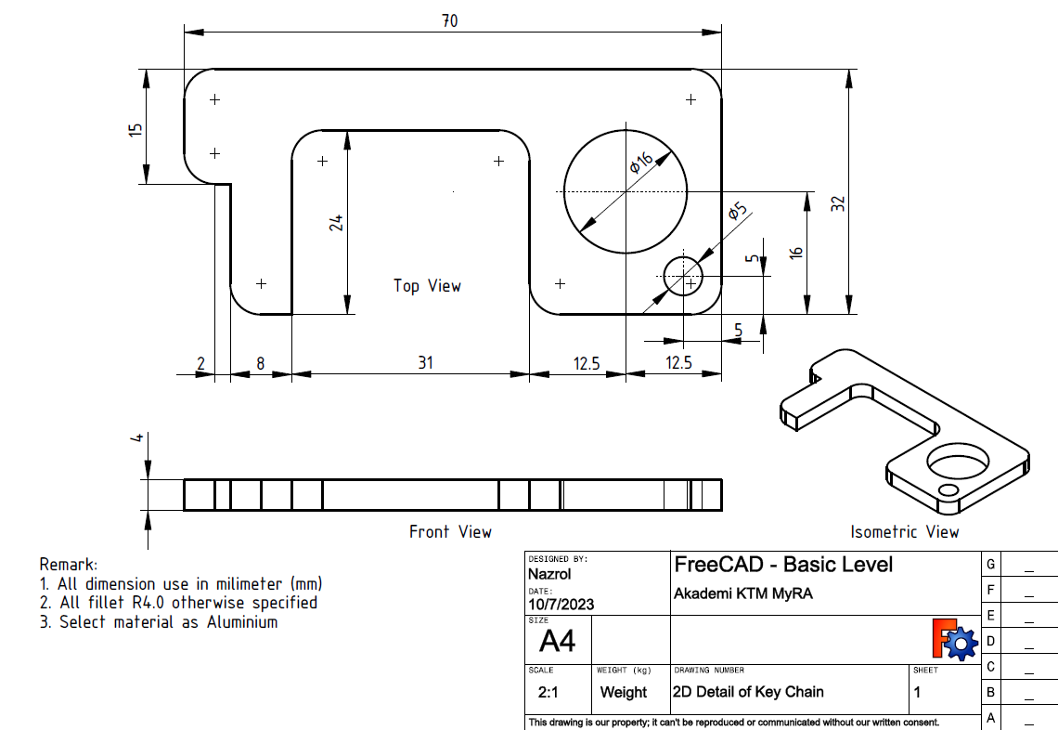
Topic 3
Course Content
Create 3D Model 1: Keychain.
The steps to create 3D Model as shown in figure below as follows:
Introduction
Create 3D Model
Assembly

Slide 5
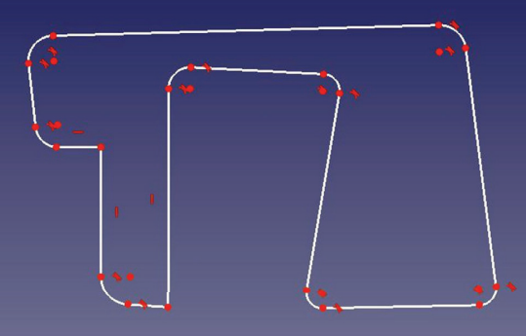
Topic 3
Course Content
The steps are:
Create new file and select Part Design Workbench .
Select create body, sketch, plane and Polyline.
Create freehand sketch. The Sketch might be like the figure below.
Introduction
Create 3D Model
Assembly

Slide 6
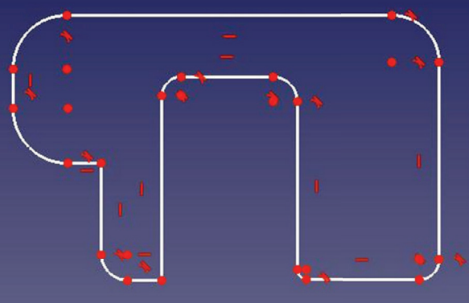
Topic 3
Course Content
d. Select the appropriate constraint if necessary. The
constraint starts with the lines without constraint symbol.
e. For (d.), use Constraint vertically and Horizontally till the
constraint symbol appear.
Introduction
Create 3D Model
Assembly

Slide 7
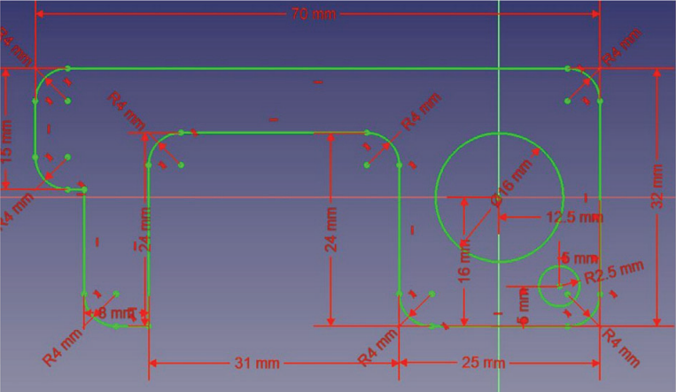
Topic 3
Course Content
f. Refer the drawing and use suitable constraint such as
Horizontally and Vertically distance, Diameter/Radius until
the sketch fully constraint.
Introduction
Create 3D Model
Assembly

Slide 8
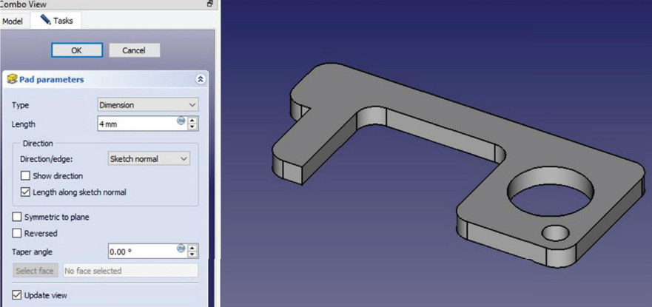
Topic 3
Course Content
g. Select circle and create circle with diameter of 16mm and
5mm.
h. Select Leave sketch . The view changed from 2D to
3D automatically.
i. Select Pad , insert length = 3mm and click ok.
j. Save file as: Key Chain
Introduction
Create 3D Model
Assembly

Slide 9
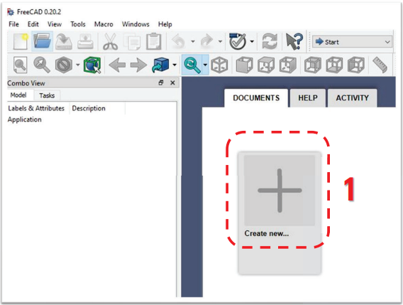
Topic 3
Course Content
New File
To create the new file following steps:
1. Select a Create New
Introduction
Create 3D Model
Assembly

Slide 10
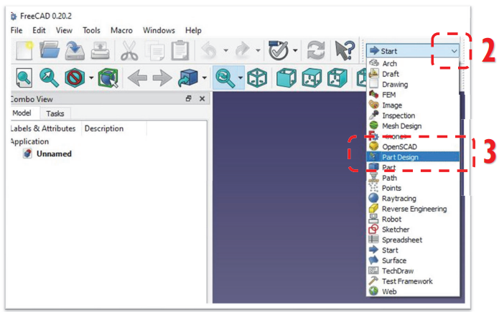
Topic 3
Course Content
2. Select Workbench: Pull down -> Part Design
3. Window for Part Design workbench as follow:
Introduction
Create 3D Model
Assembly

Slide 11
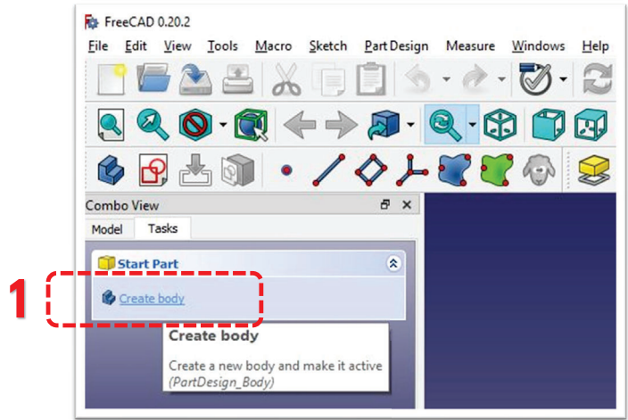
Topic 3
Course Content
New Sketch
The new sketch can be created using the steps below:
1. Select a Create Body on Combo view.
Introduction
Create 3D Model
Assembly

Slide 12
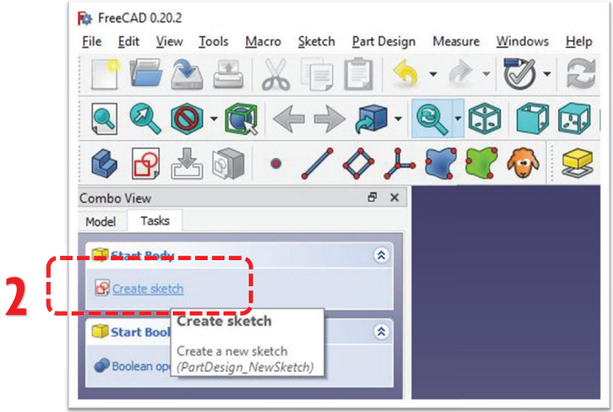
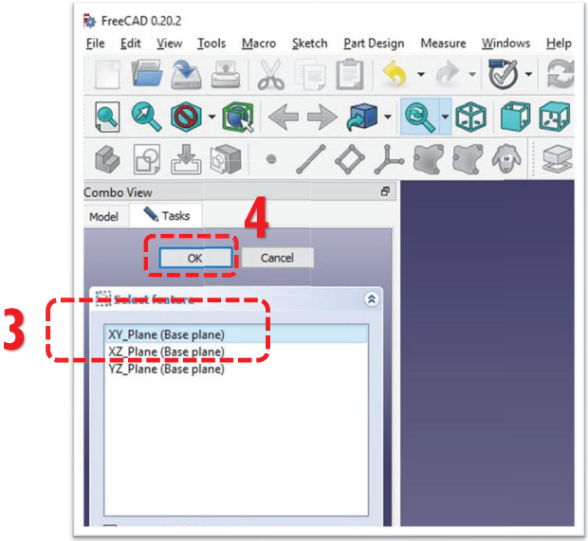
Topic 3
Course Content
2. Select a Create Sketch.
3. Select a XY-Plane
Introduction
Create 3D Model
Assembly

Slide 13
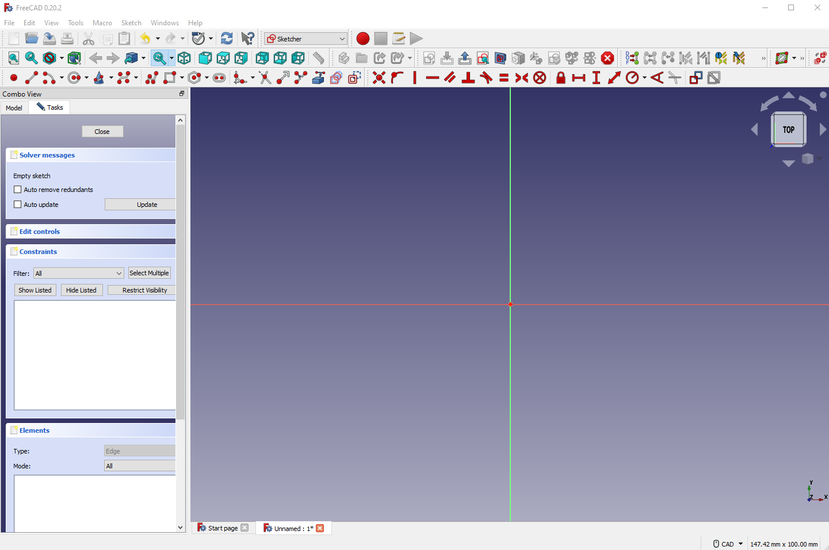
Topic 3
Course Content
4. Click Ok and the window as follow:
Introduction
Create 3D Model
Assembly

