Slide 1
HOW TO DRIVE A TRACTOR
In this presentation, we will cover everything you need to know to confidently operate a tractor.

Slide 2
Importance of Learning How to Drive a Tractor
1
Versatility
Tractors are essential for a wide range of tasks, from agricultural work to construction projects.
2
Self-Sufficiency
Being able to operate a tractor gives you the independence to handle various tasks on your own.
3
Career Opportunities
Having tractor driving skills can open doors to job opportunities in farming, landscaping, and more.

Slide 3
Basic Components of a Tractor
Engine
Transmission
The power source that generates the necessary energy for the tractor to function.
Transfers power from the engine to the wheels, enabling the tractor to move forward or backward.
Hydraulic System
Steering System
Controls the various attachments and implements, such as loaders and mowers.
Allows the operator to control the direction of the tractor.

Slide 4
Preparing to Drive a Tractor
1
Inspect the Tractor
Check for any damages, ensure proper tire pressure, and inspect fluids and fuel levels.
Adjust the Seat and Controls
2
Adjust the seat and mirrors for optimal comfort and visibility, and familiarize yourself with the controls.
3
Put on Safety Gear
Wear appropriate protective clothing, such as sturdy boots, gloves, and ear protection.
Fasten Your Seatbelt
4
Always buckle up for safety before starting the tractor.

Slide 5
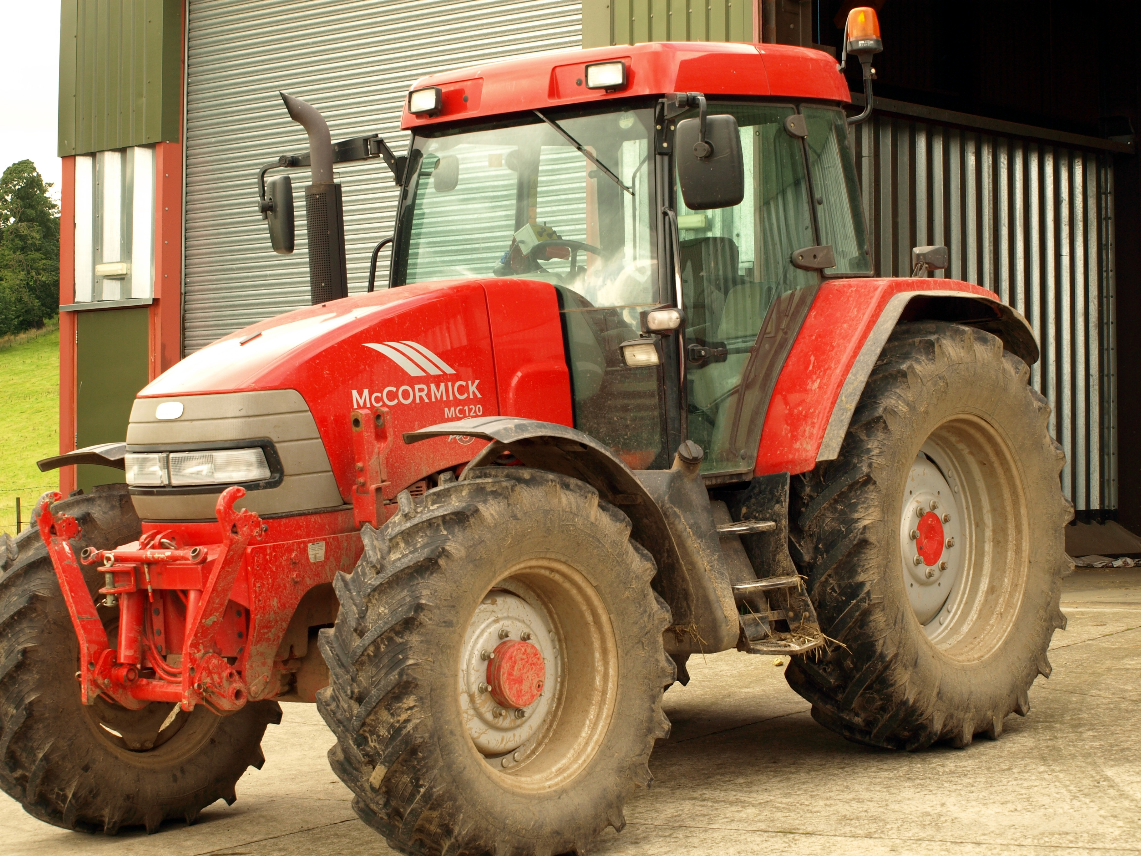
Operating a Tractor
Start the engine and allow it to warm up.
Engage the clutch and select the desired gear.
Gradually release the clutch while applying gentle pressure on the accelerator.
Steer the tractor smoothly and maintain a safe speed.
This Photo by Unknown Author is licensed under CC BY-SA

Slide 6
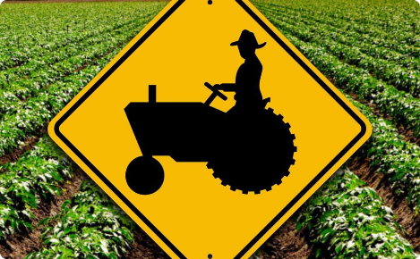
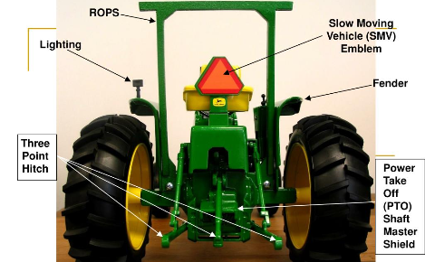
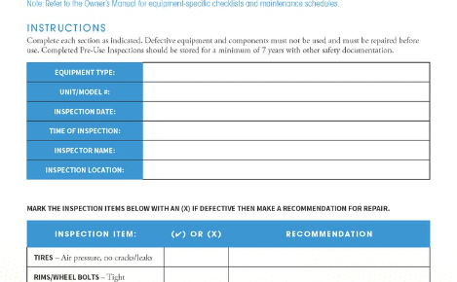
Safety Precautions While Driving a Tractor
Be Aware of Your Surroundings
Use Safety Equipment
Regularly scan the area for hazards and be mindful of pedestrians and other vehicles.
Always wear a seatbelt and any other necessary safety gear, such as a rollover protection structure (ROPS).
Maintain Proper Posture
Perform Regular Maintenance
Keep both hands on the steering wheel and sit with proper posture to ensure better control.
Check the tractor's condition regularly and follow a maintenance checklist to ensure safe operation.

Slide 7
Conclusion
Driving a tractor is an invaluable skill that offers versatility, independence, and exciting career opportunities. By following proper procedures and safety precautions, you can confidently navigate the world of tractor driving.

