Slide 1
Let’s Learn FreeCAD
Topic 4
Drafting FreeCAD 3D

Slide 2
Topic 4
Topic 4
DRAFTING
Topic 4 has one subtopics Create Drafting.
Course Content
Introduction
Create Drafting

Slide 3
Topic 4
Drafting
Designers can create parts and assemblies with great efficiency and flexibility with to the 3D environment. However, using 2D drawings to communicate manufacturing information is frequently required and represented as drafting.
Basically, drafting contain title block and drafting standards.
a. Title Blocks.
Information such as name of organization, part
number, etc.
b. Drafting Standards.
Dimension, Line, views, etc.
Introduction
Create Drafting

Slide 4
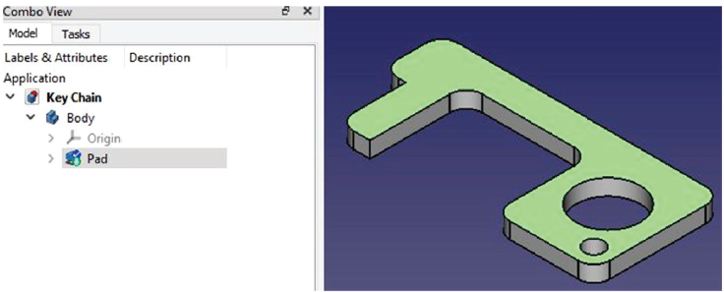
Topic 4
Steps to Create Drafting
The steps create drafting as follows:
1. Open file: Key Chain .
2. Select top surface of Key Chain (Green Color) using
mouse.
Introduction
Create Drafting

Slide 5
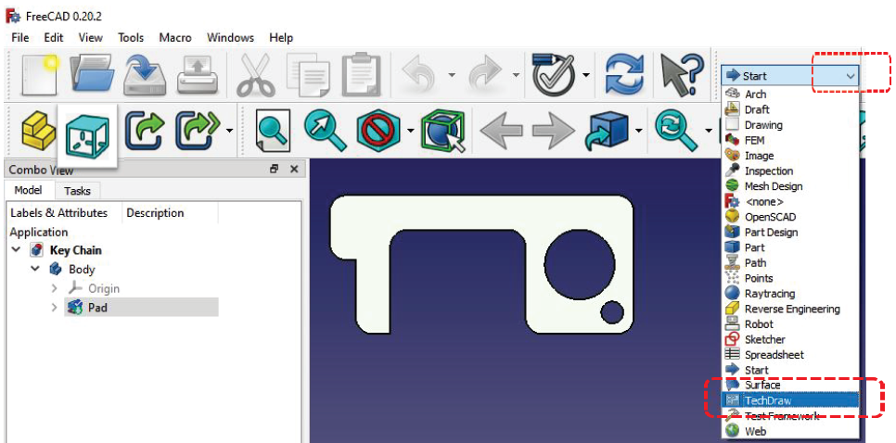
Topic 4
3. Select Top to change isometric view to top view.
4. Click arrow. Select Tech Draw.
Introduction
Create Drafting

Slide 6
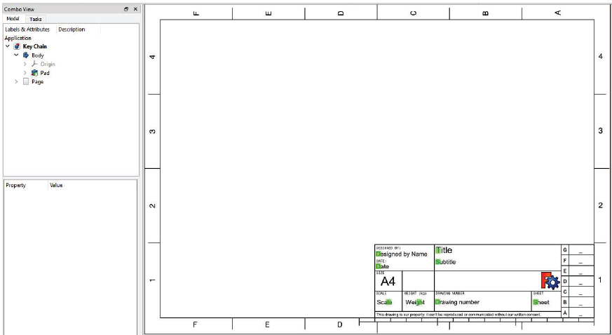
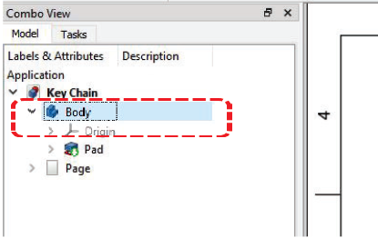
Topic 4
5. Select Insert Default Page .
6. Select Body.
Introduction
Create Drafting

Slide 7
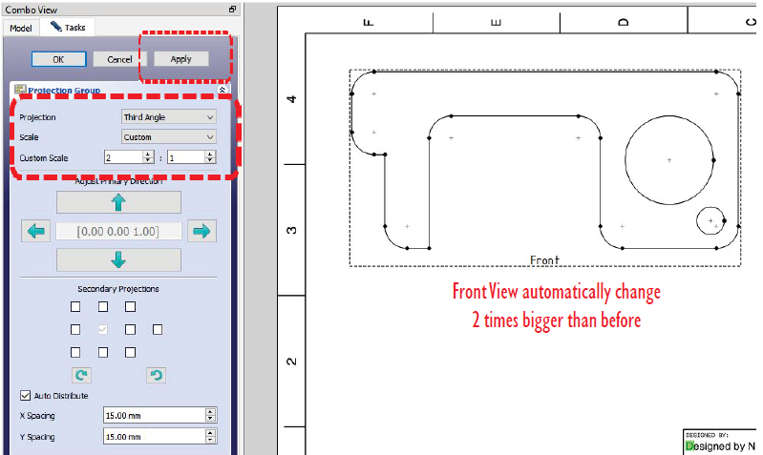
Topic 4
7. Select Insert Projection Group .
8. Select Projection = Third Angle.
9. Select Scale = Custom.
10. Select Custom Scale = 2 : 1.
Introduction
Create Drafting

Slide 8
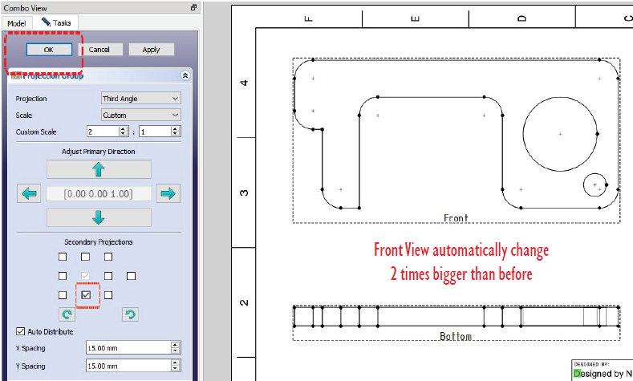
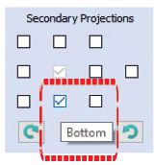
Topic 4
11. Click Apply (Front View automatically change 2 times
bigger).
12. Thick / at bottom box. (Bottom view automatically
appear).
Introduction
Create Drafting

Slide 9
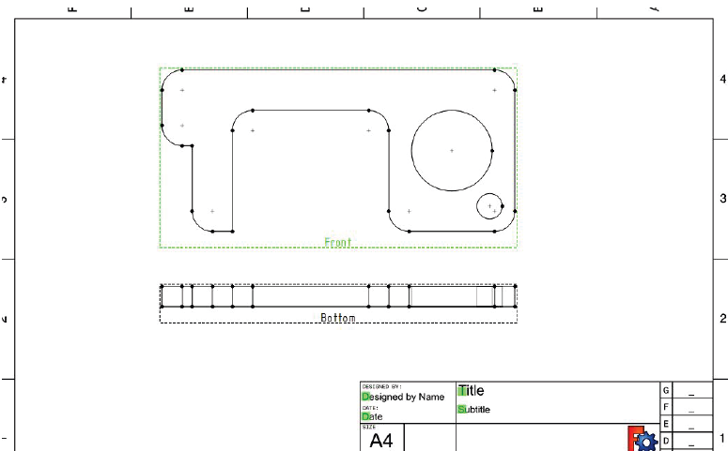
Topic 4
13. Click Ok.
14. Try to drag Front and Bottom View to the center of
drawing paper. How?..drag mouse to frame Front (dash
line), then select dash line until it turn green color. Hold
left button mouse + drag mouse left or right. The result is
both Front and Bottom View can be move.
Introduction
Create Drafting

Slide 10
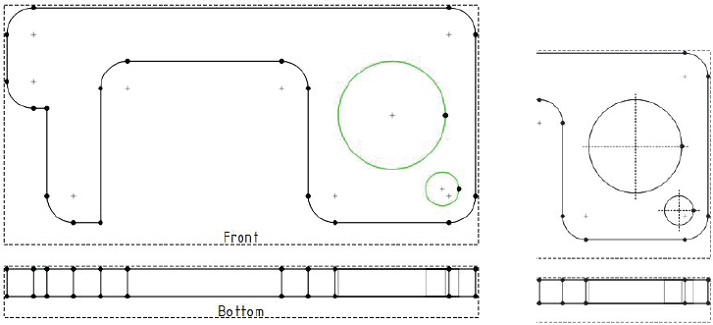
Topic 4
15. Select both two circle by hit and hold Ctrl button
(keyboard) + drag mouse to select two circle.
16. Select Add Circle Centerlines.
Introduction
Create Drafting

Slide 11
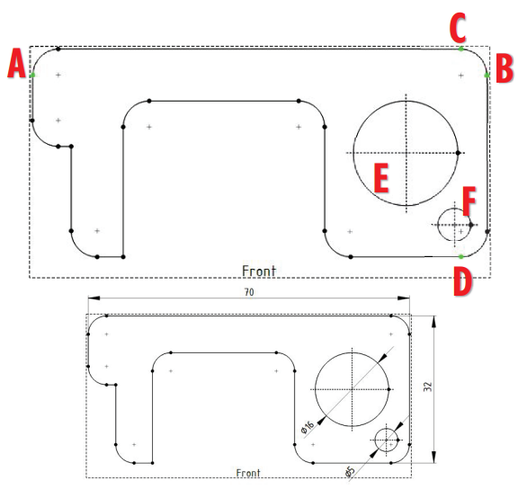
Topic 4
17. Select point A and B.
Then select Insert Length Dimension
Introduction
Create Drafting

Slide 12
Topic 4
18. Select point C and D.
Then select Insert Length Dimension .
19. Select Circle E.
Then select Insert Diameter Dimension .
20. Repeat steps 19 to dimension circle F.
21. Select appropriate Insert Dimension to complete all
dimensions at Front and Bottom View as shown in the
figure.
Introduction
Create Drafting

Slide 13
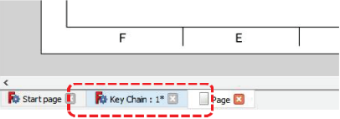
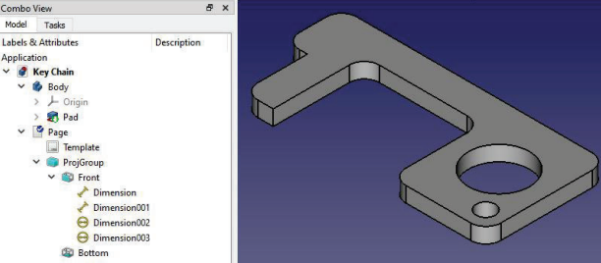
Topic 4
22. At bottom tab, select Key Chain.
23. Select Isometric to change top to isometric view .
Introduction
Create Drafting

Slide 14
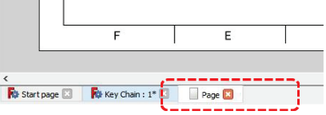
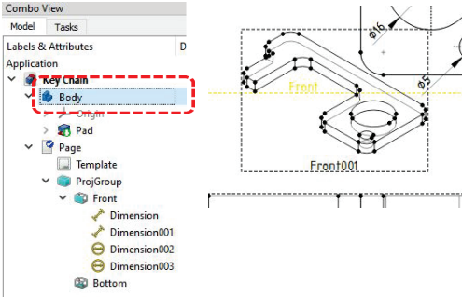
Topic 4
24. At bottom tab, select Page.
25. Select Body.
Introduction
Create Drafting

Slide 15
Topic 4
26. Select Insert Projection Group .
27. Click Ok.
28. Repeat step number 14 to move Front001 (isometric) as
shown in the figure.
29. Select Insert Annotation to create text.
30. Double click at wording Annotation .
31. Type all sentences at text box as shown in the figure.
32. Click Ok.
Introduction
Create Drafting

Slide 16
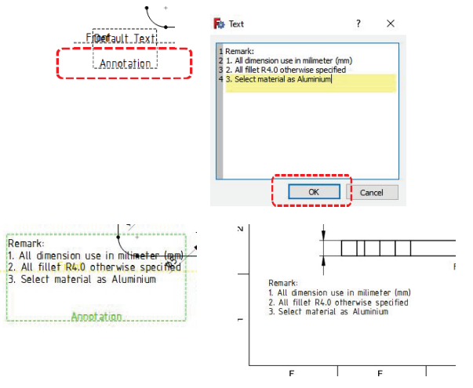
Topic 4
Introduction
Create Drafting

Slide 17
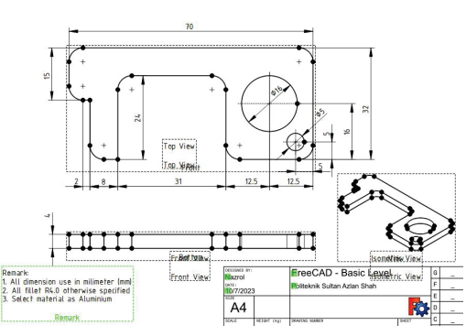
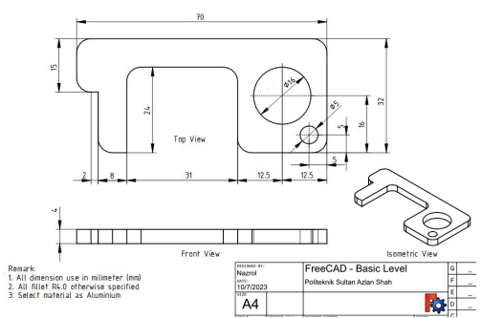
Topic 4
33. Repeat step number 14 to move Annotation as shown in
the figure.
34. Select Turn View Frame On/Off. See the difference on/off
frame as shown in the figure .
Introduction
Create Drafting

Slide 18
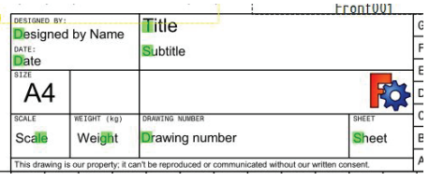
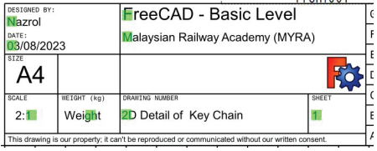
Topic 4
35. Select Turn View Frame On/Off again to edit
annotation at title block.
36. Double click at D (green color) Designed by Name (type
your own name), Date, and etc. (Refer to the title block
at handout drawing given)
Introduction
Create Drafting

Slide 19
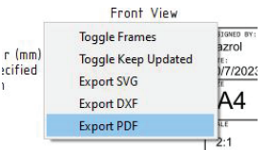
Topic 4
37. Select Turn View Frame On/Off again to off frame.
38. Overall drafting/drawing of 2D Detail of Key Chain should
be as shown in the figure.
39. To convert drafting/drawing to PDF file format, right click
mouse then select Export PDF.
40. Save file.
Introduction
Create Drafting

Slide 20
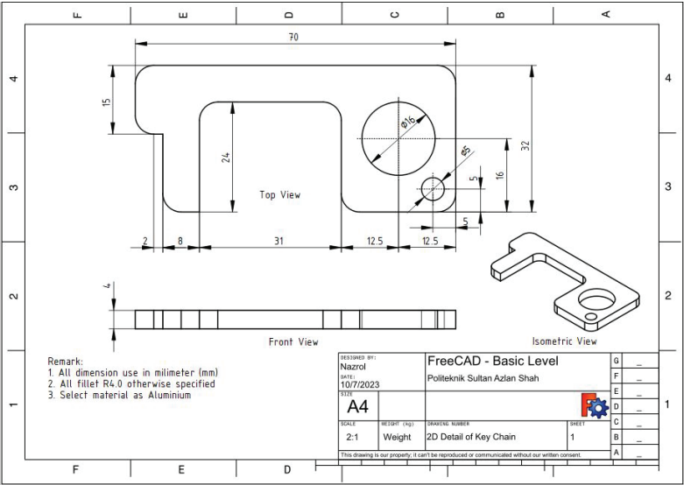
Topic 4
Introduction
Create Drafting

