Slide 1
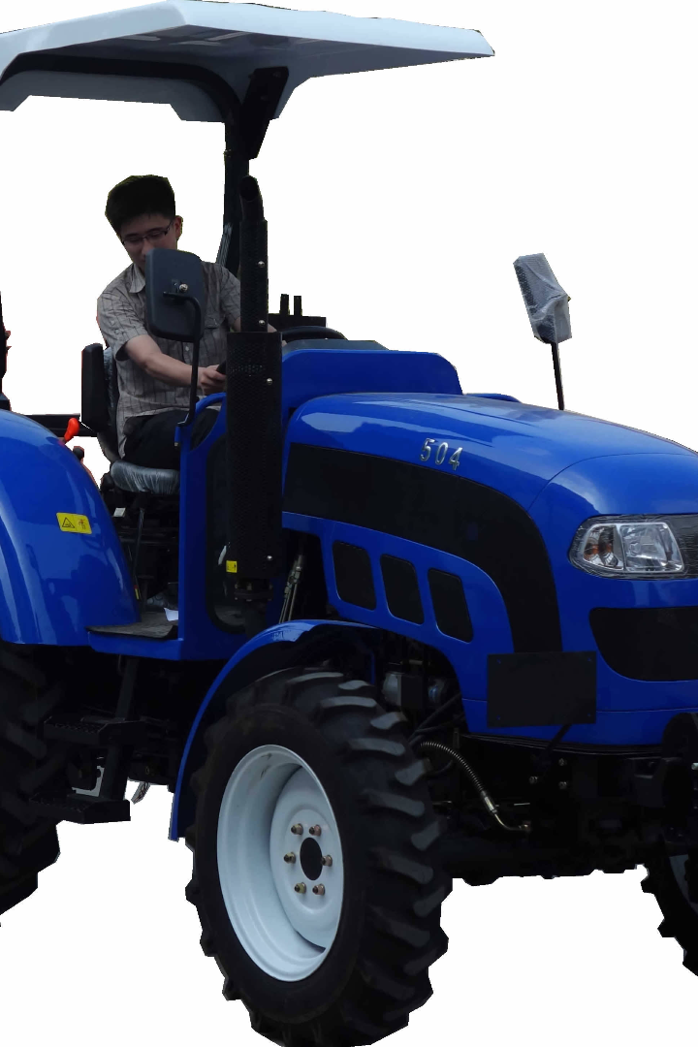
The Basic Components of a Tractor
A tractor comprises an engine, a cooling system, transmission, fuel and electrical systems, operator's station, and wheels. They operate like a truck with a steering wheel, throttle, brakes, clutch or transmission gear selector.

Slide 2
Engine and Cooling System
Engine
The engine is the heart of the tractor. It comprises the combustion chamber, fuel pump, and connected parts that generate the power needed to complete multiple farming tasks.
Cooling System
This system consists of a radiator, water pump, and fan blade. It maintains optimal engine temperature and prevents overheating.

Slide 3
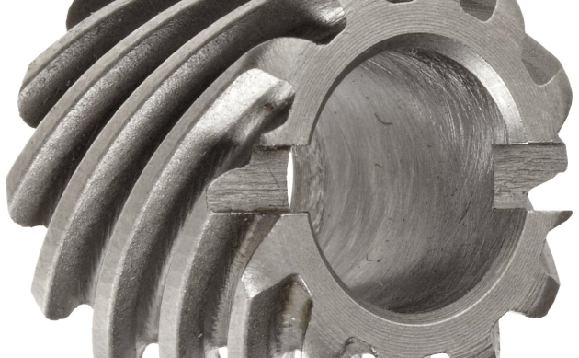
Transmission and Fuel System
Transmission
Fuel System
The tractor's transmission allows it to move forward and backward at differing speeds. It comprises gears, dials, and lever selectors that allow the operator to control power being transmitted to the wheels.
The fuel system enables the engine to produce power by providing fuel supply through a nozzle. The fuel tank also contains a filter for separating impurities like dirt or water from the fuel.

Slide 4
Electrical System and Operator's Station
Electrical System
The electrical system consists of a battery that supplies the tractor's electrical needs. These needs include powering the starter motor, head and tail lights, and instrument cluster.
Operator's Station
This section houses the control mechanisms and operator's seat. The steering wheel, throttle, brake pedals, and clutch or transmission gear selector are also located here.

Slide 5
The Wheels
1
The Front Wheels
The front wheels provide steering and support the weight of the engine. The weight from the implement attached to the tractor is also supported here.
2
The Rear Wheels
The rear wheels are the drive wheels that provide traction and power to the transmission. These wheels usually feature retractable tire chains or pads for added stability.
3
The Tire Type
The tire type varies from type and application. Some tractors use utility-type tires, while others use narrow designed tires for row crop applications.

Slide 6
Applications of a 4 Wheel Tractor
Agriculture
Construction
The most common usage of a four-wheel tractor is in farming. These tractors perform tasks like tilling, planting, harvesting, and transportation of crops.
Tractors equipped with front-end loaders, backhoes, and other attachments are useful in construction. They are used extensively for digging, moving soil, and hauling materials on job sites.

Slide 7
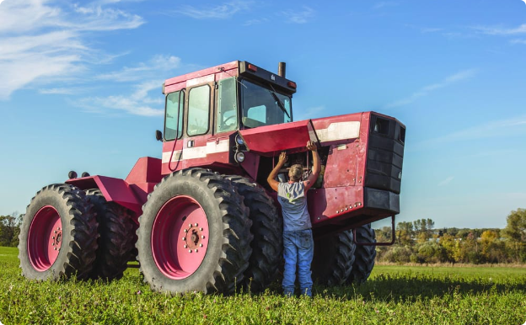
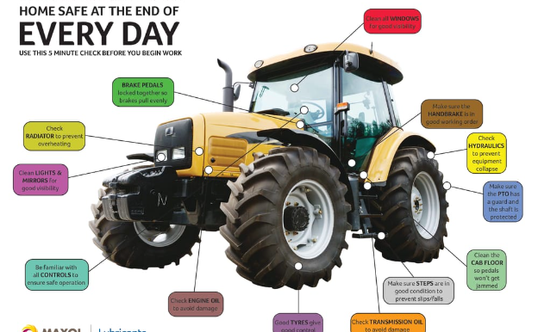
Efficiency and Safety
Efficiency
Safety
Tractors have increased productivity in farming and reduced workload tremendously, saving farmers time and resources.
Despite being common mechanized agricultural equipment, Tractors pose safety risks. As such, safety precautions must be held in high regard. Essential safety measures, which include protective gear, safety signs, and built-in safety features, should be upheld for optimal safety.

Slide 9
Conclusion
1
Versatile and Dependable
Four-wheel tractors are versatile and dependable machines that have improved the productivity of farmers and construction workers. They have become an essential agricultural tool for every crop production process.
2
Improved Mechanization
The mechanization of farming has significantly improved the efficiency of farming operations and the reduction of labor-intensive tasks like tilling, planting, harvesting, and transportation of crops.

