Slide 1
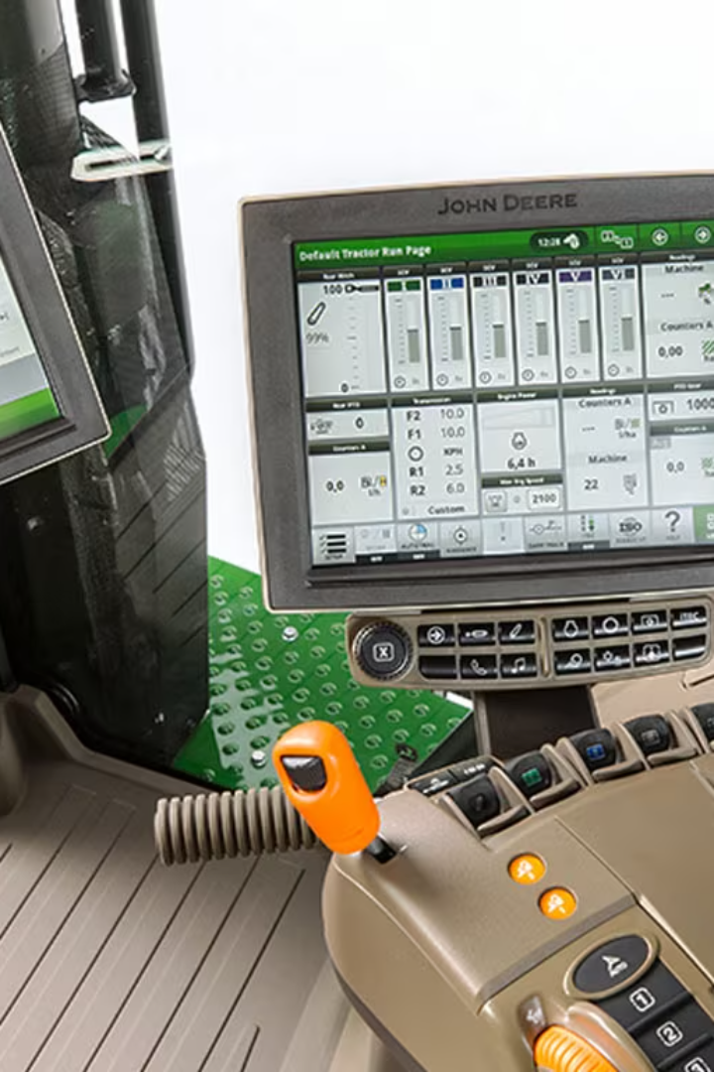
Exploring the Tractor Operator Station
Welcome to the world of tractors! In this presentation, we will dive into the functions, layout, comfort, safety features, maintenance, and importance of proper setup within the tractor operator station.

Slide 2
Functions of the Tractor Operator Station
Control the tractor's movement and operation
Monitor the performance of the tractor and its attachments
Ensure the safety of the operator
Provide a comfortable working environment

Slide 3
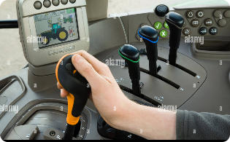
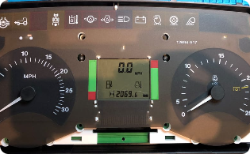
Components and Layout of the Operator Station
Control Panel
Seat
Steering Wheel
Central hub for operating the tractor and its various functions.
Ergonomically designed for optimal comfort during long hours of operation.
Allows precision control and direction of the tractor.
Dashboard
Displays vital information such as engine status, fuel level, and temperature.

Slide 4
Ergonomics and Comfort of the Operator Station
Adjustable Controls
Ample Legroom
Allow operators to customize settings for their comfort and convenience.
Provides space for operators to stretch and maintain proper posture during long hours.
Noise and Vibration Reduction
Air Conditioning and Heating
Incorporated features to minimize operator fatigue from excessive noise and vibration.
Ensure a pleasant working environment in all weather conditions.

Slide 5
Safety Features and Regulations
1
Rollover Protection Structure (ROPS)
Designed to protect the operator in the event of a rollover accident.
2
Seat Belt
Prevents the operator from being thrown off the tractor in case of sudden movements.
3
Emergency Shut-Off Switch
Allows the operator to quickly stop the tractor's engine in case of an emergency.

Slide 6
Maintenance and Cleaning Guidelines
1
Regular Inspections
2
Cleanliness
Check for any wear and tear, loose parts, or fluid leaks.
Maintain cleanliness to prevent dirt, debris, and pests from affecting the functionality of the station.
3
Lubrication
4
Operating Manual
Apply lubricant to moving parts to reduce friction and ensure smooth operation.
Refer to the manufacturer's manual for specific maintenance guidelines.

Slide 7
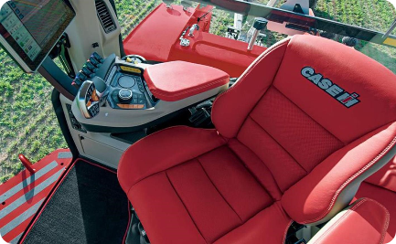
The Importance of Proper Operator Station Setup
Ergonomic Alignment
Organized Workspace
Personalized Comfort
Proper setup minimizes strain and discomfort, improving operator performance and safety.
Efficient arrangement of controls and tools ensures quick access and enhances productivity.
Operators who set up their stations according to their preferences experience reduced fatigue and increased focus.

