Slide 1
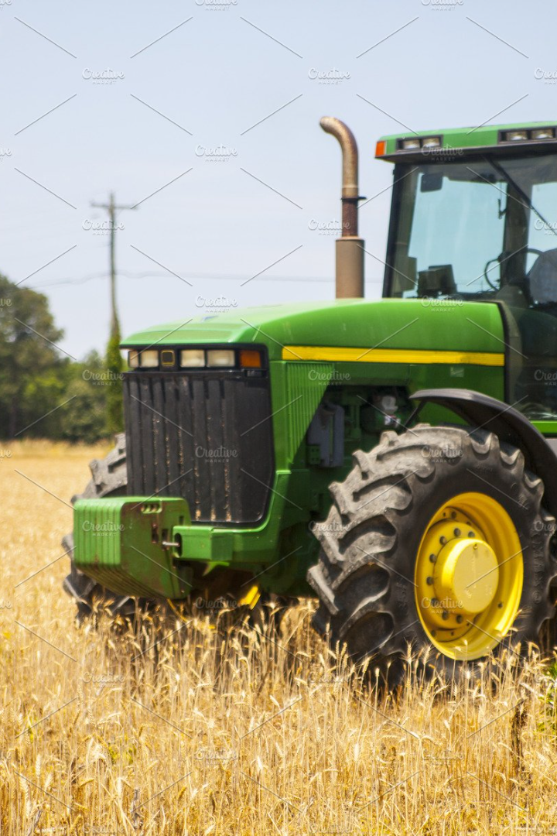
Safety Gear in Handling 4 Wheeled Tractors
Explore the importance of using proper safety gear when handling 4 wheeled tractors to ensure a secure and accident-free farming experience.

Slide 2
Introduction to Tractor Safety Gear
Discover the essential safety gear used in tractor operations for protecting farmers from potential hazards and ensuring a safe working environment.

Slide 3
Importance of Using Safety Gear
Understand the critical role of safety gear in minimizing injuries and promoting productivity while operating 4 wheeled tractors.

Slide 4
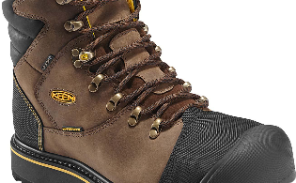
Types of Safety Gear Available
Head Protection
Hand Protection
Hearing Protection
Explore various headgear options, such as helmets and hard hats, to shield against falling objects or bumps.
Discover a range of protective gloves designed to safeguard hands from cuts, abrasions, and chemicals.
Learn about ear muffs and ear plugs to prevent hearing damage caused by loud tractor noise.
Foot Protection
Explore the importance of safety boots to protect feet from heavy objects and slippery surfaces.

Slide 5
Common Safety Gear
1
Reflective Vests
Ensure visibility during low light conditions, minimizing the risk of accidents.
Seat Belts
2
Promote driver safety and prevent ejection in case of overturn or sudden stops.
3
Rollover Protection Structure (ROPS)
Prevent fatalities by providing a protective structure in case of a rollover incident.
Fire Extinguishers
4
Combat fire emergencies promptly, safeguarding personnel and machinery.

Slide 6
Tips for Selecting Appropriate Safety Gear
Assess Risks
Evaluate potential hazards to identify the necessary safety gear required for the specific tasks.
Quality Matters
Invest in high-quality safety gear that meets industry standards and offers optimal protection.
Proper Fit
Ensure safety gear fits well to maintain comfort and effectiveness during tractor operations.

Slide 7
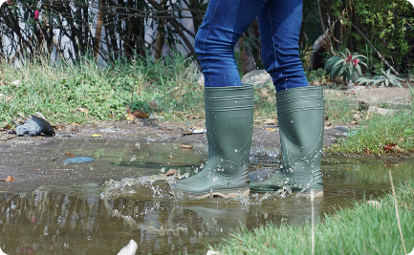
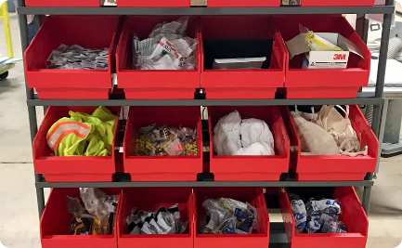
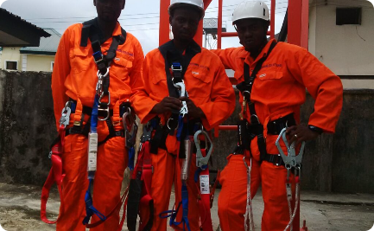
Proper Maintenance and Storage
Cleaning and Maintenance
Storage Practices
Inspection and Replacement
Discover effective storage solutions to keep safety gear in good condition and easily accessible.
Learn proper cleaning techniques and maintenance routines to prolong the lifespan of safety gear.
Learn how to regularly inspect safety gear for signs of wear and damage, and when to replace it.

Slide 8
Conclusion and Summary
By understanding the importance of safety gear, selecting the right equipment, and maintaining it properly, farmers can significantly reduce the risk of accidents and injuries while handling 4 wheeled tractors.

