Slide 1
SUPPLIER RELATIONSHIP MANAGEMENT (SRM)

Slide 2
Define supplier relationship
Discuss the key factors for developing successful partnerships
Define supplier development
Identify the importance of supplier relationship.

Slide 3
DEFINE SUPPLIER RELATIONSHIP MANAGEMENT
The definition of supplier relationship management :
“ The systematic management of supplier relationships to optimize the value delivered through the relationship over their life cycle”

Slide 4
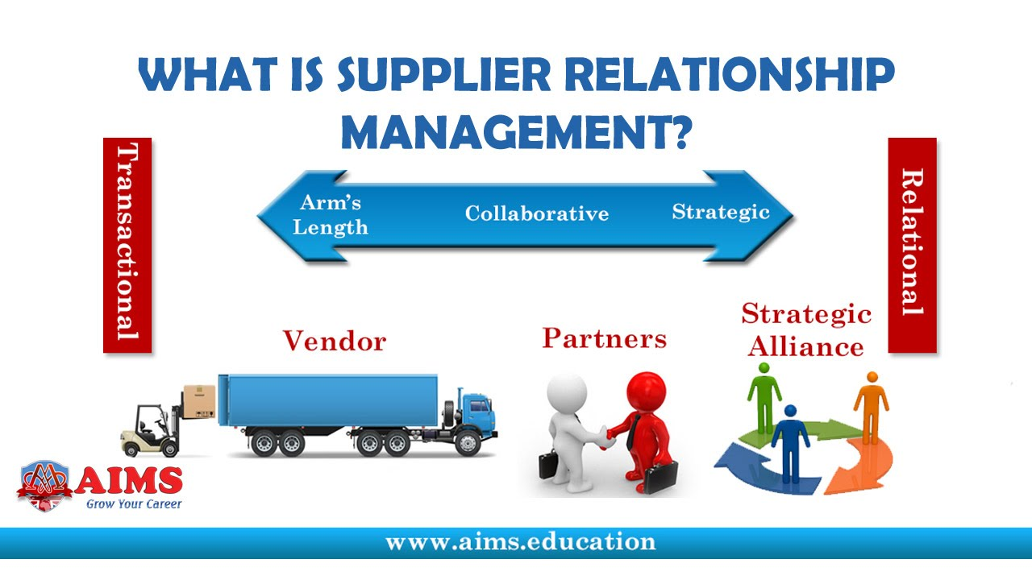


Slide 5

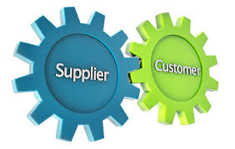


Organizations become more involved with their suppliers and customers.

Slide 6
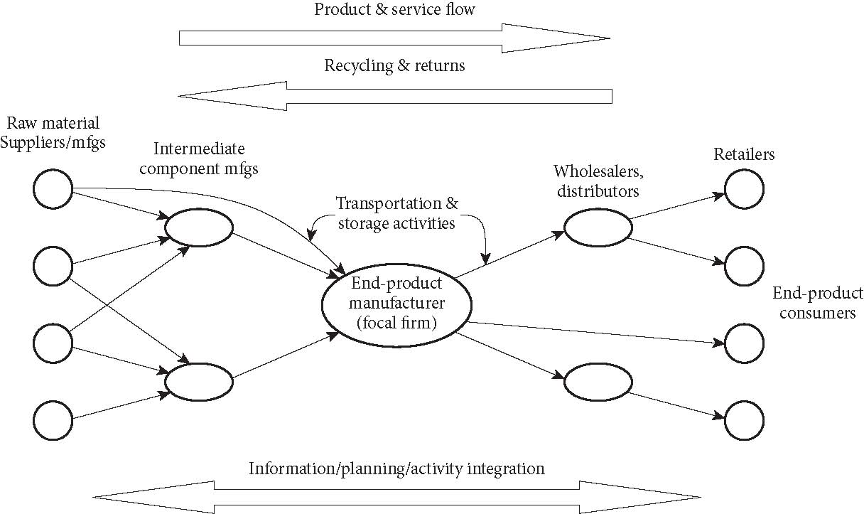
***What is a Supply Chain? (continued) IN OTHER WAY, WE STUDY THE DIAGRAM OF THE SUPPLY CHAIN FLOW
For example: Giant retailer, TESCO, Maidin Mall, Tunas Manja, Sabasun, Heng Huat Electric Shop etc
2nd TIER SUPPLIER
1ST TIER SUPPLIER
or AGENT
Operation element at operation in each level of industry players
Operation element at operation in each level of industry players
Logistic element

Slide 7
DEFINE SUPPLIER RELATIONSHIP MANAGEMENT
The definition of supplier relationship management can vary from organization to organization.
However, the typical goal of SRM is to streamline and improve processes between a buyer and its suppliers -- the organizations that supply the goods and services -- just as customer relationship management (CRM) is intended to streamline and improve the processes between an enterprise and its customers.

Slide 8
DEFINE SUPPLIER RELATIONSHIP MANAGEMENT
Underlying SRM is the focus on developing a mutually beneficially relationship with suppliers, especially those deemed as most strategic to the brand, to promote quality, efficiency, innovation and other benefits.

Slide 9
Supplier Relationship Management
Supplier Relationship Management (SRM)
Improves profits and reduces costs.
“Refers to extended procurement processes such as sourcing analytics, sourcing execution, procurement execution, payment and settlement, supplier score carding and performance monitoring.”

Slide 10
Just as the actual definition of supplier relationship management can vary, depending on which organization defines it, the processes of strategic sourcing related to SRM can vary as well. However, these broad categories can be used to understand the following important supplier relationship management processes:
Segmenting suppliers, which categorizes suppliers based on their importance to the business;
Developing governance and performance management models to align business processes and assign stakeholders according to business goals; and
Improving relationships with suppliers, which involves sharing strategic information with key suppliers in order to develop better products and services.

Slide 11
The foundational step of supplier relationship management is determining suppliers' contributions, especially in light of their strategic importance to the success of the business.
Different suppliers have different influence on organizational profitability.
As a hypothetical example, ABC Smartphone Company's stationary supplier has little influence on the outcome of its profitability, but its main electronics supplier has a huge impact. Any risk to the electronics maker's operations is a major risk to ABC Smartphones.
This makes THE ELECTRONICS maker A KEY STRATEGIC PARTNER.

Slide 12
DEFINITION OF PARTNERSHIP
A supply chain partnership is when two (or more) brands team up from different parts of a supply chain. Being part of a supply chain essentially allows one brand to outsource the manufacturing of a product to a supplier, saving them time, money and resources.

