Slide 1
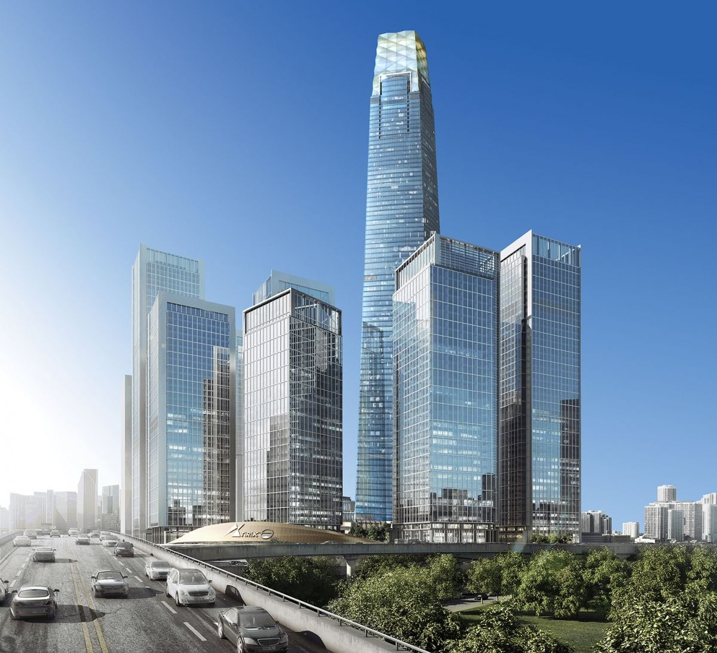
ACCOUNTING FOR DISPOSAL OF NON CURRENT ASSETS
Calculate depreciation of property, plant and equipment under MFRS 13 and MFRS 116
Discuss the de-recognition of property, plant and equipment under MFRS 13 and MFRS 116
Show the presentation of property, plant and equipment in Financial Statements under MFRS 116

Slide 2
DEPRECAITION ASSSETS
Main reason for calculate depreciation is to calculate the recovery of cost that is incurred on PPE over it useful life.
Depreciation commences when the asset is made available for use and to continue depreciating till derecognition, depreciating even during idle period.
MFRS 116 Depreciation is the systematic allocation of the depreciation amount of an asset over its useful life.
Residual value based on expected future circumstances measured at current prices and no adjustment to be made for changing price.
Depreciation charge is determined separately for each significant part of an item of property, plant and equipment. E.g: land and buildings are also considered as separable assets and are accounted for separately, even they are acquire together.

Slide 3
Depreciable Amount is basically the cost of asset or other amount substituted for cos less its residual value.
Residual Value of an assets is the estimated amount that an entity would currently obtain from disposal of the asset, after deducting the estimated costs of disposal, if the asset was already of the age in the condition expected at the end of its useful life.
Useful life is the period over which an asset is expected to be available for use by an entity; or the number of production or similar units expected to be obtained from the assets by an entity.
Useful life and residual value to be reviewed annually. Changes are considered as change in accounting estimates.

Slide 4
Example 1:
On 1 March 2019, a motor vehicle was bought at RM180,000 by cheque. Total depreciation until 31 December 2019 is RM15,000, show the journal entries for this transaction.
Answer:
Dr Motor vehicle RM180,000
Cr Bank RM180,000
Dr Depreciation RM15,000
Cr Accumulated Depreciation RM15,000

Slide 5
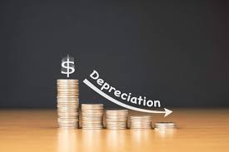
METHODS of DEPRECIATION
Straight-line method
The depreciable amount of an asset on a systematic basis over its useful life.
Reducing balance method.
Straight Line Method
Straight Line method is a very common, and the simplest method of calculating depreciation expense. In this method, the depreciation expense amount is the same every year over the useful life of the asset.

Slide 6

Example 2:
An equipment at cost RM25,000 with an estimated useful life of 8 years and a RM2,000 residual value. Calculate the depreciation expense per year for this equipment.
Solution:
Depreciation = Cost – Residual Value
Useful Life
= 25,000 – 2,000
8 years
= RM2,875 per annum
Accumulated Depreciation Account
Year | Depreciation Expenses (RM) | Accumulated Depreciation (RM)
1 | 2,875 | 2,875
2 | 2,875 | 5,750
3 | 2,875 | 8,625
4 | 2,875 | 11,500
5 | 2,875 | 14,375
6 | 2,875 | 17,250
7 | 2,875 | 20,125
8 | 2,875 | 23,000
 |  | RM |  |  |  |  | RM
Y1 | Balance c/d | 2,875 |  |  | Y1 | Depreciation | 2,875
 |  | 2,875 |  |  |  |  | 2,875
Y2 | Balance c/d | 5,750 |  |  | Y2 | Balance b/d | 2,875
 |  |  |  |  |  | Depreciation | 2,875
 |  | 5,750 |  |  |  |  | 5,750
Y8 | Balance c/d | 23,000 |  |  | Y8 | Balance b/d | 20,125
 |  |  |  |  |  | Depreciation | 2,875
 |  | 23,000 |  |  |  |  | 23,000

Slide 7
Example 3:
A machine at cost RM500,000 is depreciate at 10% per annum. Show the depreciation for 5 years.
Solution:
Depreciation = 500,000 x 10%
= RM50,000 per annum
Accumulated Depreciation Account
Year | Depreciation Expenses (RM) | Accumulated Depreciation (RM)
1 | 50,000 | 50,000
2 | 50,000 | 100,000
3 | 50,000 | 150,000
4 | 50,000 | 200,000
5 | 50,000 | 250,000
 |  | RM |  |  |  |  | RM
Y1 | Balance c/d | 50,000 |  |  | Y1 | Depreciation | 50,000
 |  | 50,000 |  |  |  |  | 50,000
Y2 | Balance c/d | 100,000 |  |  | Y2 | Balance b/d | 50,000
 |  |  |  |  |  | Depreciation | 50,000
 |  | 100,000 |  |  |  |  | 100,000
Y5 | Balance c/d | 250,000 |  |  | Y5 | Balance b/d | 200,000
 |  |  |  |  |  | Depreciation | 50,000
 |  | 250,000 |  |  |  |  | 250,000

Slide 8
Example 4:
The information below is extract from the book of Emma Sdn. Bhd. On 1 January 2019.
Buildings RM650,000
Accumulated depreciation RM200,000
Book Value RM450,000
The company policy is to depreciate at rate 15% per annum using straight line method. Show the accumulated depreciation account for year ended 31 December 2019.
Solution:
Depreciation = 650,000 x 15%
= RM97,500 per annum
Accumulated Depreciation Account
 |  | RM |  |  |  |  | RM
 | Balance c/d | 297,500 |  |  |  | Balance b/d | 200,000
 |  |  |  |  |  | Depreciation | 97,500
 |  | 297,500 |  |  |  |  | 297,500

Slide 9
Reducing Balance Method
A fixed percentage is discharged in each accounting period to the net balance of the fixed asset (book value). Thus, the rate percent is not calculated on cost of asset but on the book value of asset, which in turn is calculated by subtracting depreciation from its cost.
Formula:
Depreciation Expense = (Cost – Accumulated Depreciation) x Rate of depreciation
Depreciation Expense = Book Value x Rate of depreciation

Slide 10
Example 5:
A company buy a van for RM155,000. It is depreciate at 20% of its value each year. Calculate the first four years of depreciation using the reducing balance method and accumulated depreciation account.
Solution:
Accumulated Depreciation Account
Year | Book Value x 20% | Depreciation Expenses (RM) | Accumulated Depreciation (RM)
1 | (155,000 – 0) 20% | 31,000 | 31,000
2 | (155,000 – 31,000) 20% | 24,800 | 55,800
3 | (155,000 – 55,800) 20% | 19,840 | 75,640
4 | (155,000 – 75,640) 20% | 15,872 | 91,512
 |  | RM |  |  |  |  | RM
Y1 | Balance c/d | 31,000 |  |  | Y1 | Depreciation | 31,000
 |  | 31,000 |  |  |  |  | 31,000
Y2 | Balance c/d | 55,800 |  |  | Y2 | Balance b/d | 31,000
 |  |  |  |  |  | Depreciation | 24,800
 |  | 55,800 |  |  |  |  | 55,800
Y3 | Balance c/d | 75,640 |  |  | Y3 | Balance b/d | 55,800
 |  |  |  |  |  | Depreciation | 19,840
 |  | 75,640 |  |  |  |  | 75,640
Y4 | Balance c/d | 91,512 |  |  | Y4 | Balance b/d | 75,640
 |  |  |  |  |  | Depreciation | 15,872
 |  | 91,512 |  |  |  |  | 91,512

Slide 11
Example 6:
The following information at Jovein Sdn. Bhd. on 1 January 2019.
Machinery RM820,600
-) Accumulated Depreciation RM310,000
Book Value RM510,600
All machine are depreciate at the rate 20% annually. Show the accumulated depreciation account for the year ended 31 December 2019.
Solution:
Depreciation Expense = (Cost – Accumulated Depreciation) x Rate of depreciation
= 510,600 x 20%
= RM102,120
Accumulated Depreciation Account
 |  | RM |  |  |  | RM
 | Balance c/d | 412,120 |  |  | Balance b/d | 310,000
 |  |  |  |  | Depreciation | 102,120
 |  | 412,120 |  |  |  | 412,120

Slide 12
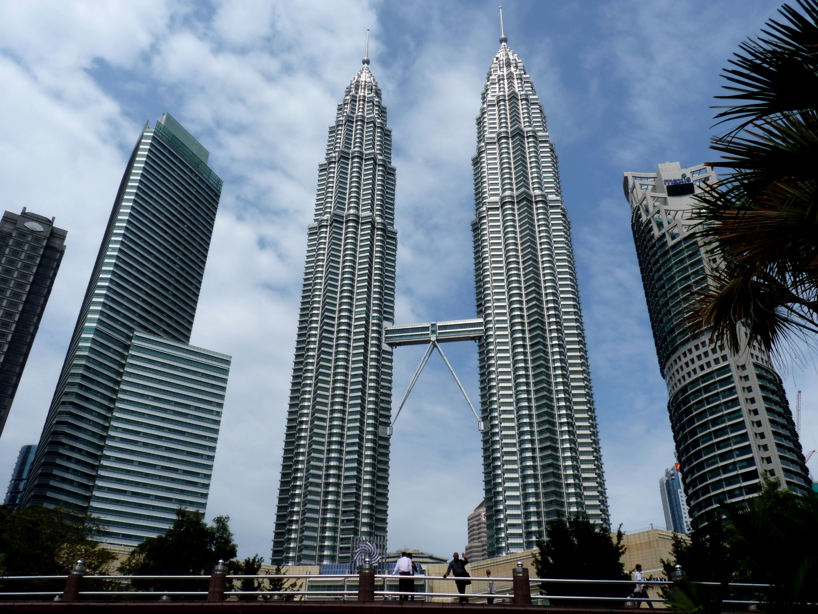
Thank
You

