Slide 1
CUSTOMER RELATIONSHIP MANAGEMENT
(CRM)

Slide 2
Expose the concept of customer relationship management
Customer relationship management
Roles of customer relationship management in supply chain management
Design and implementation of a successful customer relationship programs
a. Creating the customer relationship plan
b. Involving users from the outset
c. Selecting the right application and provider
d. Integrating existing applications
e. Establish performance measures
f. Training for users

Slide 3
Introduction
“Finding a new customer costs five times as much as keeping an old customer”
  CRM means focusing on customer requirements, then delivering products and services in a manner resulting in high levels of customer satisfaction
  Also refers to automated transaction and communication applications, however this can cause problems for some firms
  CRM must still include talking to customers, understanding their behavior and their requirements, and then building a system to satisfy those requirements

Slide 4
Customer Relationship Management (CRM) Defined
“The infrastructure that enables the delineation of and increase in customer value, and the correct means by which to motivate valuable customers to remain loyal—indeed to buy again.”
“…Managing the relationships among people within an organization and between customers and the company’s customer service representatives in order to improve the bottom line.”
“… To keep track of customers, learning about each one’s likes and dislikes from various sources like transaction records, call-center logs, web site clicks, and search engine queries.”
More simply – building & maintaining profitable long-term customer relationships

Slide 5
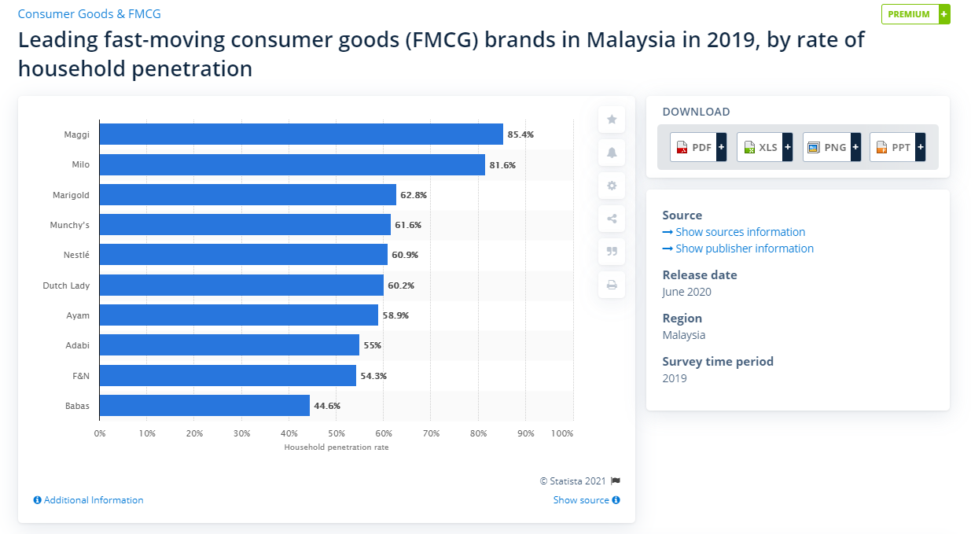

Slide 6
CRM’s Role in Supply Chain Management
The firm seeks position as a value-enhancing supplier to its customers.
  (1) Firms must create methods for finding and developing good suppliers
  (2) Firms must create methods for becoming and staying good suppliers themselves. To include 1st tier customer training and education to ensure proper use of purchased products, and consequently, maximum end-customer benefits.
  (3) It may be necessary for a firm to certify its intermediate customers as to their ability to adequately represent their firm’s products.

Slide 7
The Customer Relationship Management (CRM) Application Providers
Finding the best application and supplier can be accomplished several ways, including:
Using a CRM consulting firm
Visiting a CRM-oriented tradeshow
Searching the many CRM supplier directories and websites
Using the knowledge of internal IT personnel, who already know the market, and
Searching CRM or business publications such as Call Center Magazine, Call Center News, and Inside Supply Management

Slide 8
Designing & Implementing a Successful CRM Program
* * * * *
Step 1. Creating the CRM Plan
Step 2 - Involve CRM Users from Outset
Step 3 - Select the Right Application & Provider
Step 4 - Integrate Existing CRM Applications
Step 5 - Establish Performance Measures
Step 6 - Providing CRM Training for All Users
TREND IN CRM
8

Slide 9
Designing & Implementing a Successful CRM Program
Step 1. Creating the CRM Plan:
Step 1. Creating the CRM Plan:
  Objectives of the CRM program
  CRM’s fit with corporate strategy
  New applications to be purchased or developed
  Integration or replacement of existing legacy systems
  Personnel Requirements- personnel, training, policies, Upgrades, & maintenance &
  The costs & time frame for implementation

Slide 10

Designing & Implementing a Successful CRM Program (Continued)
Step 2 - Involve CRM users from Outset
Step 2 - Involve CRM users from Outset
- Employees should understand how it affects their jobs
  Create a project team with members from all affected organizational areas.
  Test with a pilot application

Slide 11
Designing & Implementing a Successful CRM Program (Continued)
Step 3 - Select the Right Application & Provider
Step 3 - Select the Right Application & Provider
- Find an appropriate application & determine the extent of customization
  Visit trade show, read trade literature, hire consultant, etc.
  Compare based on performance, security, reporting capabilities, system availability, etc.

Slide 12
Designing & Implementing a Successful CRM Program (Continued)
Step 4 - Integrate Existing CRM Applications
Step 4 - Integrate Existing CRM Applications
- CRM is a collection of various applications implemented over time.
  Customer contact mechanisms need to be coordinated so that every CRM user in the firm knows about all of the activity associated with each customer.
  Centralized database or data warehouse containing all customer information.

Slide 13
Designing & Implementing a Successful CRM Program (Continued)
Step 5 - Establish Performance Measures
Step 5 - Establish Performance Measures
- This allows the firm to –
  Determine if objectives have been met
  Compare actual to planned variance

Slide 14
Designing & Implementing a Successful CRM Program (Continued)
Step 6 - Providing CRM Training for All Users
Step 6 - Providing CRM Training for All Users
  Provide & require training for all of the initial users & then provide training on an ongoing basis as applications are added
  Training can also help convince key users like sales, call center, & marketing personnel of the benefits & uses of CRM applications

Slide 15
Trends in CRM
Customer data privacy
  Rules & laws regarding invasion of privacy include patriot act in the US and internet privacy law in the EU
Social Media
  Creating and cultivating virtual communities around product or brand is a powerful way to engage consumers
Cloud Computing (Software as a Service)
  Ala carte & on demand offerings accessed via web browser
  Changing the cost structure of CRM applications

