Slide 1
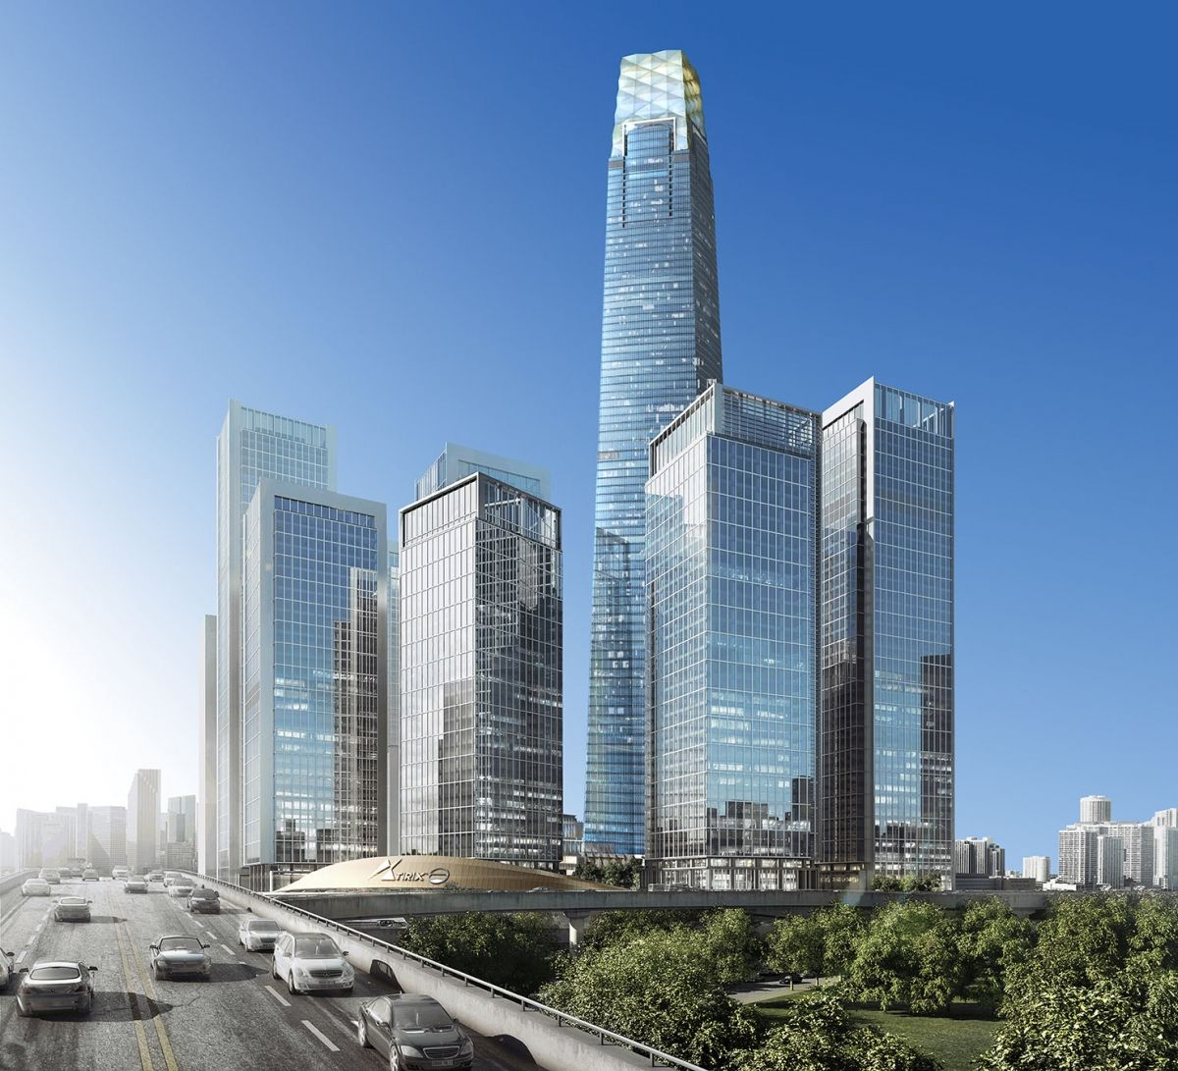
ACCOUNTING FOR DISPOSAL OF NON CURRENT ASSETS
Discuss the de-recognition of property, plant and equipment under MFRS 13 and MFRS 116
Show the presentation of property, plant and equipment in Financial Statements under MFRS 116

Slide 2
Gain or Loss on Disposal
1
Remove the asset from the account asset
Dr Disposal Account xx
Cr Fixed Asset xx
The accounting for disposal of fixed assets can be summarized as:
2
Remove accumulated depreciation for disposable asset
Dr Accumulated Depreciation xx
Cr Disposal Account xx
3
Record cash receive or the receivable created from the sales
Dr Cash/Bank xx
Cr Disposal Account xx
4
Recognize the resulting gain or loss
Dr Disposal Account xx
Cr Income Statement (Gain) xx
Or
Dr Income Statement (Loss) xx
Cr Disposal Account xx

Slide 3
Example 6:
On January 2017, Company b purchased equipment at a cost of RM2,000,000. The company depreciate the asset on a straight-line method by monthly basis at 10% per annum and was sold at RM500,000 on 31 December 2019. Accumulated depreciation until date of sales are:
RM1,800,000
RM1,400,000
Solution:
Gain/ (loss) = Sales - Carrying Amount/ Book Value
= RM500,000 – (2,000,000 – 1,800,000)
= RM300,000
Journal entries:
Dr Bank RM500,000
Accumulated Depreciation RM1,800,000
Cr Equipment RM2,000,000
SOCI (gain from disposal) RM300,000
Solution:
b) Gain/ (loss) = Sales - Carrying Amount/ Book Value
= RM500,000 – (2,000,000 – 1,400,000)
= (RM100,000)
Journal entries:
Dr Bank RM500,000
Accumulated Depreciation RM1,400,000
SOCI (loss from disposal) RM100,000
Cr Equipment RM2,000,000

Slide 4
Example 7:
A machine was purchased for RM2,000 on 25 January 2017 and is depreciated by 10% each year, using the straight line method. On 18 November 2019, the machine is sold for RM600. Show for the 3 years (2017 - 2019):
Accounting year ended 31 December every year.
Machine Account
Accumulated Depreciation Account
Disposal Account
Year | Vehicle A RM2,000 | SOCI
2017
2018
2019

Slide 5
Example 8:
The following is an extract of Statement of Financial Position for Al-Meerah Sdn Bhd as at 1st January 2019.
The following transactions are occurred for the year 2019:
It is the business policy by monthly basis. Depreciation for vehicle 10% per year by straight line method and office equipment 5% per year by reducing balance method
You are required to prepare:
Calculation of depreciation for assets
Assets Account
Accumulated Depreciation Accounts
Disposal of Assets Account
Assets | Cost | Accumulated Depreciation
Vehicle | RM76,000 | RM30,400
Office Equipment | RM25,400 | RM4,800
1 January | Purchase a new office equipment by cash RM5,600
30 April | Sold a vehicle A purchased on 1st January 2015 at cost RM28,000 and fair value RM16,000.
30 June | Sold office equipment for RM11,000 which is bought on 1 July 2016 at cost RM19,000.

Slide 6
Vehicle
Year | Vehicle A RM28,000 | Balance RM48,000 | SOCI
2015 | 2,800 |  | 2,800
2016 | 2,800 |  | 2,800
2017 | 2,800 |  | 2,800
2018 | 2,800 |  | 2,800
2019 | 2,800 x 4/12 = 933 | 4,800 | 5,733
 | 12,133 (dispose)
Calculation
Office Equipment
Year | Old O/Equipment RM19,000 | New O/Equipment RM5,600 | Balance RM6,400 | SOCI
2016 | 950 x 6/12 = 475 |  | Acc. Depreciation = 4,800 – 2,275 = 2,525 Depreciation = (6,400-2,525) 5% = 194 | 475
2017 | 18,525 x 5% = 926 |  |  | 926
2018 | 17,569 x 5% = 874 |  |  | 874
2019 | 16,695 x 5% x 6/12 = 417 | 280 |  | 891
 | 2,692 (dispose)

Slide 7
Vehicle Account
Off. Equipment Account
 | RM |  |  |  | RM
Balance b/d | 76,000 |  |  | Disposal | 28,000
 |  |  |  | Balance c/d | 48,000
 | 76,000 |  |  |  | 76,000
 | RM |  |  |  | RM
Balance b/d | 25,400 |  |  | Disposal | 19,000
Cash | 5,600 |  |  | Balance c/d | 12,000
 | 31,000 |  |  |  | 31,000
Acc. Depreciation for Vehicle Account
Acc. Depreciation for O/E Account
 | RM |  |  |  | RM
Disposal | 12,133 |  |  | Balance b/d | 30,400
Balance c/d | 24,000 |  |  | SOCI | 5,733
 | 36,133 |  |  |  | 36,133
 | RM |  |  |  | RM
Disposal | 2,692 |  |  | Balance b/d | 4,800
Balance c/d | 2,999 |  |  | SOCI | 891
 | 5,691 |  |  |  | 5,691
Disposal for Vehicle Account
Disposal for O/E Account
 | RM |  |  |  | RM
Vehicle | 28,000 |  |  | Acc. Dep | 12,133
SOCI (Gain) | 133 |  |  | Cash | 16,000
 | 28,133 |  |  |  | 28,133
 | RM |  |  |  | RM
Off. Equip | 19,000 |  |  | Acc. Dep | 2,692
 |  |  |  | Cash | 11,000
 |  |  |  | SOCI (Loss) | 5,308
 | 19,000 |  |  |  | 19,000

Slide 8
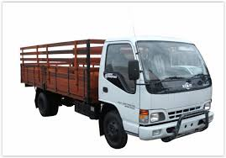
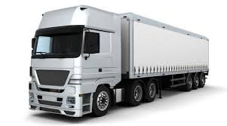
EXCHANGE ASSET
It is also possible for companies to exchange an existing asset for a new asset. Old machine exchanged for a new machine. This is also known as trade in transaction.
The disposal value of the asset will be the trade in value.
The exchange asset may be at a loss (exchange value is less than the book value) or gain (exchange value exceeds the book value) to the entity.
Difference between the value of old asset and new asset is settled by the payment or receiving of cash.
Old lorry
Cost?
New lorry
Depreciation?
Exchange Value?

Slide 9
The accounting for exchange fixed assets can be summarized as follows:
1
Remove the asset from the account asset
Dr Disposal Account xx
Cr Asset xx
2
Remove accumulated depreciation for disposable asset
Dr Accumulated Depreciation xx
Cr Disposal Account xx
3
Record exchange value/ trade in
Dr Asset xx
Cr Disposal Account xx
4
Record settled payment to received new asset
Dr Asset xx
Cr Cash/Bank xx
5
Recognize the resulting gain or loss
Dr Disposal Account xx
Cr Income Statement (Gain) xx
Or
Dr Income Statement (Loss) xx
Cr Disposal Account xx

Slide 10
Example 9:
The old machinery was exchanged with a new one on 1 January 2019. The new machine cost is RM120,000. The supplier of the new machine has accepted RM42,000 for the old machine as trade in value. The remaining amount was settled by cheque. The cost of the old asset is RM140,000 and accumulated depreciation till the date of exchange is RM96,000.
Prepare:
Calculate gain or loss on exchange transaction
Prepare Machine Account and Disposal Account
Gain/ (loss) = Book Value – Exchange Value
= (140,000 – 96,000) – 42,000
= RM2,000
Solution:
Machine Account
Acc. Depreciation for Machine Account
 | RM |  |  |  | RM
Balance b/d | 140,000 |  |  | Disposal | 140,000
Disposal | 42,000 |  |  | Balance c/d | 120,000
Bank | 78,000
 | 260,000 |  |  |  | 260,000
 | RM |  |  |  | RM
Machine | 140,000 |  |  | Acc. Dep | 96,000
 |  |  |  | Machine | 42,000
 |  |  |  | SOCI (Loss) | 2,000
 | 140,000 |  |  |  | 140,000

Slide 11
Example 10:
Sutera Sdn. Bhd. started a business on 1 January 2010. Below are summary of SOFP as at 31 December 2018.
Non-Current Assets | Cost (RM) | Accumulated Depreciation (RM)
Machine | 190,500 | 28,200
The following transactions occurred during the year 2019.
1 March 2019 Machine A, which was bought on 10 April 2017 at the cost of RM45,000 have been traded in with
a new Machine B valuing RM78,000. The trade in value was RM 36,500. The balance was paid
by cheque.
25 August 2019 Bough new Machine C cost RM91,000 by cheque.
2 Sept 2019 Machine D, bought on 1 June 2016 for RM36,000 was sold for RM19,000.
All vehicles are depreciated at the rate of 10% using straight line method and is calculated according to monthly basis.
You are required to prepare on 31 December 2019:
Machine Account
Accumulated Depreciation Account
Disposal Account

Slide 12
Solution:
Year | Machine A RM45,000 | Machine B RM78,000 | Machine C RM91,000 | Machine D RM36,000 | Balance RM109,500 | SOCI
2016 |  |  |  | 3,600 x 7/12 = 2,100
2017 | 4,500 x 9/12 = 3,375 |  |  | 3,600
2018 | 4,500 |  |  | 3,600
2019 | 4,500 x 2/12 = 750 | 7,800 x 10/12 = 6,500 | 9,100 x 4/12 = 3,033 | 3,600 x 8/12 = 2,400 | = 10,950 | = 23,633
 | 8,625 |  |  | 11,700

Slide 13
Machine Account
Disposal Account – Machine
 | RM |  |  | RM
Balance b/d | 190,500 |  | Disposal – A | 45,000
Disposal – B | 36,500 |  | Disposal – D | 36,000
Bank | 41,500 |  | Balance c/d | 278,500
Bank | 91,000
 | 359,500 |  |  | 359,500
 | RM |  |  | RM
Machine A | 45,000 |  | Acc. Dep – A | 8,625
Machine D | 36,000 |  | Machine – B | 36,500
 |  |  | Acc. Dep – D | 11,700
 |  |  | Bank | 19,000
 |  |  | SOCI (Loss) | 5,175
 | 81,000 |  |  | 81,000
Accumulated Depreciation Account – Machine
 | RM |  |  | RM
Disposal – A | 8,625 |  | Balance b/d | 28,200
Disposal – D | 11,700 |  | SOCI | 23,633
Balance c/d | 31,508
 | 51,833 |  |  | 51,833

Slide 14
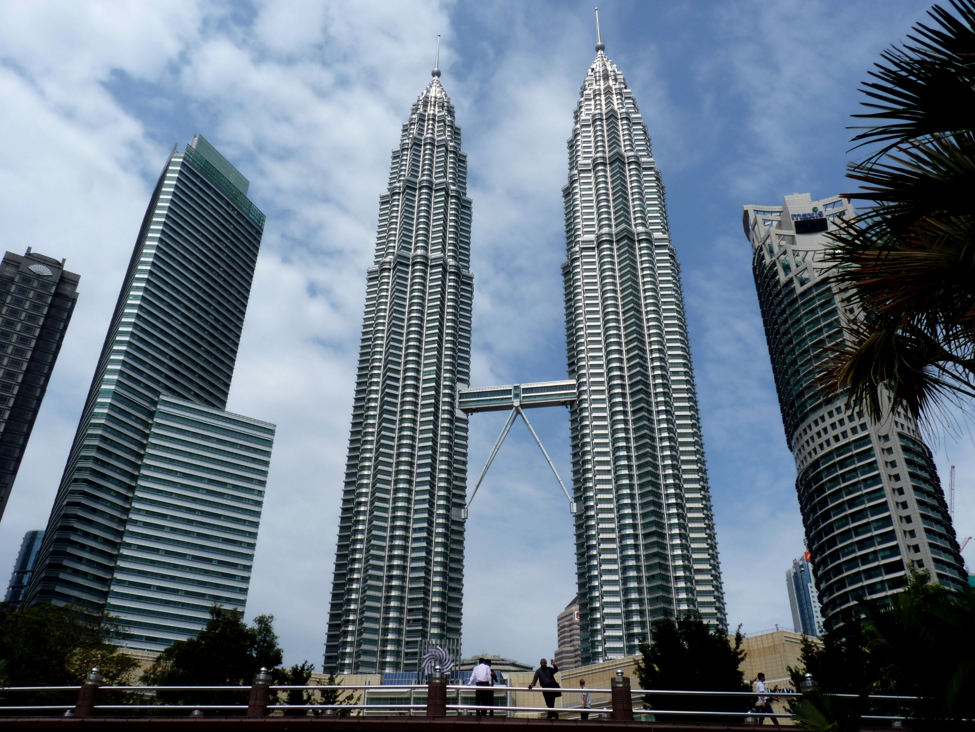
Thank
You

