Slide 1
UNIT-I
Introduction
Chassis

Slide 2
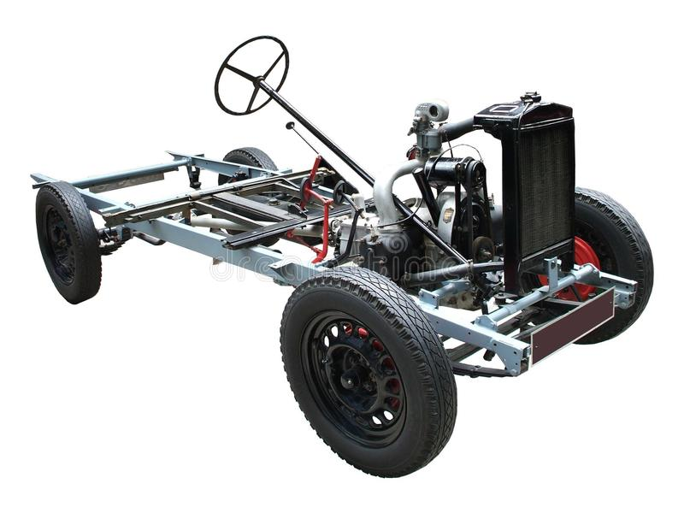
UNIT-I
Chassis

Slide 3
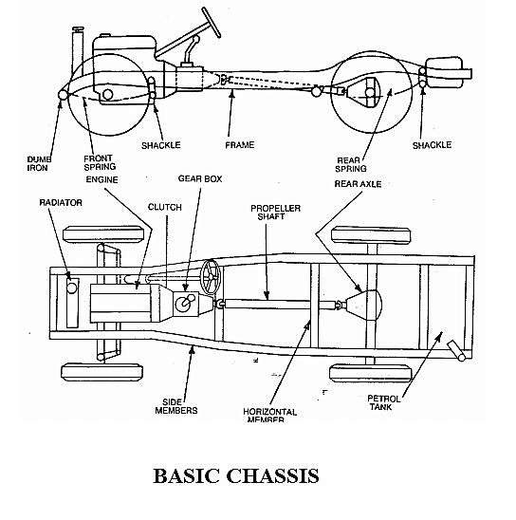
Chassis
Main Supporting Structure of vehicle consist of almost all major parts except automobile body

Slide 4
Types
of Chassis
• According to layout
• Conventional
• Forward
• Semi forward
• According to mounting of engine and transmission
• Engine at front
• Engine fitted in front but crosswise
• Engine fitted at the center of the chassis
• Engine fitted at the back

Slide 5
According
to
mounting
of
Component
of
Chassis
• Front Engine Rear Wheel Drive
• Front Engine Front Wheel Drive
• Rear Engine Rear Wheel Drive
• All Wheel Drive

Slide 6
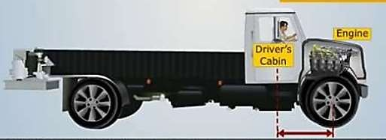
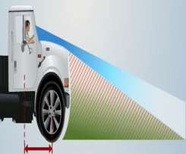
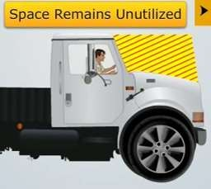
Conventional Chassis
Affects visibility of driver
Engine is fitted in front of the driver cabin or driver seat such as in cars.
Chassis portion can not be utilized for carrying passengers and goods
Heavy Engine can be fitted, which can used to give more power

Slide 7
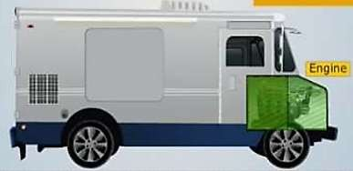
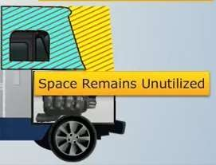
Semi
Forward
Chassis
• Half portion of the engine is in the driver cabin
half is outside the cabin such as in Tata trucks /
& and remaining
Tempos
• In this arrangement a part of the chassis is utilized for carrying
extra passengers

Slide 8
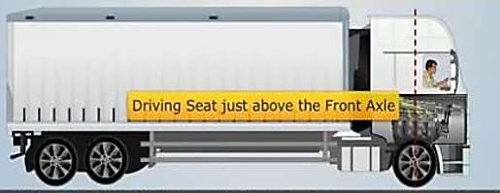
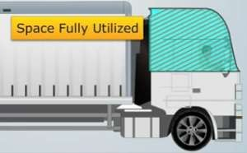

Forward
Chassis
• Complete engine is mounted inside the driver cabin, Driver seat
is just above the front wheel.
• More Boot Space Available as full utilization of chassis

Slide 9
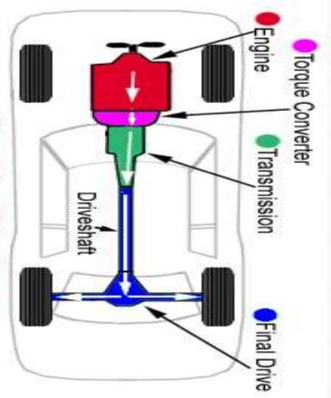
Engine
Conventionally
at
front
•
the
engines
are
fitted
at front
&
drive
is
given to
“rear”
the
wheels
from the
•
•
Advantages
Enough space is available for luggage behind the rear seat
The weight of vehicles is well
balance
•
•
Increased
efficiency
of
cooling system
24

Slide 10
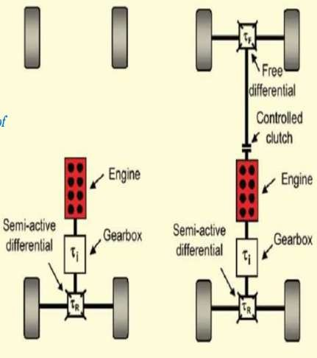
Engine
is
mounted
at
center
•
Mid-engine,
rear-wheel drive
format can
be considered the
original layout of automobiles.
Drive is given to the rear.
Equal Distribution of weight.
•
•
•
Largest drawback of mid-engine
cars is
space;
restricted rear passenger
•
Consequently most mid-engine
vehicles are two-seat vehicles.
The engine in effect pushes the
passenger compartment forward
towards the front axle (if engine is
behind driver).
•

Slide 11
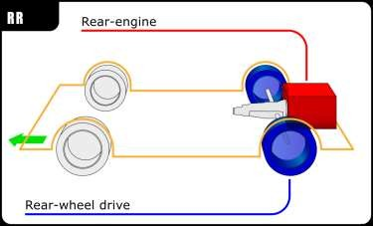
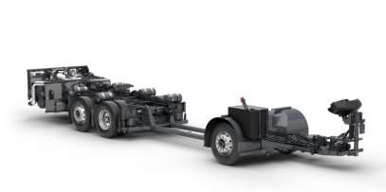
Engine
Fitted
at
back
•
Flat floor is available since
long
propeller
shafts
are
eliminated
•
With
propeller
elimination
of
center
giving
shaft
the
of
gravity
lowered
stable driving
Better adhesion
•
on road
climbing
specially
hill
when

Slide 12
Other
important
chassis
types
• Tabular Space Frame
• Monocoque Frame
• Backbone Frame
28

Slide 13
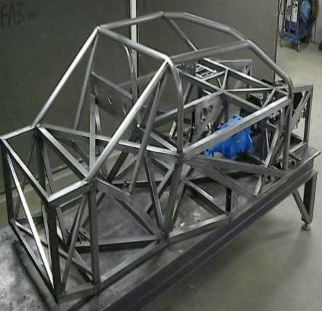
Tubular
Frame
•
•
It is 3-dimensional design
Tubular space frame chassis employs dozens of circular section tube, positions in
different
directions
to
provide mechanical strength against force from anywhere.
•
These tubes are welded &
forms
a
very
complex
structure.
r
r
h
• Fo
ngt
required
highe
y
stre
b
sports
cars, tubular space
frame
chassis
usually
incorporate a strong structure under both doors.

Slide 14
Advantages
&
Dis
advantages
• Very
strong
in
any •
Very complex , costly
and time consuming to
be built.
It engages a lot of
spaces rise the door seal
and result in difficult to
access to the cabin.
direction
with ladder
Monocoque
(compared
chassis and
chassis
of
•
the
same
weight)
•
Impossible
for
robotized production.

Slide 15
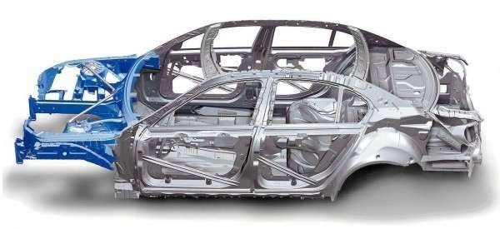
Monocoque
Monocoque is a one-piece structure which defines overall shape of the car. while ladder, tabular & backbone provide only stress members.
Today 99% car produced in this planet are made of steel Monocoque chassis.
Chassis are made by welding of Several pieces. (Spot Welding )
Monocoque is made of steel
31

Slide 16
Advantages
&
Disadvantages
• Space-efficiency.
• Monocoque
•
chassis •
It is very heavy.
Impossible for small
volume production.
In case of accidents
benefit crash production
because it uses
metal.
a
lot of
•
whole structure
obsolete.
become
• Cheap
production
for
mass

Slide 17
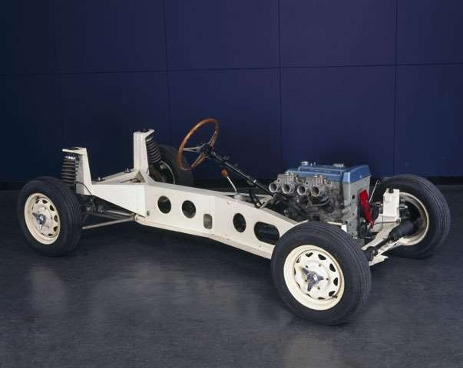
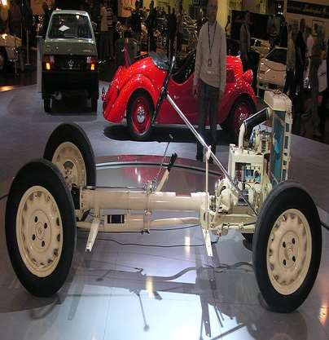
Back
• Similar
design.
Bone
Frame
to the body frame
• It consist
backbone
of a strong tubular
(Usually
rectangular in C/s).
• A body is placed on the structure.
• This type of chassis has been
used in numerous sports cars.

Slide 18


















Advantages
&
Disadvantages
•
The vulnerable parts of the
drive shaft are covered by a
•
Manufacturing
backbone chassis
comp
the
more
is
thick
tube.
The
whole
licated an
.
d m
,
ore
e
system is extremely reliable.
costly
How
eve
r
ll
th m
-
ore
However,
if
a
problem
axles
with
wheel
drive
occurs, repairs are more
complicated.
are ne
eded,
t
he co
st
benefit tur
ns in f
e
avor
of
sis
•
The modular system enables
configurations of 2-, 3-, 4-,
5-, 6-, or 8-axle vehicles
backbon chas
.
•
The backbone
chassis
is
heavier for a given torsional
stiffness than a uni-body.
with various wheel
bases.
✓The
chassis
gives
no
side
protection
impacts.
against
34

Slide 19
Types
of
Vehicle
Layout
Or
Chassis
Layout
35

Slide 20
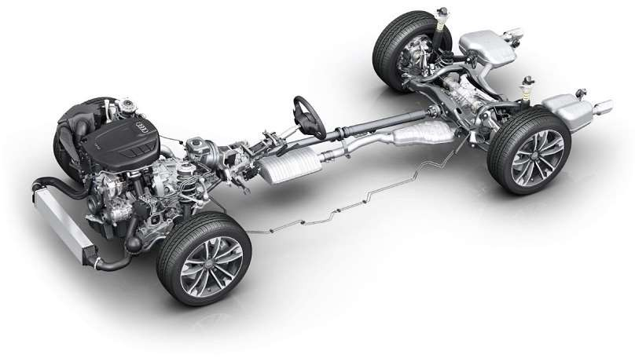




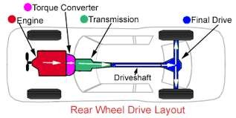

Front
Engine
Rear
Wheel
Drive
Engine
Transmission
Drive Shaft
Clutch
Final Drive

Slide 21
Front
Drive
Engine
Rear
Wheel
• Most common type of layout.
• Engine Located at front and driving power is given
to rear wheels.
• Driving Power
flows from engine to rear wheel
through
various
mechanical
linkages.

Slide 22


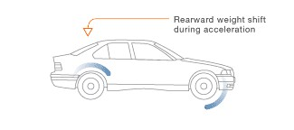
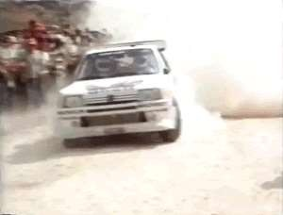
Advantages
&
Disadvantages
• Better handling : - Accelerating force is applied to
the rear wheels, on which the down
due to load transfer in acceler
force
increases,
ation, making the rear
ltaneous acceleration es.
tires better able to take simu
and
curving
than
the
front
tir
ON DRY ROAD ONLY

Slide 23
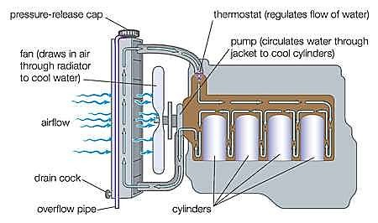
Less
load
at front
axle
• The driving force is given at rear axle hence there is
no
need
to
provide
complex
design
on
front
axle.
Effective Cooling of the engine due
to
exposure of cooling system to flowing air

Slide 24
Disadvantages
Decreased interior space – This isn't an issue in a vehicle with a ladder frame like a pickup truck, where the space used by the drive line is unusable for passengers or cargo. But in a passenger car, rear wheel drive means: Less front leg room (the transmission tunnel takes up a lot of space between the driver and front passenger), less leg room for center rear passengers (due to the tunnel needed for the drive shaft), and sometimes less trunk space (since there is also more hardware that must be placed underneath the trunk).

Slide 25
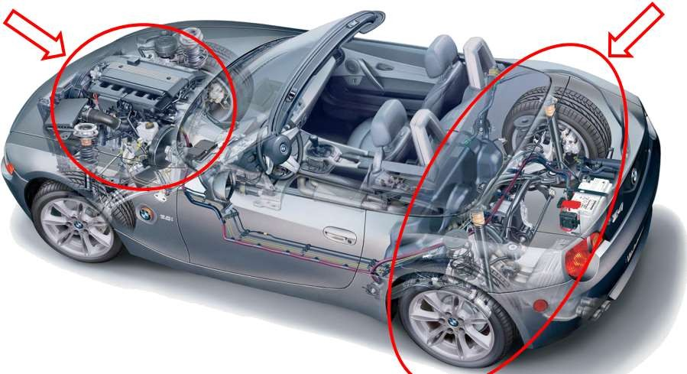
Less
Inner
space

Slide 26
Increased
weight
• The drive shaft, which connects the engine at the
front to the drive axle in the back, adds weight.
There is extra sheet metal to form the transmission
tunnel. A rear wheel drive car will weigh
slightly
more than a comparable front
wheel
drive
car,
but
less
than
four
wheel
drive.

Slide 27
Higher
purchase
price
• Due to the added cost of materials, rear wheel
drive
is
typically
slightly
more
expensive
to
purchase
vehicle.
.
than
a
comparable
front
wheel
drive

Slide 28
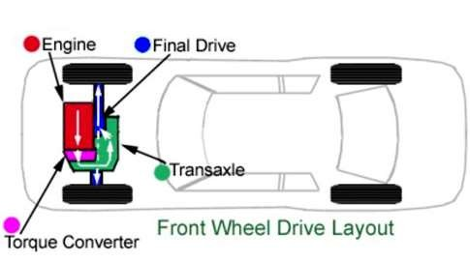
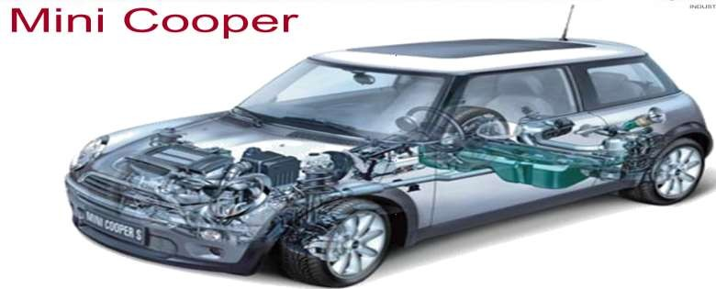




Front
Engine
Front
Wheel
Drive
Engine
Transmission
Final Drive

Slide 29
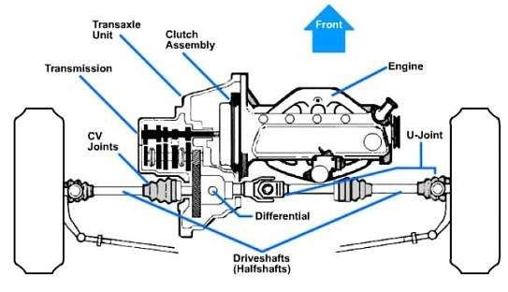
Front
Drive
Engine
Front
Wheel
•
In this type the engine is
mounted on the front side
of
the vehicle and
the
driving power is given to
the front wheels only.
The power flows from
engine to front axle.
This type of arrangement
•
•
have
additional
sub
type
cross
i.e.
front
mounted
engine.

Slide 30
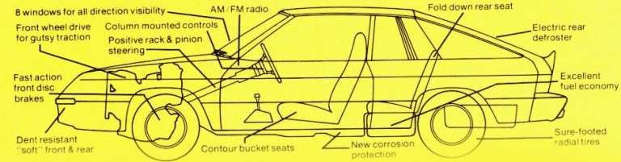


Advantages
• Interior space:
• Since the powertrain
engine compartment
is a single unit contained in the
of the vehicle, there is no need
to
devote
interior
space
for
a driveshaft
tunnel
or
for
rear differential, increasing
the volume
available
passengers
and
cargo.
Engine
Inner
SPACE

Slide 31
Better
handling
on
slippery
surface
• Slippery-surface traction: placing the mass of the
drivetrain
over
the
driven
wheels
improves traction on wet, snowy, or icy surfaces.
Improved
drive
train
efficiency
• The
direct
connection
between
engine
and
transaxle reduce the mass and
of the drivetrain compared to
mechanical inertia
a rear-wheel drive
vehicle
with
a
similar
engine
and
transmission,
allowing greater fuel economy.

Slide 32
Disadvantages
• Less Turning Radius
• The drive shafts may limit the amount by which the
front wheels can turn, they are generally unable to
make the.
• More Weight on front results in rapid wear of
front tires.
• Front-wheel drive has worse acceleration than rear-wheel drive, which is why most sporty and race cars use rear-wheel drive.

Slide 33
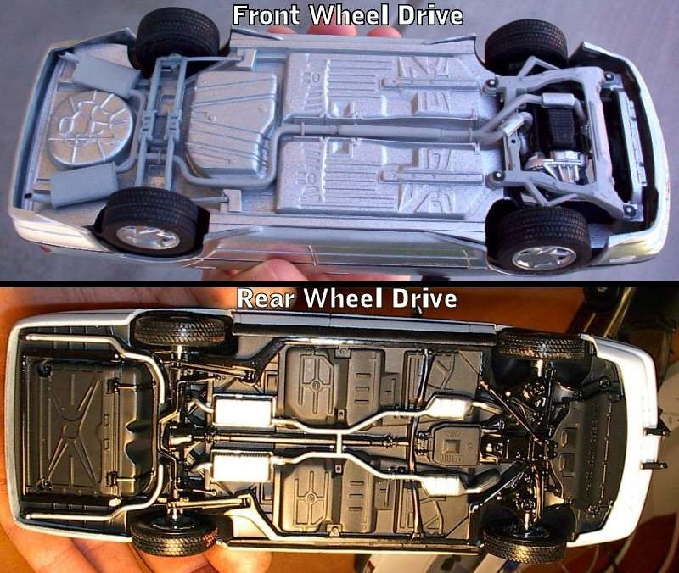
FWD
VS
RWD

Slide 34
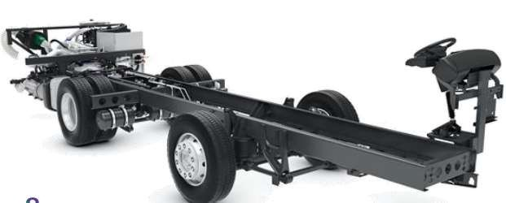
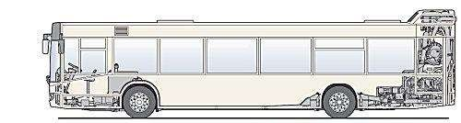
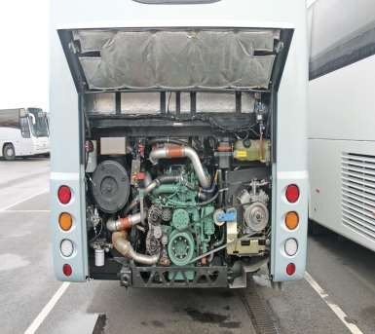
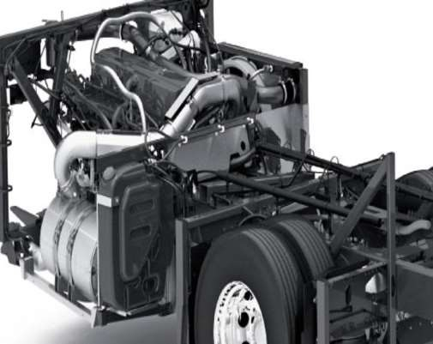
Rear
Engine
Rear
Wheel
Drive

Slide 35
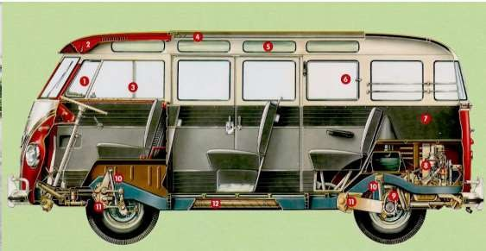
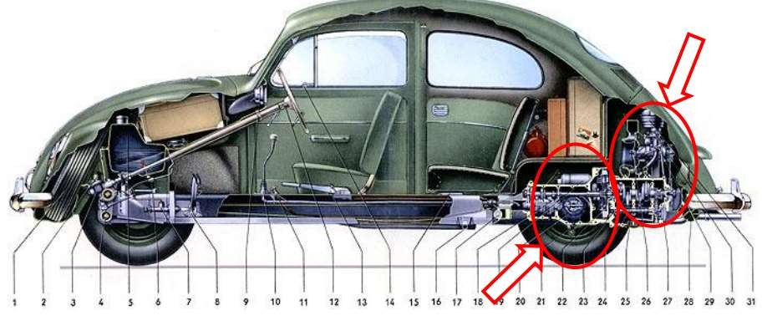
54

Slide 36
Advantages
• Weight over rear wheels, increased traction while
accelerating.
• Front axle construction is simplified.
• Absence of propeller shaft results in decrease of floor height.
• Engine components mounted at rear of rear axle
hence more space is available.

Slide 37
Disadvantages
• Separate cooling mechanism
is needed for
effective cooling
mounted at rear.
of
the
engine
as the
engine
is
• More load on rear side may result in overturning
(Over steer) of the vehicle.
• Longer linkages are required to operate clutch,
gears from driver.

Slide 38
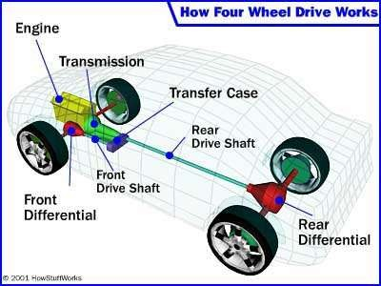
All
wheel
Drive

Slide 39
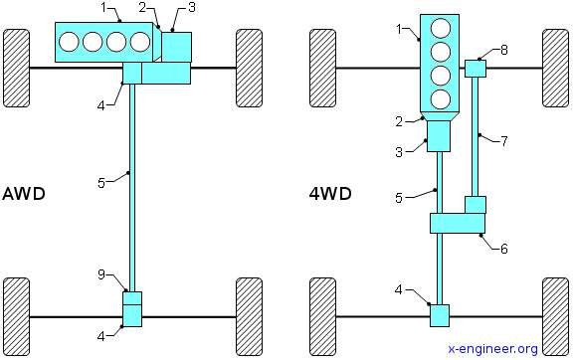
AWD
or
4WD
4 wheels can be engaged only in difficult terrain.
In normal condition power is given to rear wheels only.
All wheels Always
engaged.
Safe and advantageous over 4WD

Slide 40
Advantages
• 4WD improves traction
in dangerous driving
conditions,
such
as
snow,
make
ice,
rocks,
and
other
scenarios that can
control
difficult.
By
engaging both sets of wheels, traction and control
improves.
• Additional weight contributes to better grip on the
road.
• 4WD is great for those who like off-roading.

Slide 41
Disadvantages
•
The main disadvantage of 4WD is added cost for
purchase, maintenance, and fuel. The extra equipment
(differentials, transfer case, etc.) adds complexity and
weight to the vehicle, increasing initial market value,
tire wear, and the cost of repairs and maintenance.
The added power and weight of 4WD and AWD systems require more fuel, making them less efficient than their 2WD counterparts.
Added weight improves traction and control, but it also increases the braking distance required to make a complete stop. Lighter vehicles can avoid collision easier than heavier vehicles.
•
•

Slide 42

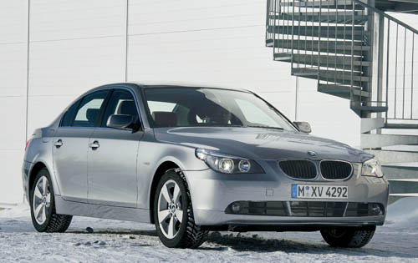
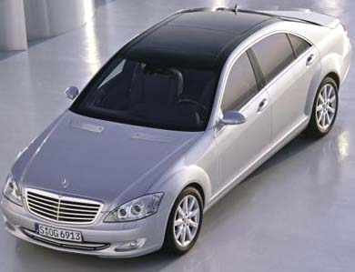
Type of Car
Sedan/Saloon car -
most common for modern car, with four-door passengers compartment between the lower hood – covering the engine in the front, and the lower trunk at the rear.

Slide 43
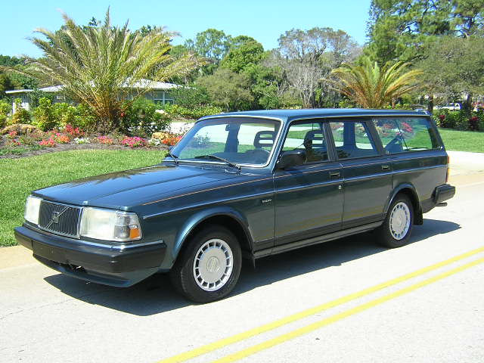
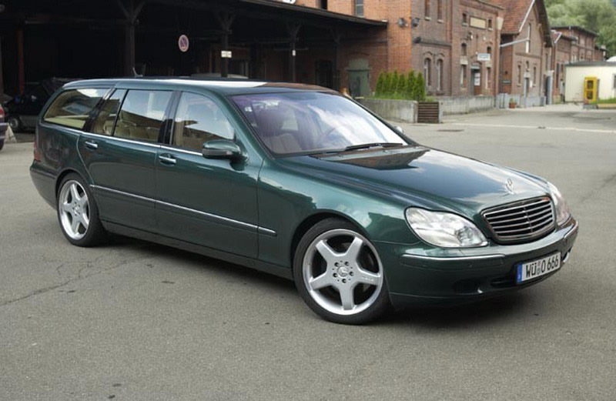
Type of Car
Station wagon –
car with a body style variant of a sedan/saloon with its roof extended rearward over a shared passenger/cargo volume with access at the back via a third or fifth door instead of a trunk lid.

Slide 44
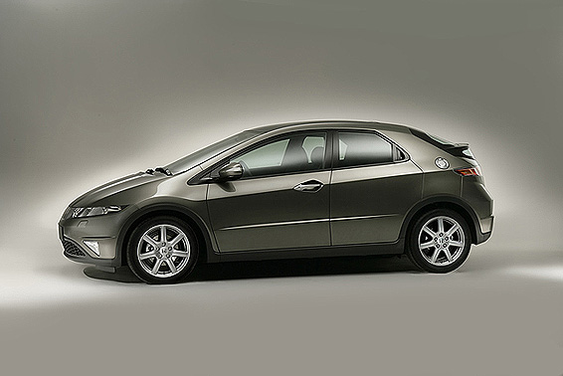
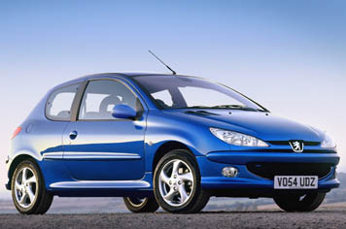
Type of Car
Hatchback –
Rear door wt back window that opens vertically to access a storage area not separated from the rest of the passenger compartment.
May be 2 or 4 doors and 2 or 4 seats.
Known as 3 door or 5 door in England.

Slide 45
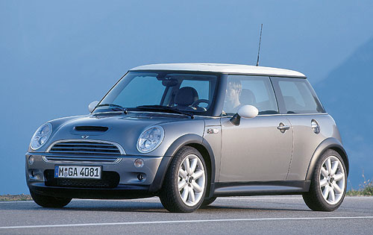
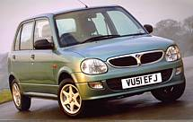
Type of Car
Mini car / small car
Small size car -
The original Mini was a revolutionary and distinctive small car designed for the British Motor Corporation (BMC) by Sir Alec Issigoris (1906–1988).

Slide 46
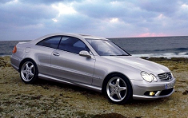
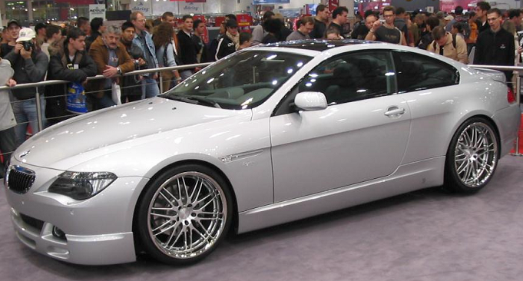
Type of Car
A coupe -
2 doors with 2 / 4 - seaters car.
Fixed roof and doors are longer than those of a sedan.
In some cases the rear seats are small and not intended for regular use; this is often called a 2+2.

Slide 47
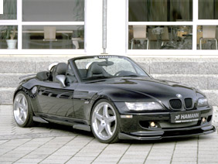
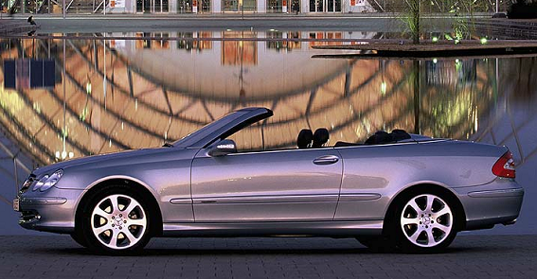
Type of Car
Roadster –
Two seat open car with minimal weather protection.
Folding top with side curtains, but with no side glass.
Also called convertible sport car

Slide 48
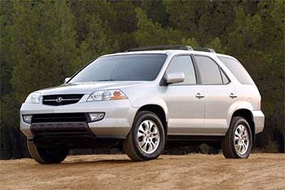
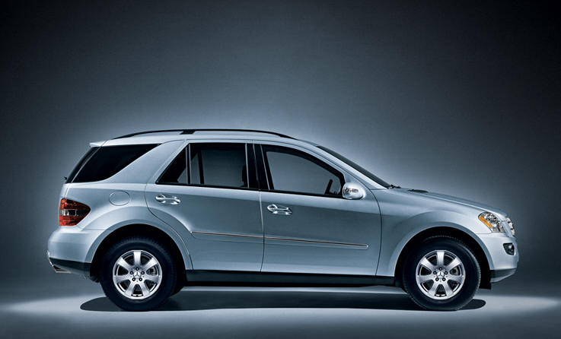
Type of Car
Sport Utilities Vehicles -
Derivative of off-road or four-wheel drive vehicles but with car-like levels of interior comfort and drivability. Also sometimes called a "soft-roader".

Slide 49


Type of Car
MPV –
Multi-purpose vehicle, a large car which easily convertible to facilitate loading of goods or to carry people.

Slide 50


Type of Car
Concept Car
Designed for advanced technology and most futuristic design.
Evolve and make changes in the technology of automotive design.
Method to survey the potential market and response of the users.

