Slide 1
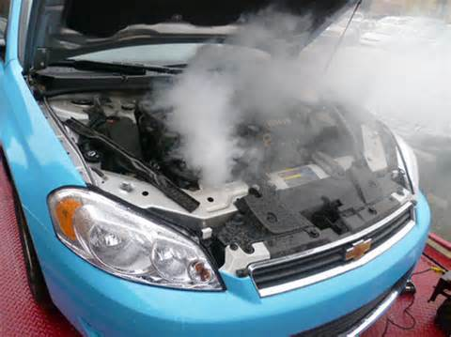
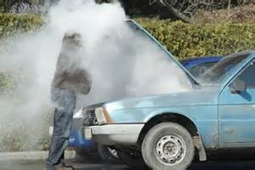
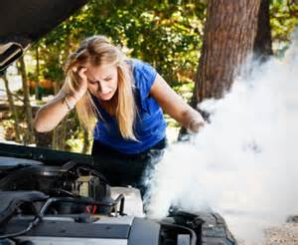
COOLING SYSTEM
DJA20013

Slide 2
Function of Cooling System
The cooling system keeps the engine at its most efficient temperature at all speeds and operating conditions
Removes excess heat by passing it through the radiator
Helps bring the engine up to normal operating temperature as quickly as possible.

Slide 3
Operation of Cooling System
The cooling system uses five basic parts to control engine temperature.
Water jackets
Water Pump
Thermostat
Radiator
Radiator Fan

Slide 4
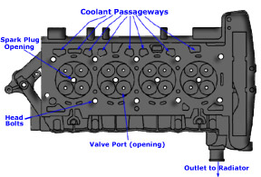
Water Jackets
The cylinder block and cylinder head have internal passages or water jackets that surround the cylinder and combustion chamber.
Water mixed with antifreeze (coolant) flows through the water jackets, picking up heat. This cools the metal parts and heats the coolant.

Slide 5
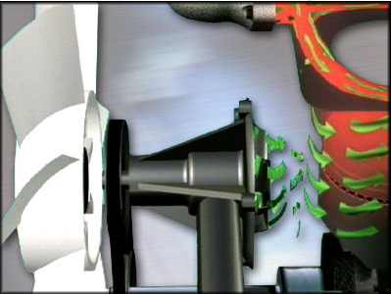
Water Pump
An engine-driven water pump pushes the hot coolant out of the water jackets and through the radiator

Slide 6

Thermostat
Control coolant flow
When the engine is cold, the thermostat closes to prevent coolant circulation to the radiator. This keeps all heat in the engine so its warm up quickly.
As the engine is warm up, the thermostat opens to allow coolant flow through the radiator.

Slide 7
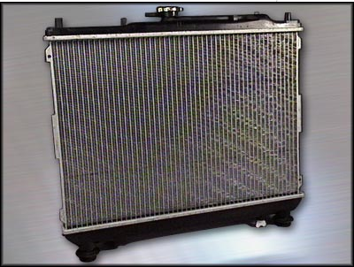
Radiator
Heat exchanger with two sets of passages.
One set is for coolant and the other for outside air.
In the radiator, the coolant loses heat to the passing air.
Then the coolant flows back through the water jackets to pick up heat again.
The coolant circulates continuously between the water jackets and the radiator.

Slide 8
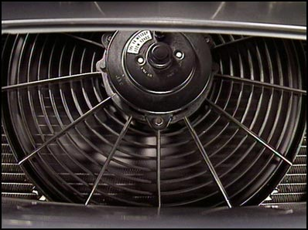
Radiator Fan
A fan pulls or pushes outside air through the radiator. This improves engine cooling, especially at idle an low speed

Slide 9
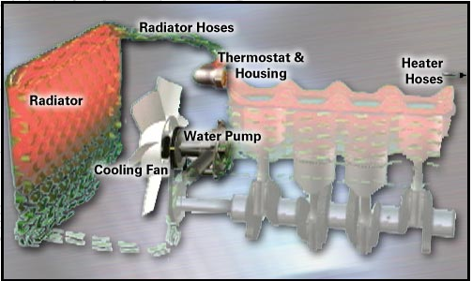
Cooling System Components

Slide 10
Radiator

Slide 11
The radiator is located in a convenient position under the hood of the vehicle. Its actual location under the hood depends on the engine configuration, available space and the shape or line of the hood itself.
The radiator consists of top and bottom tanks, and a core.
The radiator core allows the coolant to pass through it in either a vertical down or horizontal cross flow direction. In addition, the radiator core serves as a good conductor of heat away from the engine.

Slide 12
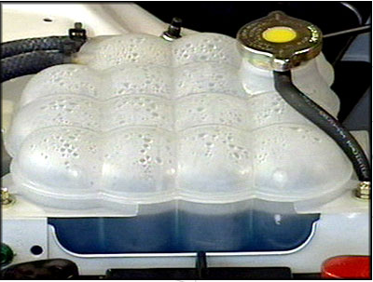
Reservoir
The header tank, or reservoir, can be mounted separately from the radiator. It has a supply of coolant and is located higher than the top of the radiator. The reservoirs are usually made of hardened plastic, which allows for a visual checking of the fluid level through the plastic

Slide 13
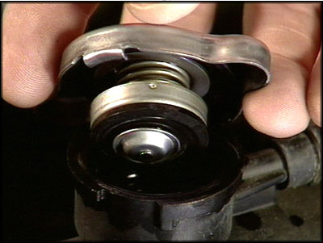
Radiator Cap
The pressurized radiator cap is used to increase the boiling point of the coolant. It can be located directly on the top of the radiator or on the header (or surge) tank

Slide 14
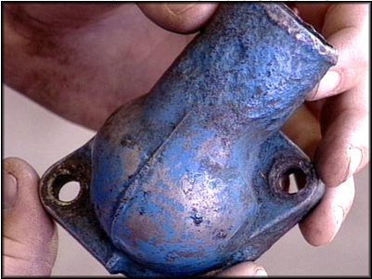
Thermostat & housing
The thermostat is located under the thermostat housing.
The thermostat regulates the flow of coolant, allowing a circulation of coolant to flow from the engine to the radiator when the engine is running at its operating temperature. But it is closed when the engine is cold to allow the engine to warm up more rapidly.

Slide 15
Water pump
The water pump is normally bolted to the front of the engine block. The bottom radiator hose comes from the radiator and is connected to the water pump inlet.
The water pump is driven by the engine via a fan or drive belt.
As the coolant leaves the outlet of the radiator, which has removed much of its heat, the water pump forces it through the water jackets by the action of the impeller in the pump.

Slide 16
Cooling fan
The cooling fan can be located on the water pump shaft, or it may be attached directly to the engine crankshaft. In most cases, this requires some engine power to drive the fan.
The blades of the cooling fan can be made of steel or plastic. The blades draw cooling air through the radiator core, thus lowering the temperature of the coolant

Slide 17
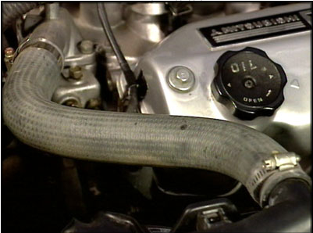
Radiator Hose
On most vehicles there are two radiator hoses. A top radiator hose is attached to the thermostat housing, which allows the heated coolant to enter the top or inlet side of the radiator.
The bottom or lower radiator hose is connected between the outlet of the radiator and the inlet of the water pump

Slide 18
Properties of Engine Coolant
To prevent freezing of the water in the cooling system, antifreeze is added to form the coolant.
The coolant is liquid that circulates through the cooling system.
It removes waste heat from the engine and delivers the heat through radiator hose to the radiator
This cool the liquid which continuously recirculates through water jackets, repeating the cooling cycle.

Slide 19
Engine coolant can be divided into three chemical types: Methanol, ethylene glycol and propylene glycol
The most commonly used antifreeze is ethylene glycol. The mixture will not freeze above -37◦F(-34◦C)
Antifreeze contains several additives. These include a corrosion inhibitor and foam inhibitor
Corrosion and rust can shorten the life of metal parts. It also forms and insulating layer which reduces heat transfer from the metal to the coolant

Slide 20
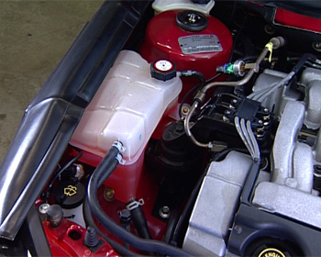
The foam inhibitor helps prevent the coolant from foaming as it passes through the water pump. Foam contains air bubbles which do not conduct heat as well as the liquid coolant
Antifreeze is coloured with a dye for identification. The colour is usually green or red.

Slide 21
Use of Coolant
The mixture of half water and half antifreeze performs three basic jobs:
It lowers the freezing point of the engine coolant
It raises the boiling point of the engine coolant.
It helps protect the cooling system metals from deposits and corrosion.

