Slide 1

Loadings

Slide 2
TYPES OF ACTIONS
Actions are classified as :
•
Permanent Actions (Gk) – a load of constant
magnitude and position that acts permanently
such as floor slab, finishing, partitions and self-
weight.
Variable Actions (Qk) – load on a structure or member produced by the external environment or the intended occupancy or use.
•
•
Accidental
Actions – explosions, vehicle impact.

Slide 3
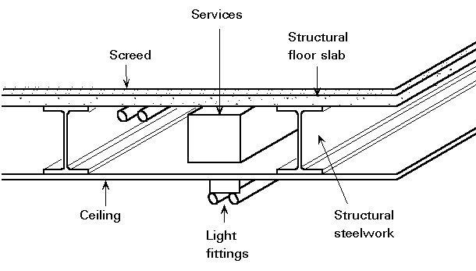
typical permanent actions

Slide 4
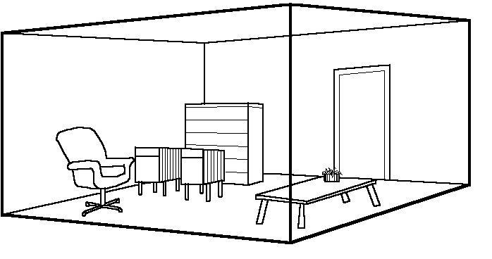
typical variable actions

Slide 5
Weights
of
Building
Materials
MATERIAL
UNIT MASS
Normal Concrete Lightweight Concrete Reinforced Concrete Steel
Water
2400 kg/m3
1700 kg/m3
2400 kg/m3
7850 kg/m3
1000 kg/m3
Clay solid brickwork per 25 mm thick Solid blockwork per 25 mm thick Aerated blockwork per 25 mm
Gypsum panels and partitions per 75 mm thick
55 kg/m2
55 kg/m2
15 kg/m2
44 kg/m2

Slide 6
DESIGN LOADS
Design load = characteristic load x partial safety Factor
Common design load combination :
Permanent
load
and
variable
load
w = 1.35 Gk + 1.5 Qk

Slide 7
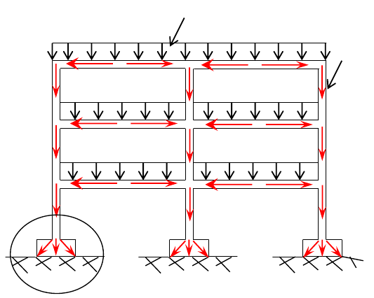
Loads
Distribution
Loads
Column
Beam
Footing
Soil

Slide 8
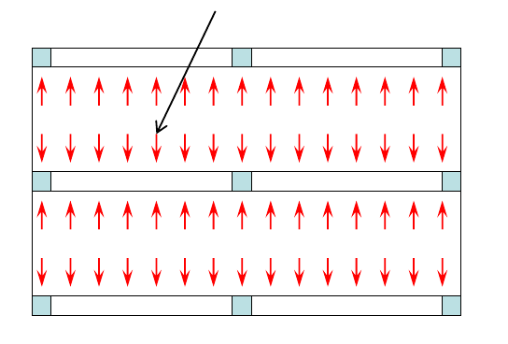
Loads
Distribution
Load w kN/m2
Column
Slab
Beam

Slide 9

FLOOR
LOAD DISTRIBUTION
One-way
Slab
L1
L1
/
L2
>
2.0
L2

Slide 10




FLOOR LOAD DISTRIBUTION
Two-way
Slab
L1
/
L2 <
2.0
L1
L1
L2
L2

Slide 11
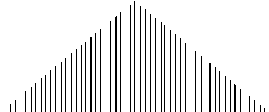
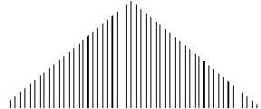
FLOOR LOAD DISTRIBUTION
Two-way
Slab
L1
/
L2
= 1.0
L1
L1
L2
L2

Slide 12
Example 1
Draw the load distribution profile for the given floor layout.
A
B
C
3 m
5 m
1
5 m
2
4 m
3

Slide 13
Example
1
A
B
C
3 m
5 m
1
Slab A-B/1-3 :
L1/L2 = 9/3 = 3.0
> 2.0
5 m
one way slab
Slab B-C/1-2 :
2
L1/L2 = 5/5 = 1.0 <
2.0
two way slab
4 m
Slab B-C/2-3 :
L1/L2 = 5/4 = 1.25 < 2.0
two way slab
3

