Slide 1
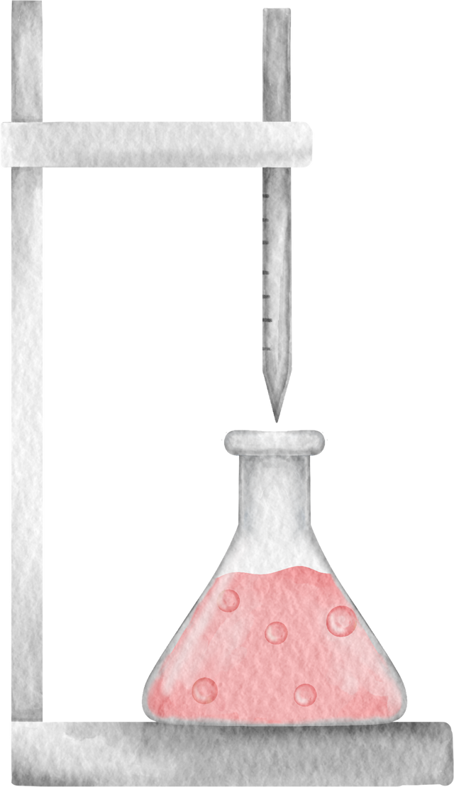




BASE

Slide 2

INTRODUCTION TO BASES
Definition of Bases
A base is a substance that can accept hydrogen ions (H⁺) or donate a pair of valence electrons to form a bond. Bases are the opposite of acids in a chemical reaction.
Common Examples: Sodium hydroxide (NaOH), Potassium hydroxide (KOH), Ammonia (NH₃)

Slide 3
INTRODUCTION TO BASES
Basic Properties of Bases
Taste bitter
Slippery or soapy to the touch
Turn red litmus paper blue
Conduct electricity in aqueous solutions (electrolytes)

Slide 4
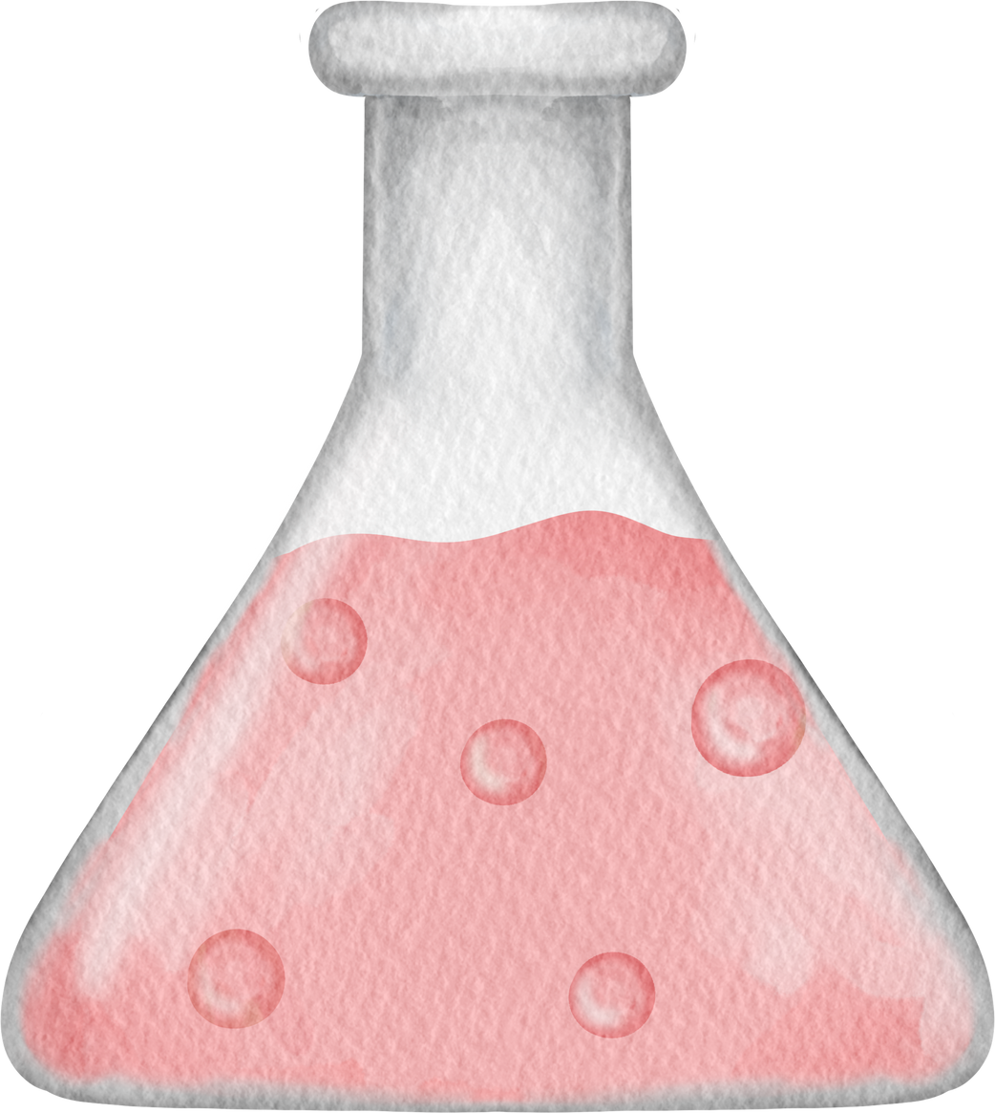
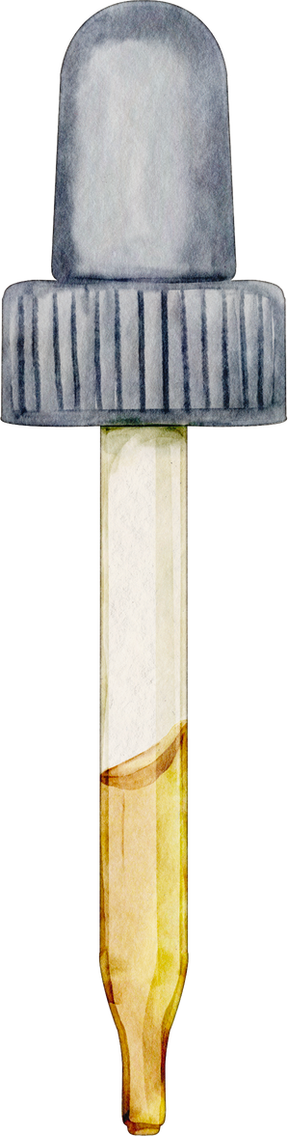
THE PH SCALE AND BASES
pH of Bases:
Bases have a pH value greater than 7.
The stronger the base, the higher its pH. For example, NaOH in solution can have a pH near 14.
pH Range:
Weak bases: pH 7-9
Strong bases: pH 10-14
Examples of pH Values:
Baking soda (NaHCO₃): pH 9
Sodium hydroxide (NaOH): pH 14

Slide 5

THEORIES OF BASES (ARRHENIUS, BRØNSTED-LOWRY, AND LEWIS)
Arrhenius Theory:
Bases dissociate in water to produce hydroxide ions (OH⁻).
Example: NaOH → Na⁺ + OH⁻
Brønsted-Lowry Theory:
Bases are proton (H⁺) acceptors.
Example: NH₃ + H₂O → NH₄⁺ + OH⁻
Lewis Theory:
Bases are electron pair donors.
Example: NH₃ donates an electron pair to form a bond with a proton (H⁺).

Slide 6

STRONG AND WEAK BASES
STRONG BASES:
Fully dissociate in water.
Examples: NaOH, KOH, Ba(OH)₂
WEAK BASES
Partially dissociate in water.
Examples: Ammonia (NH₃), Sodium bicarbonate (NaHCO₃).
DISSOCIATION COMPARISON
Strong base: NaOH → Na⁺ + OH⁻ (100% dissociation).
Weak base: NH₃ + H₂O ⇌ NH₄⁺ + OH⁻ (partial dissociation).

Slide 7
COMMON REACTIONS INVOLVING BASES
NEUTRALIZATION REACTIONS:
Acid + Base → Salt + Water
Example: HCl + NaOH → NaCl + H₂O.
REACTION WITH METALS:
Some bases react with metals to produce hydrogen gas.
Example: 2Al + 2NaOH + 6H₂O → 2NaAl(OH)₄ + 3H₂.
SAPONIFICATION:
Reaction between a base and fats/oils to form soap and glycerol.
Example: NaOH + Fat → Soap + Glycerol.

Slide 8
USES OF BASES IN DAILY LIFE
HOUSEHOLD CLEANING PRODUCTS:
Bases like NaOH and NH₃ are used in cleaning products because they can dissolve grease and oils.
BAKING AND COOKING:
Sodium bicarbonate (baking soda) is used as a leavening agent.
When heated, NaHCO₃ releases CO₂ gas, causing dough to rise.
AGRICULTURE
Lime (Ca(OH)₂) is used to neutralize acidic soils.
MEDICINE
Antacids contain weak bases like magnesium hydroxide (Mg(OH)₂) to neutralize stomach acid.

Slide 9
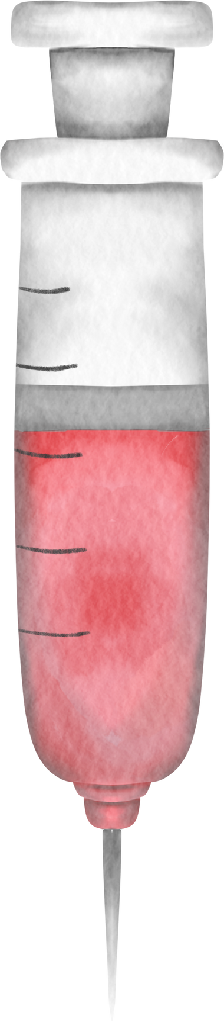
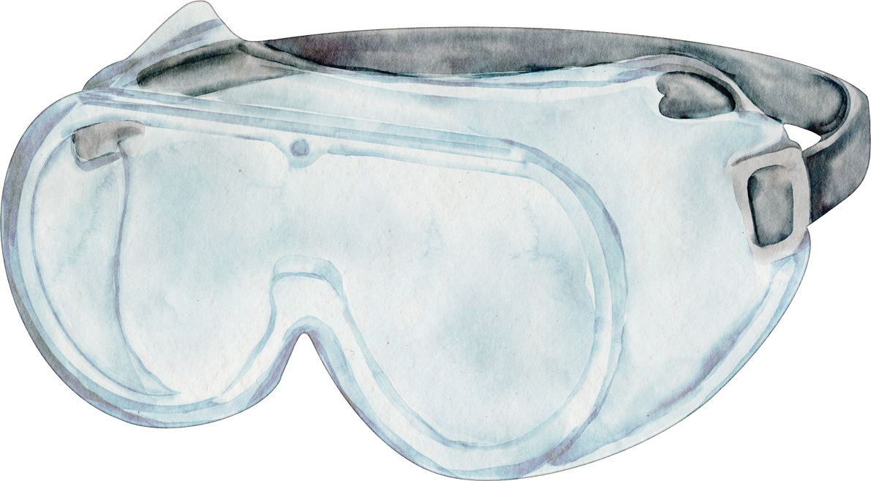
DO YOU HAVE ANY QUESTIONS?

Slide 10
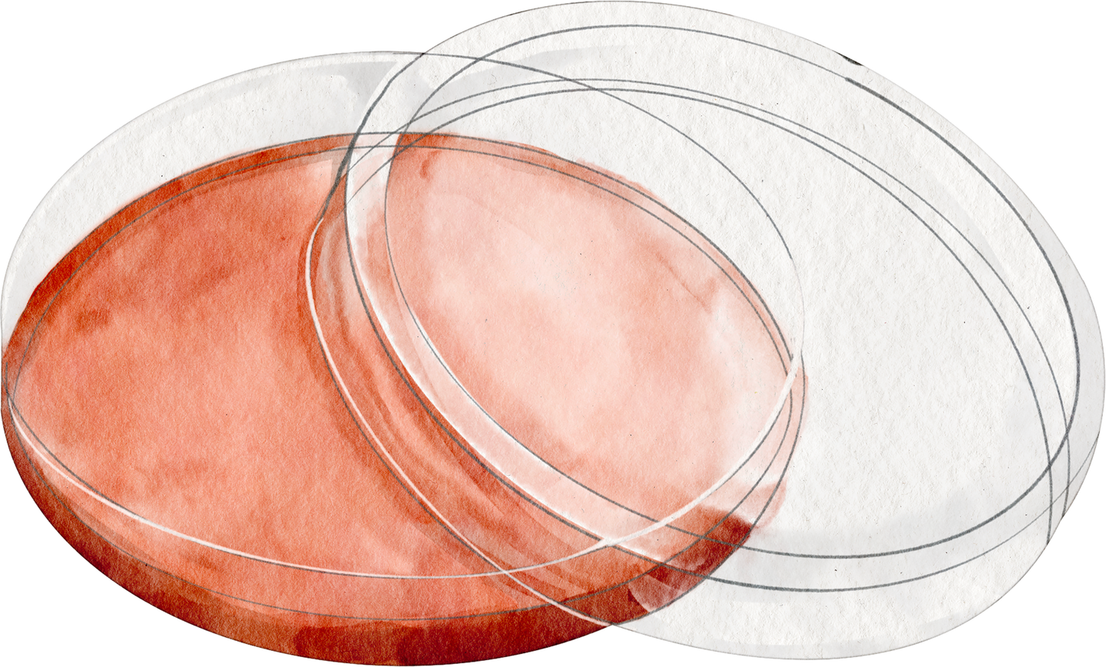

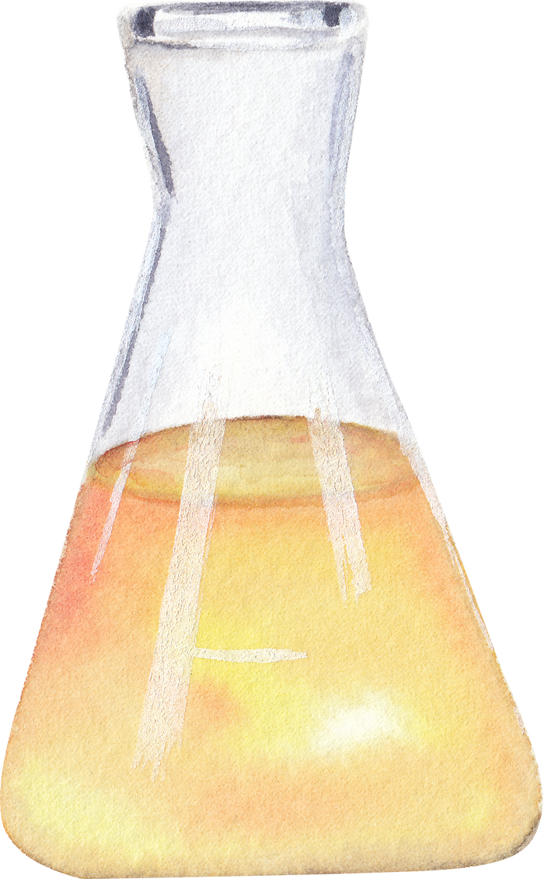
ACTIVITY TIME
TRY AND LEARN
Add instructions or guidelines here.
You can also put in the amount of time allotted for this.

Slide 11
SUMMARY OF TODAY'S CLASS
RECAP 1
RECAP 3
Elaborate on the concepts with helpful examples and illustrations. Duplicate this page as many times as needed to give you more space for discussion.
Elaborate on the concepts with helpful examples and illustrations. Duplicate this page as many times as needed to give you more space for discussion.
RECAP 2
RECAP 4
Elaborate on the concepts with helpful examples and illustrations. Duplicate this page as many times as needed to give you more space for discussion.
Elaborate on the concepts with helpful examples and illustrations. Duplicate this page as many times as needed to give you more space for discussion.

Slide 12



THANK YOU!

