Slide 1

Title and Content Layout with List

Slide 2
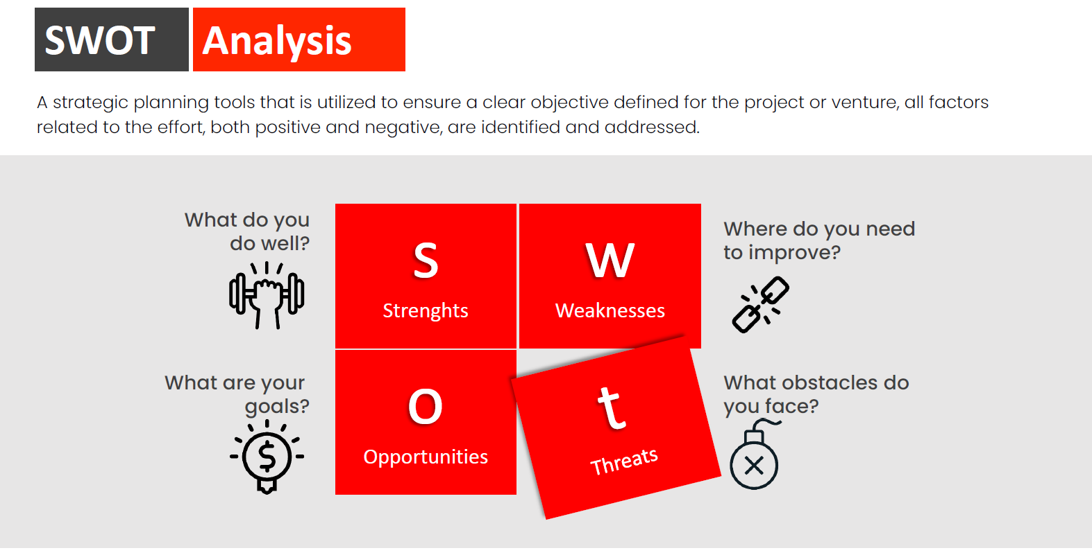
Title and Content Layout with List

Slide 3
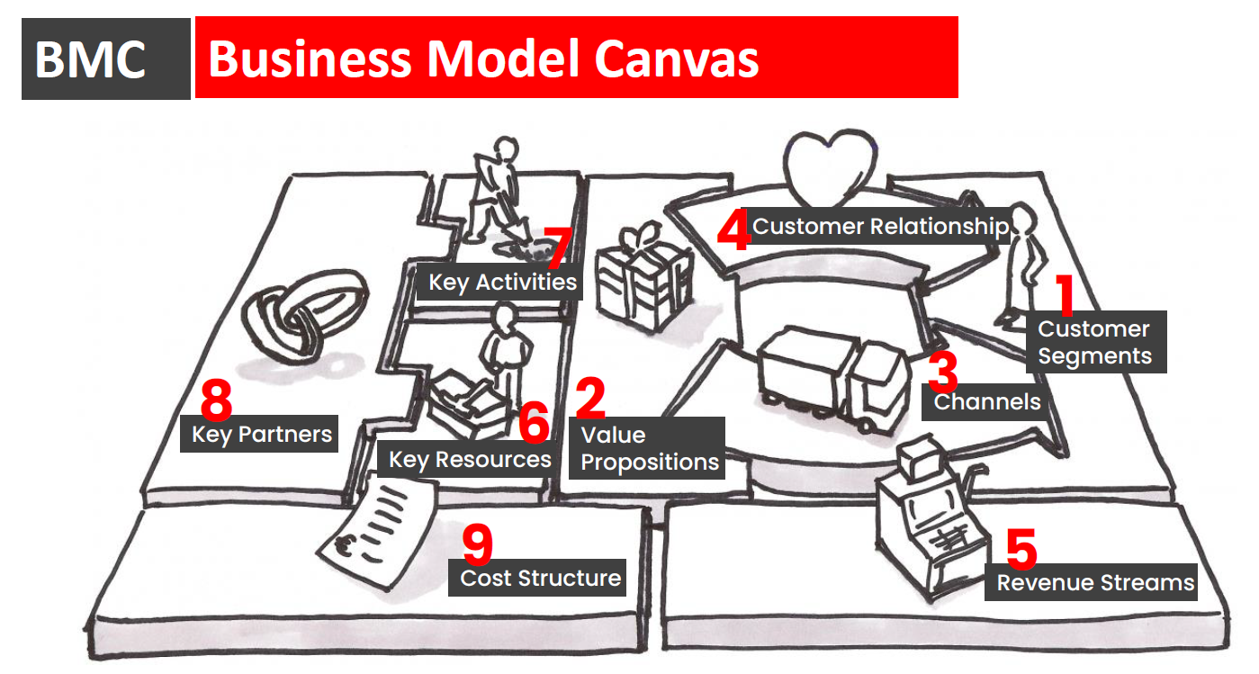
Title and Content Layout with List

Slide 4
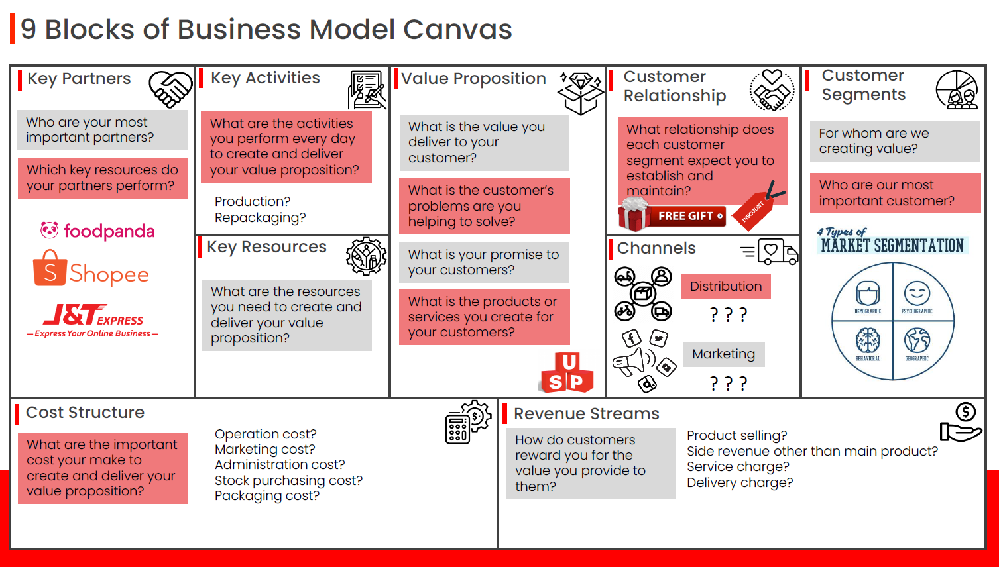
Title and Content Layout with List

Slide 5
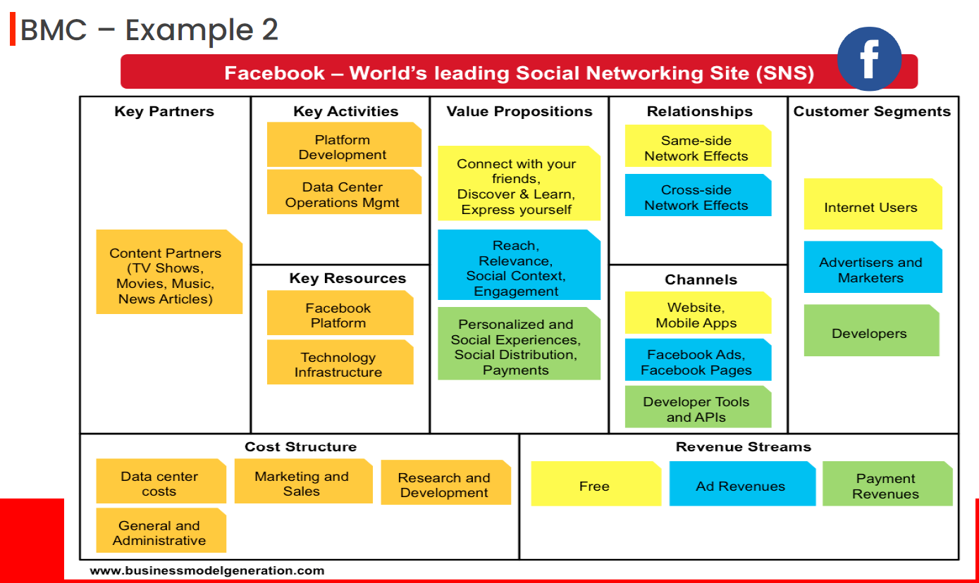
Title and Content Layout with List

Slide 6
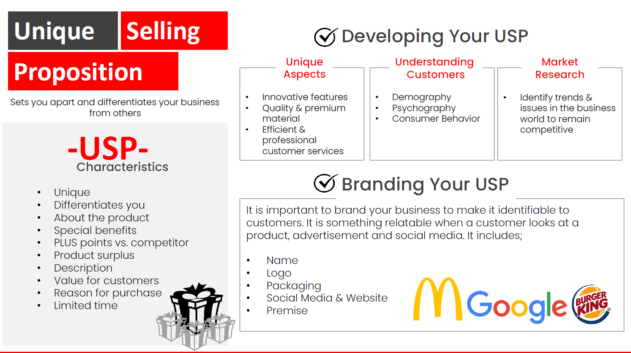
Title and Content Layout with List

