Slide 1

The Introduction of DC Drives
Presented by : Fadzilah, Nor Hasrimin, Hamidah Haneym and Shahida

Slide 2








  our team
SHAHIDA YUSOF
NOR HASRIMIN MD NOR
HAMIDAH HANEYM
AB HAMID
FADZILAH HASHIM

Slide 3

DEFINITION OF ELECTRICAL DRIVES
•AN ELECTRICAL DRIVES CAN BE DEFINED AS AN ELECTROMECHANICAL DEVICE FOR CONVERTING ELECTRICAL ENERGY INTO MECHANICAL ENERGY TO IMPART MOTION TO DIFFERENT MACHINES AND MECHANISMS FOR VARIOUS KINDS OF PROCESS CONTROL.
•IT’S FUNCTIONS IS TO TURN AND DRIVE THE MOTOR ACCORDING TO LOAD REQUIREMENTS WITH RESPECT TO THE DESIRED TORQUE OR SPEED NEEDED BY THE USER.

Slide 4

SPEED CONTROL METHODS OF DC SEPARATELY EXCITED MOTORS
The speed control by adding armature resistance
The speed control by adjusting armature voltage
The speed control by adjusting field voltage

Slide 5

Method 1:
CONTROLLING SPEED BY ADDING RESISTANCE
The operation

Slide 6
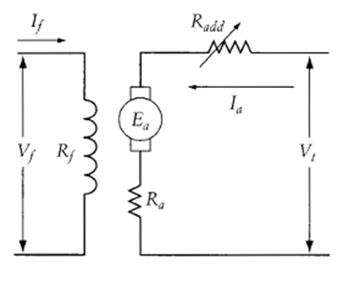
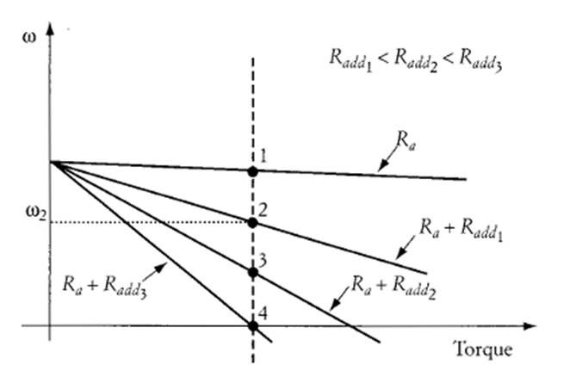
CONTROLLING SPEED BY ADDING RESISTANCE
A SETUP FOR SPEED CHANGE BY
ADDING AN ARMATURE RESISTANCE
EFFECT OF ADDING AN ARMATURE RESISTANCE ON SPEED

Slide 7
CONTROLLING SPEED BY ADDING RESISTANCE
EXPLANATION
EFFECT OF ADDING AN ARMATURE RESISTANCE ON SPEED
•ASSUME THAT THE FIELD AND ARMATURE VOLTAGES ARE CONSTANT.
•AT POINT 1, NO EXTERNAL RESISTANCE IS IN THE ARMATURE CIRCUIT.
•IF A RESISTANCE R_ADD1 IS ADDED TO THE ARMATURE CIRCUIT, THE MOTOR OPERATES AT POINT 2, WHERE THE MOTOR SPEED Ω_2

Slide 8
CONTROLLING SPEED BY ADDING RESISTANCE
EXPLANATION
EFFECT OF ADDING AN ARMATURE RESISTANCE ON SPEED
•IF THE ADDED RESISTANCE KEEPS INCREASING, THE MOTOR SPEED DECREASES UNTIL THE SYSTEM OPERATES AT POINT 4, WHERE THE SPEED OF THE MOTOR IS ZERO.
•THE OPERATION OF THE DRIVE SYSTEM AT POINT 4 IS KNOWN AS "HOLDING."
•IT IS QUITE COMMON TO OPERATE THE MOTOR UNDER ELECTRICAL HOLDING CONDITIONS IN APPLICATIONS SUCH AS ROBOTICS AND ACTUATION.

Slide 9
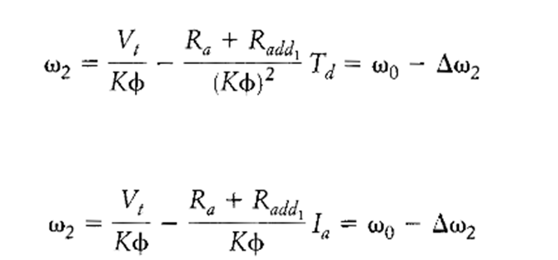
CONTROLLING SPEED BY ADDING RESISTANCE
EQUATIONS
EFFECT OF ADDING AN ARMATURE RESISTANCE ON SPEED
...

Slide 10
Method 1:
CONTROLLING SPEED BY ADJUSTING ARMATURE VOLTAGE
The operation

Slide 11
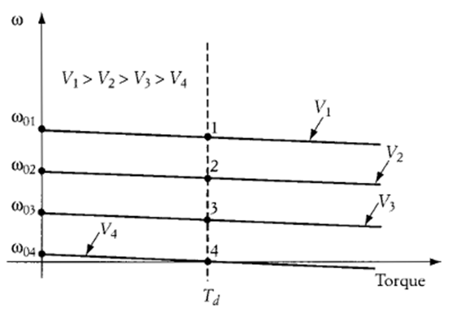
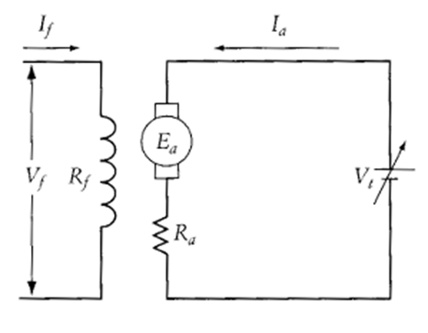
CONTROLLING SPEED BY ADJUSTING ARMATURE VOLTAGE
A SETUP FOR SPEED CHANGE BY
ADJUSTING ARMATURE VOLTAGE
EFFECT OF ADJUSTING ARMATURE VOLTAGE ON SPEED

Slide 12
CONTROLLING SPEED BY ADJUSTING ARMATURE VOLTAGE
EXPLANATION
EFFECT OF ADJUSTING ARMATURE VOLTAGE ON SPEED
  THE ONLY CONTROLLED VARIABLE IS THE ARMATURE VOLTAGE OF THE MOTOR, WHICH IS DEPICTED AS AN ADJUSTABLE-VOLTAGE SOURCE.
  •THIS METHOD IS HIGHLY EFFICIENT AND STABLE AND IS SIMPLE TO IMPLEMENT.
  • WHEN THE ARMATURE VOLTAGE IS REDUCED, THE NO-LOAD SPEED Ω_0 IS ALSO REDUCED.

Slide 13
CONTROLLING SPEED BY ADJUSTING ARMATURE VOLTAGE
EXPLANATION
•MOTOR CHARACTERISTICS WHEN ARMATURE VOLTAGE CHANGES
  •NOTE THAT WE ARE ASSUMING THE FIELD VOLTAGE IS UNCHANGED WHEN THE ARMATURE VOLTAGE VARIES.
  •ELECTRIC HOLDING CAN BE DONE IF THE ARMATURE VOLTAGE IS REDUCED UNTIL ∆Ω IS EQUAL TO Ω_0.

Slide 14
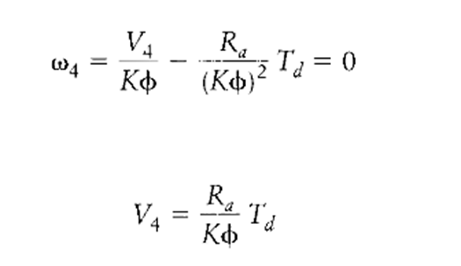
CONTROLLING SPEED BY ADJUSTING ARMATURE VOLTAGE
EQUATIONS
•MOTOR CHARACTERISTICS WHEN ARMATURE VOLTAGE CHANGES

Slide 15
Method 1:
CONTROLLING SPEED BY ADJUSTING FIELD VOLTAGE
The operation

Slide 16
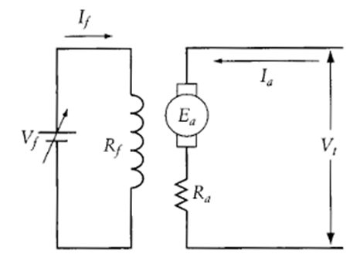
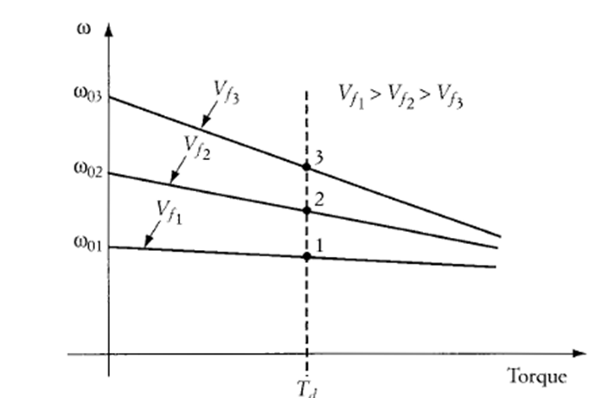
CONTROLLING SPEED BY ADJUSTING FIELD VOLTAGE
A SETUP FOR SPEED CHANGE BY
ADDING ADJUSTING FIELD VOLTAGE
EFFECT OF ADDING ADJUSTING FIELD VOLTAGE ON SPEED

Slide 17
CONTROLLING SPEED BY ADJUSTING FIELD VOLTAGE
EXPLANATION
EFFECT OF ADDING ADJUSTING FIELD VOLTAGE ON SPEED
  IF WE REDUCE THE FIELD VOLTAGE, THE FIELD CURRENT AND CONSEQUENTLY THE FLUX ARE REDUCED.
  •EQUATION 2.1 & 2.2 SHOW THE DEPENDENCY OF MOTOR SPEED ON THE FIELD FLUX.
  •THE NO-LOAD SPEED IS INVERSELY PROPORTIONAL TO THE FLUX, AND THE SLOPE OF EQUATION (2.1)IS INVERSELY PROPORTIONAL TO THE SQUARE OF THE FLUX.

Slide 18
CONTROLLING SPEED BY ADJUSTING FIELD VOLTAGE
EXPLANATION
EFFECT OF ADDING ADJUSTING FIELD VOLTAGE ON SPEED
  WHEN THE FIELD FLUX IS REDUCED, THE NO-LOAD SPEED Ω_0 IS INCREASED IN INVERSE PROPORTION TO THE FLUX, AND THE SPEED DROP ∆Ω IS ALSO INCREASED.
  •WHEN MOTOR SPEED IS CONTROLLED BY ADJUSTING THE FIELD CURRENT, THE FOLLOWING CONSIDERATIONS SHOULD BE KEPT IN MIND.
1. THE FIELD VOLTAGE MUST NOT EXCEED THE ABSOLUTE
MAXIMUM RATING.
2. SINCE DC MOTORS ARE RELATIVELY SENSITIVE TO
VARIATIONS IN FIELD VOLTAGE, LARGE RE-DUCTIONS IN FIELD
CURRENT MAY RESULT IN EXCESSIVE SPEED.
3. BECAUSE THE ARMATURE CURRENT IS INVERSELY
PROPORTIONAL TO THE FIELD FLUX (I_A=T_D/K∅), REDUCING
THE FIELD RESULTS IN AN INCREASE IN THE ARMATURE
CURRENT (ASSUMING THAT THE LOAD TORQUE IS UNCHANGED).

Slide 19

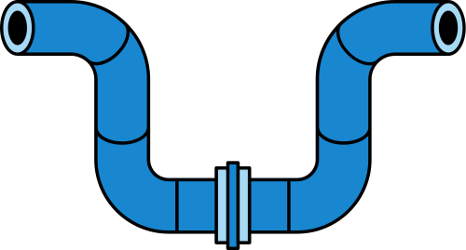
REFLECTIONS
  Solid-state control is used for enhanced efficiency and for versatile operation of electric drive systems.
  For dc machines, converters are often used in the armature circuit to control the terminal voltage of the motor. In some cases, the converter is also used to control the field voltage.

Slide 20
THANK YOU

