Slide 1

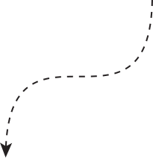



PRINCIPLES OF
SOLID STATE CONTROL

Slide 2

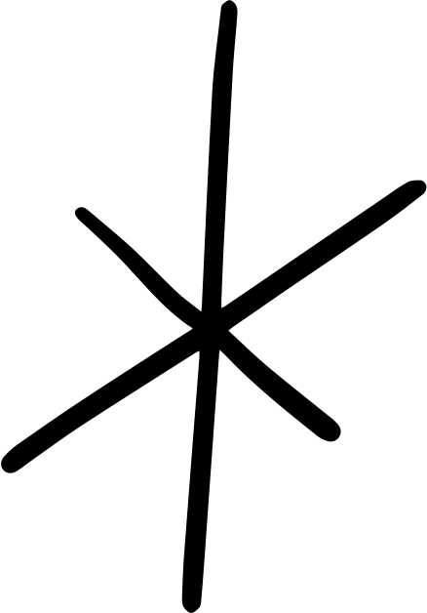





The team
Norhasrimin Md Nor
Fadzilah Hashim
Shahida Yusof
Hamidah Haneym Ab Hamid

Slide 3



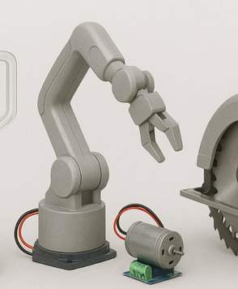
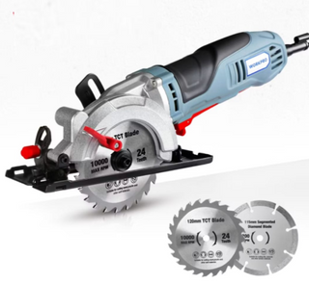
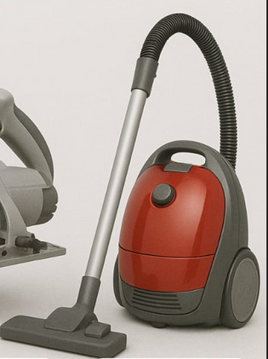

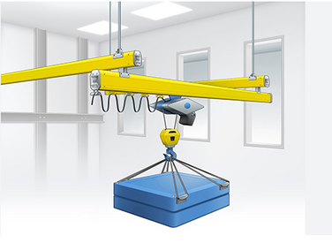
ELECTRIC TRAIN
BLENDER
ROBOT ARM
Application
CIRCULAR SAW
OF DC
DRIVES
VACUUM CLEANER
CRANE & HOIST
TEXTILE MILL

Slide 4




PRINCIPLES OF SOLID STATE CONTROL (THYRISTOR CONTROLLED)

Slide 5


PRINCIPLES OF SOLID STATE CONTROL (THYRISTOR CONTROLLED)
  we will analyzed the DC separately excited motor when energized by:
SINGLE-PHASE, HALF-WAVE DRIVES
SINGLE-PHASE, FULL-WAVE DRIVES

Slide 6
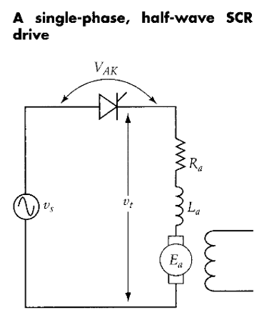
SINGLE-PHASE, HALF-WAVE DRIVES

Slide 7
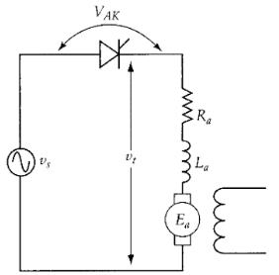
SINGLE-PHASE, HALF-WAVE DRIVES
The armature circuit of the motor is connected to the converter, which is fed from an ac source. The field circuit of the motor is excited from the ac source through a full wave rectifier circuit, which may contain filters.
The converter in this case is a simple SCR triggered by a control circuit not shown in the figure.

Slide 8

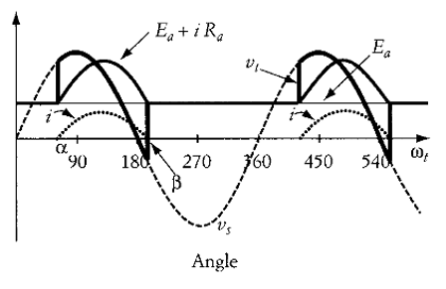
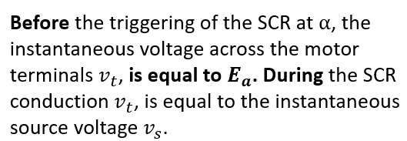
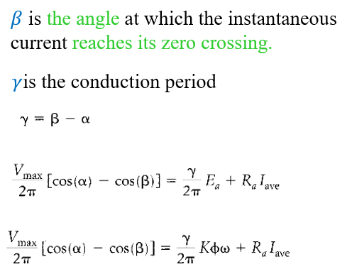

SINGLE-PHASE, HALF-WAVE DRIVES
1
2

Slide 9
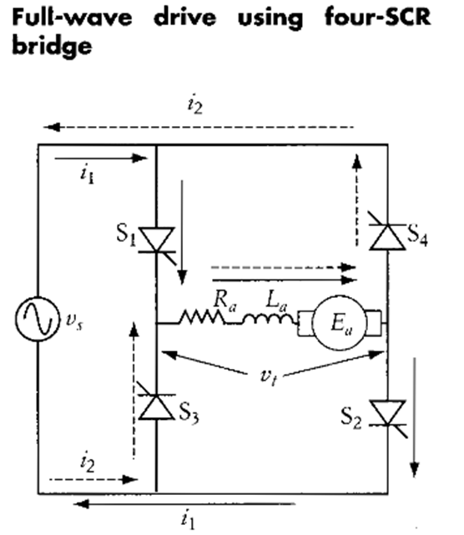
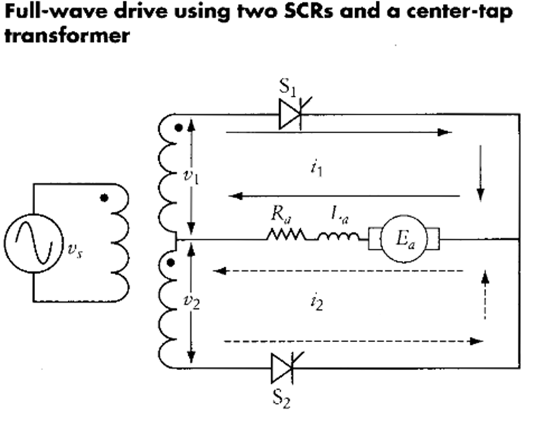
SINGLE-PHASE, FULL-WAVE DRIVES

Slide 10
SINGLE-PHASE, FULL-WAVE DRIVES
•The switching of the SCRs is dependent on the polarity of the source voltage vs.The current i1 (solid lines) flows when the ac waveform of the source voltage is in the positive half-cycle, and SCRs S1 and S2 are triggered.
•Similarly, current i2 (dashed lines) flows when the waveform of the source voltage is in the negative half, and S3 and S4are triggered.
•In either half of the cycle, the current will flow in the same direction inside the motor.

Slide 11
SINGLE-PHASE, FULL-WAVE DRIVES
•Figure shows center-tap transformer as another alternative where two SCRs are used.
•The secondary of the transformer should have double the voltage rating of the motor; that is, V1 = V2 = rated armature voltage.
•When the source voltage Vs, is in the positive half of its cycle and S1 is triggered, i1 flows in the upper half of the transformer's secondary windings.
•When the source voltage is in the negative part and S2 is closed, i2 flows in the lower half of the secondary windings.
•Again, in either half of the source waveform, the armature current of the machine is unidirectional.

Slide 12
PRINCIPLES OF SOLID STATE CONTROL (CHOPPER)

Slide 13

Introduction to DC Chopper
A chopper circuit is any of the many different kinds of electrical switching devices and circuits used in signal and power management applications. A chopper is a device that directly transforms a fixed DC input voltage into a variable DC output voltage. Choppers are essentially electronic switches that are used to interrupt signals that are controlled by other signals.

Slide 14
PRINCIPLES OF SOLID STATE CONTROL (CHOPPER CONTROLLED)
There are two control strategies employed in DC chopper:
Time ratio control
Current limit control

Slide 15
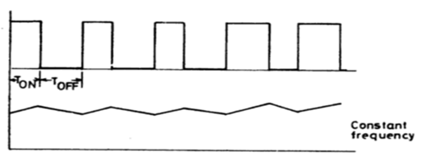
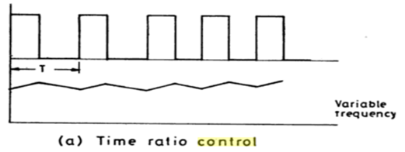
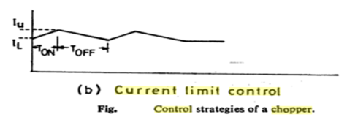
PRINCIPLES OF SOLID STATE CONTROL (CHOPPER CONTROLLED)
Time ratio control
Current limit control
value of TON/T is varied.
1. TON or TOFF is kept constant
2. TON or TOFF are varied
The chopper is switched ON and OFF so that the current in the load is maintained between two limits.

Slide 16
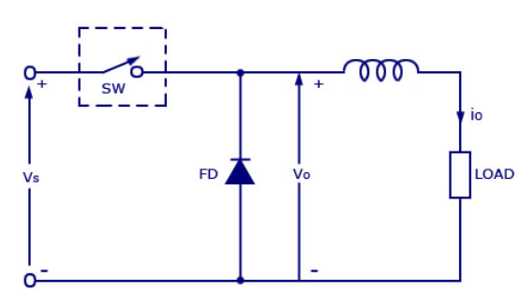
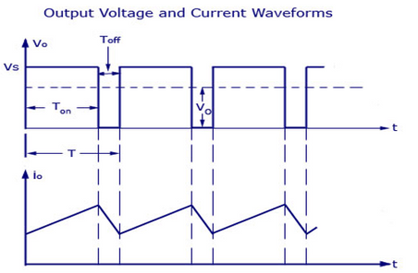
PRINCIPLES OF SOLID STATE CONTROL (CHOPPER CONTROLLED)
Example :Time ratio control
Average load Voltage is given by
V0 = Ton/ (Ton +Toff) * Vs = (Ton/T) V = A Vs
Ton : on -time
Toff : off- time
T = Ton +Toff= chopping period
A = Ton /T = duty cycle
Equation above shows that the load voltage is independent of load current it can be also written as
V0 = f. Ton .Vs
f= 1/T = chopping frequency

Slide 17
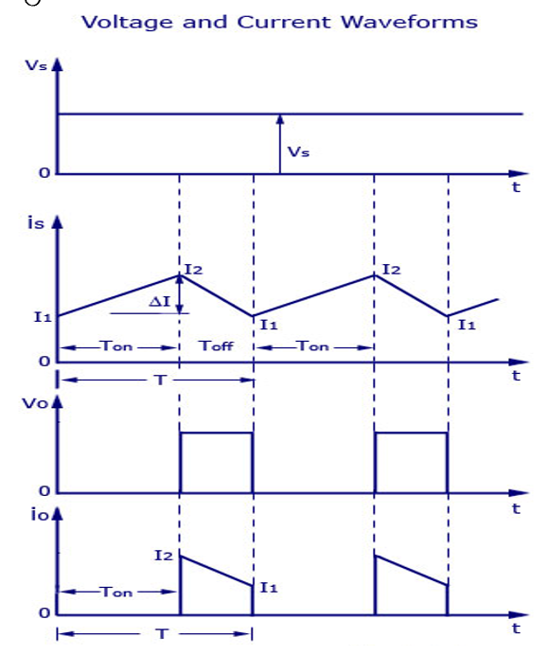
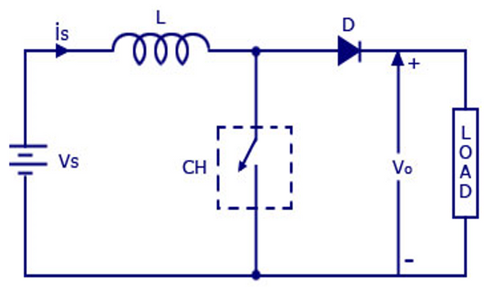
PRINCIPLES OF SOLID STATE CONTROL (CHOPPER CONTROLLED)
Example: Current limit control

Slide 18
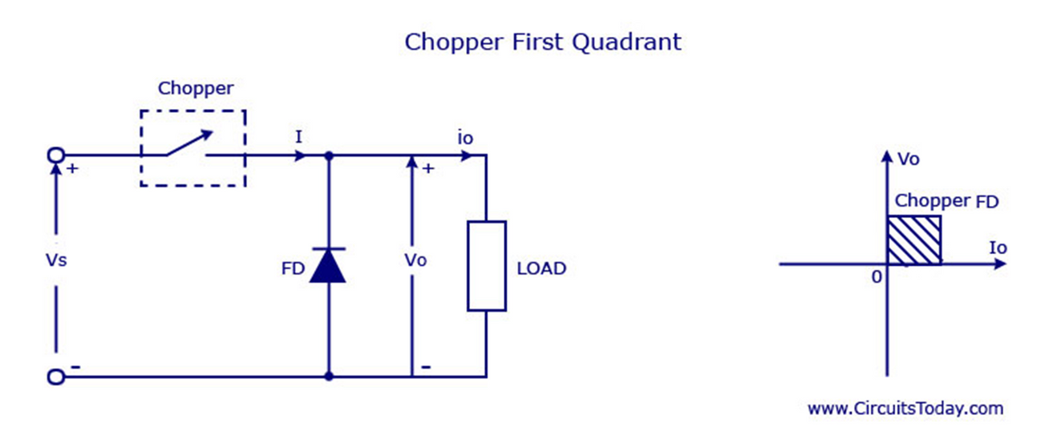

PRINCIPLES OF SOLID STATE CONTROL (CHOPPER CONTROLLED)
class A chopper
•First Quadrant

Slide 19
PRINCIPLES OF SOLID STATE CONTROL (CHOPPER CONTROLLED)
class A chopper
•First Quadrant
•It is known as first-quadrant chopper or type A chopper.
i.When the chopper is on, v0 = VS current flows in the direction of the load. But
ii. when the chopper is off v0 is zero but I0 continues to flow in the same direction through the freewheeling diode FD, thus average value of voltage and current say V0 and I0 will be always positive as shown in the graph.
•In type A chopper the power flow will be always from source to the load. As the average voltage V0 is less than the dc input voltage Vs

Slide 20
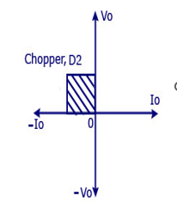
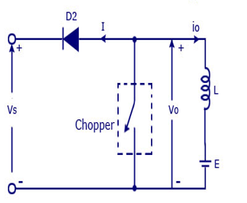
PRINCIPLES OF SOLID STATE CONTROL (CHOPPER CONTROLLED)
class B chopper
•Second Quadrant

Slide 21
PRINCIPLES OF SOLID STATE CONTROL (CHOPPER CONTROLLED)
class B chopper
•In type B or second quadrant chopper the load must always contain a dc source E .
i. When the chopper is on, v0 is zero but the load voltage E drives the current through the inductor L and the chopper, L stores the energy during the time Ton of the chopper .
ii. When the chopper is off , v0 =( E+ L . di/dt ) will be more than the source voltage Vs . Because of this the diode D2 will be forward biased and begins conducting and hence the power starts flowing to the source.
•Second Quadrant

Slide 22

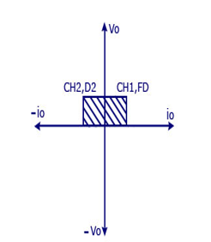
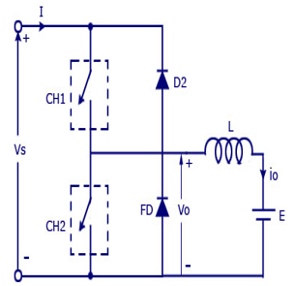
PRINCIPLES OF SOLID STATE CONTROL (CHOPPER CONTROLLED)
class C chopper
•Two Quadrant

Slide 23
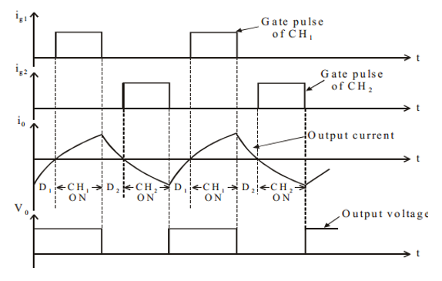
PRINCIPLES OF SOLID STATE CONTROL (CHOPPER CONTROLLED)
class C chopper
•Two Quadrant

Slide 24
PRINCIPLES OF SOLID STATE CONTROL (CHOPPER CONTROLLED)
class C chopper
•Two Quadrant

Slide 25
PRINCIPLES OF SOLID STATE CONTROL (CHOPPER CONTROLLED)
class C chopper
•Type C chopper is obtained by connecting type –A and type –B choppers in parallel.
•We will always get a positive output voltage V0 as the freewheeling diode FD is present across the load.
•When the chopper is on the freewheeling diode starts conducting and the output voltage v0 will be equal to Vs .
•The direction of the load current i0 will be reversed. The current i0 will be flowing towards the source and it will be positive regardless the chopper is on or the FD conducts.
•The load current will be negative if the chopper is or the diode D2 conducts. We can say the chopper and FD operate together as type-A chopper in first quadrant. In the second quadrant, the chopper and D2 will operate together as type –B chopper.
•Two Quadrant

Slide 26
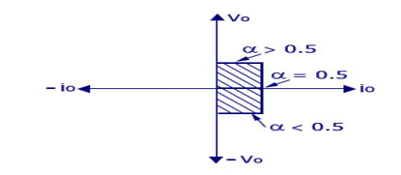
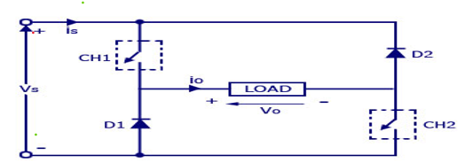
PRINCIPLES OF SOLID STATE CONTROL (CHOPPER CONTROLLED)
class D chopper
•Two Quadrant Operation

Slide 27
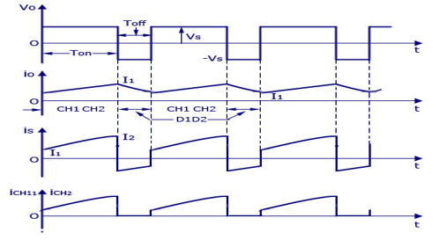
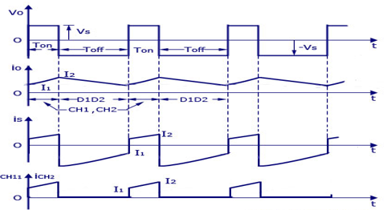
PRINCIPLES OF SOLID STATE CONTROL (CHOPPER CONTROLLED)
class D chopper
•Two Quadrant Operation

Slide 28
PRINCIPLES OF SOLID STATE CONTROL (CHOPPER CONTROLLED)
•When the two choppers are on the output voltage v0 will be equal to Vs . When v0 = – Vs the two choppers will be off but both the diodes D1 and D2 will start conducting.
•V0 the average output voltage will be positive when the choppers turn-on the time Ton will be more than the turn off time Toff its shown in the wave form below.
• As the diodes and choppers conduct current only in one direction the direction
•The power flows from source to load as the average values of both v0 and i0 is positive. From the wave form it is seen that the average value of V0 is positive thus the forth quadrant operation of type D chopper is obtained.
•From the wave forms the Average value of output voltage is given by
V0= (Vs Ton-VsToff)/T = Vs.(Ton-Toff)/T
•n of load current will be always positive.
class D chopper
•Two Quadrant Operation

Slide 29
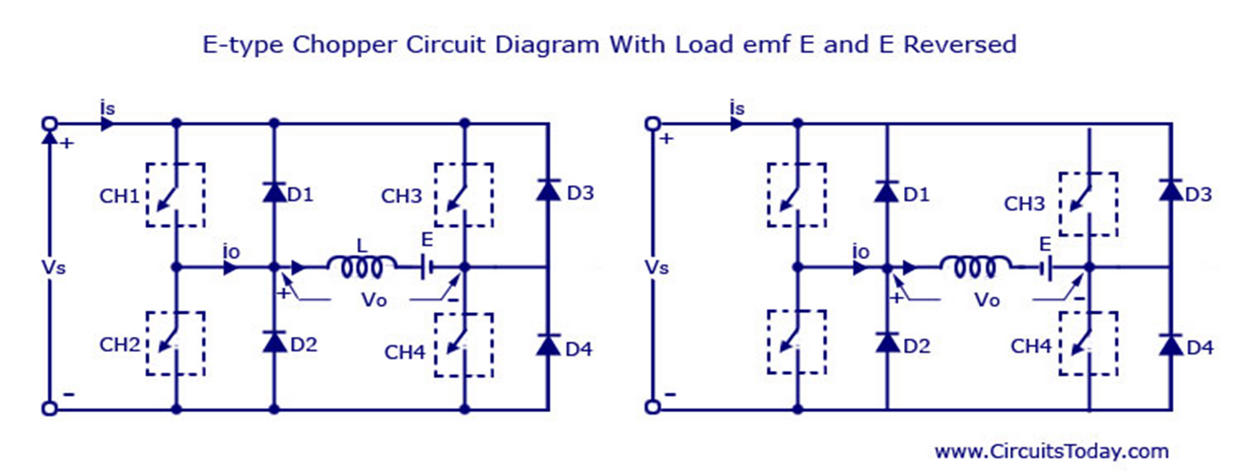
PRINCIPLES OF SOLID STATE CONTROL (CHOPPER CONTROLLED)
class E chopper
•Four Quadrant

Slide 30
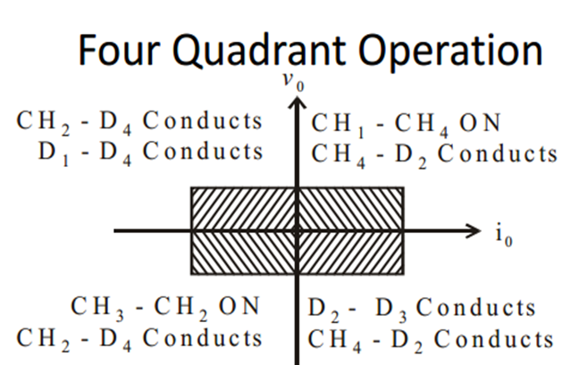
PRINCIPLES OF SOLID STATE CONTROL (CHOPPER CONTROLLED)
class E chopper
•Four Quadrant

Slide 31
PRINCIPLES OF SOLID STATE CONTROL (CHOPPER CONTROLLED)
class E chopper
•Four Quadrant
•Class E is a four quadrant chopper
•When CH1 and CH4 are triggered, output current iO flows in positive direction through CH1 and CH4 , and with output voltage vO = V.
•This gives the first quadrant operation.
•When both CH1 and CH4 are OFF, the energy stored in the inductor L drives iO through D2 and D3 in the same direction, but output voltage vO = -V.
•Therefore the chopper operates in the fourth quadrant.

Slide 32


CONCLUSIONS
After studying the slides before, it is hoped that all students will be able to understand the principles of SOLID STATE CONTROL, whether Thyristor Controlled or chopper CONTROLLED. Solid-state control is used for enhanced efficiency and for versatile operation of electric drive systems.

Slide 33
THANK
YOU!

