Slide 1
TOPIC 1
FACILITIES MANAGEMENT OVERVIEW
BY : En Muhamad Zakwan Bin Zakariah

Slide 2
Introduction
Facility Managers make things happen. They do it by planning, organizing , budgeting and controlling. To be successful in this profession facility manager have to be good leaders and managers.
Up-to-date information in facility management is a necessity, not a luxury.
Facility manager have to be open-minded and armed with current best practices, procedure, technology and information
Good FM is based on good leadership of a proper organization

Slide 3
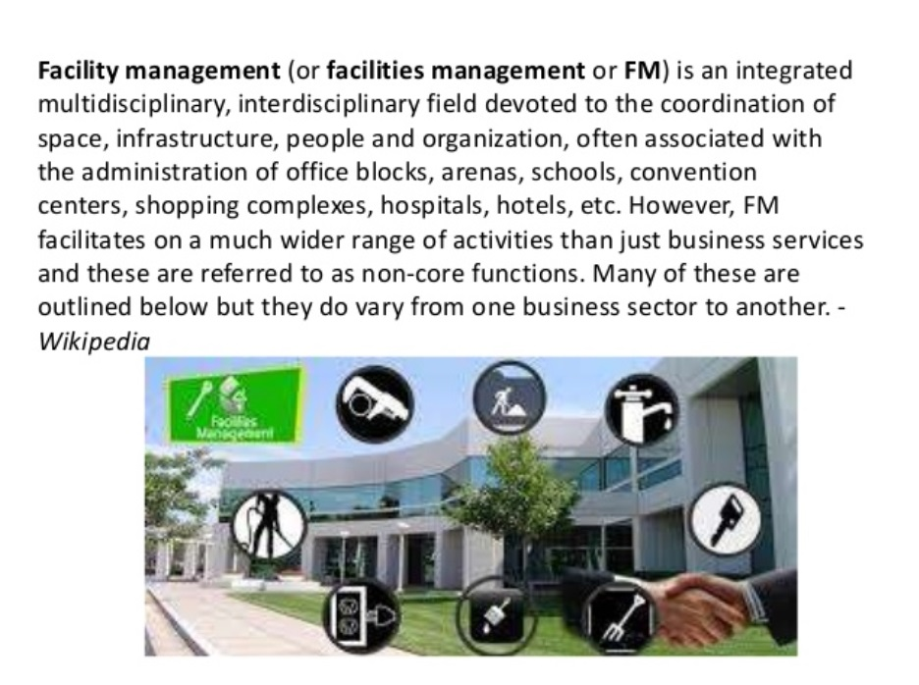

Slide 4
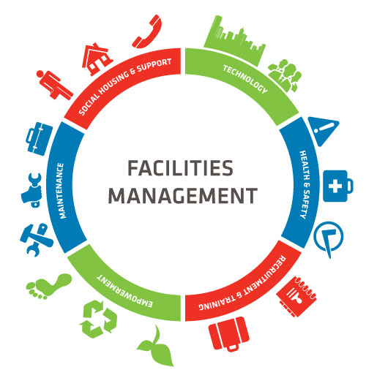

Slide 5
Definition of Facilities Management
Facility management (FM) is a profession that encompasses multiple disciplines to ensure functionality, comfort, safety and efficiency of the built environment by integrating people, place, process and technology.
These services could either be performed in-house or outsourced to contractors.
Facilities management could therefore be seen as the integration of people, process, place and technology to ensure functionality, improved services and effectiveness of an organisationes primary objectives. Facilities management is responsible for all the support services that ensure the effective operation of the core objectives of any organisation or business.

Slide 6
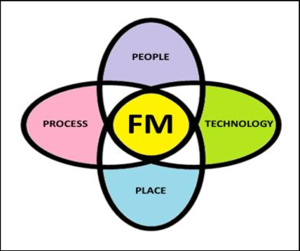
FACILITIES MANAGEMENT - FM

Slide 7
Definition of FM - Drion and Kelly
A more or less coherent management function focusing on how to develop, maintain and improve the physical assets needed to support and add value to an organisationÊs business processes and create and maintain a physical workplace that provides optimal support to the people and work of the organisation.
(Drion et al., 2012)
An integrated profession where the role of the facilities manager is to ensure that services are tailored to suit the core business they operate.
(Kelly et al., 2005)

Slide 8
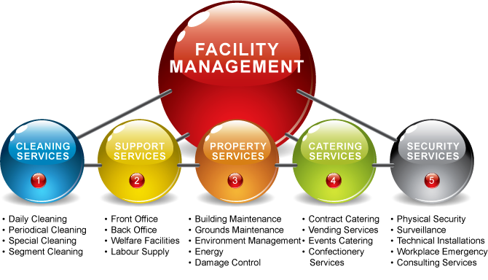

Slide 9
Facilities Management Framework
Sustainability is the main issue of facilities management. A key component of sustainability adoption in any organization involves change.
An understanding of providing essential insights that allow all staffs at all levels of the organization to grasp the need for and impact of the change is very important.

Slide 10
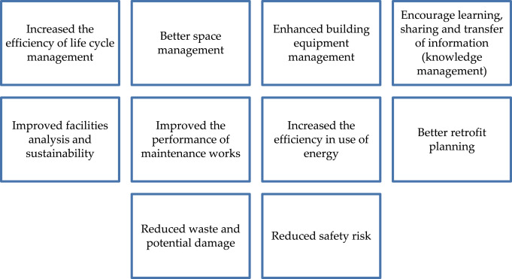
The development of facilities management

Slide 11
Service covered in Facilities Management
(a) Single Service Provision
The single service provision route describes delivering a single FM service type such as catering, security, maintenance, etc. through a specialist provider.
(b) Multiple or Packaged Service Provision
The multiple FM services delivery route is when two or more FM services or functions are outsourced to a service provider. For instance, a security company could provide burglar alarm systems, manned guards, electronic entry systems as a single package.
(c) Management Contracting
This is a combination of management and delivery services where client organisations could employ management contractors, and later allowing the client company overall management control.
(d) Integrated Facilities Management (IFM)
Integrated facilities management is the bringing together of several support services into a single management structure. The client company relieves itself completely of the total support provision by delegating its entire facility requirements FM service providers. Such wide range of services could be delivered directly or through sub-contractors

Slide 12
Con’t
(e) Infrastructure Management
Involves the maintenance and management of bridges, railways, roads and utilities (gas, water and electricity).
(f) Building Operations and Maintenance
Involves buildings and content management, maintenance, plant and systems management, including maintenance and management of M&E services.
(g) Business Support Services
Providing administrative, finance, human resources management, procurement and risk management.
(h) Property Management
Entails asset management, acquisitions/disposal planning, space planning, project management and relocation management.

Slide 13
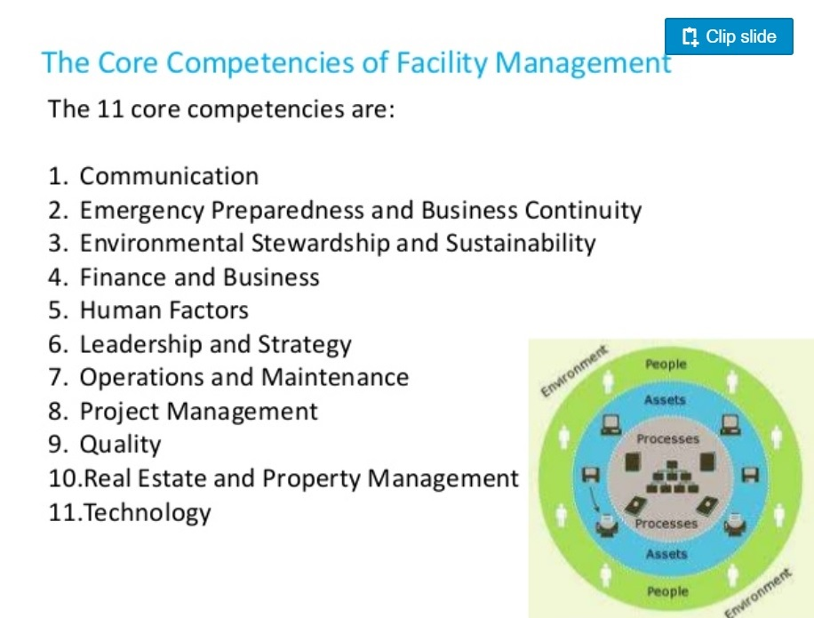

Slide 14
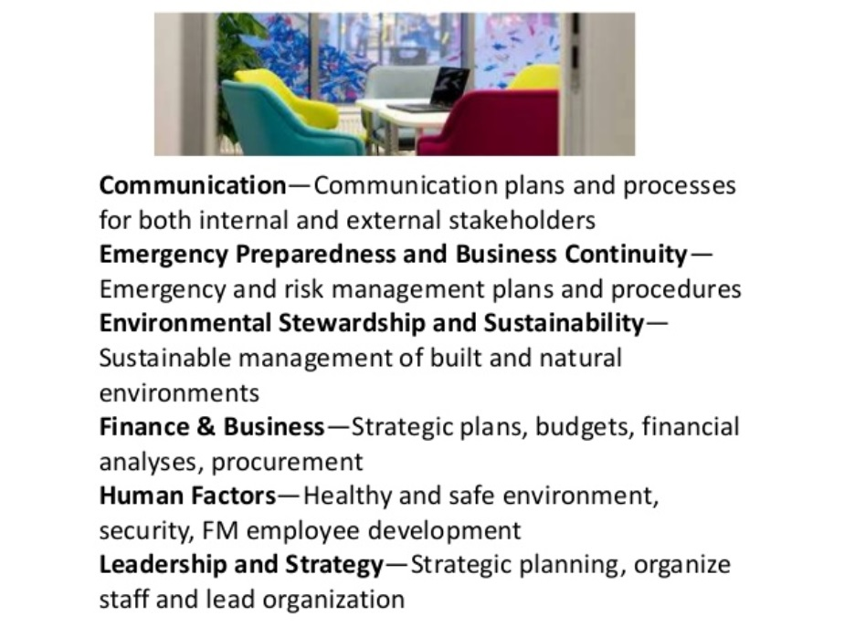

Slide 15
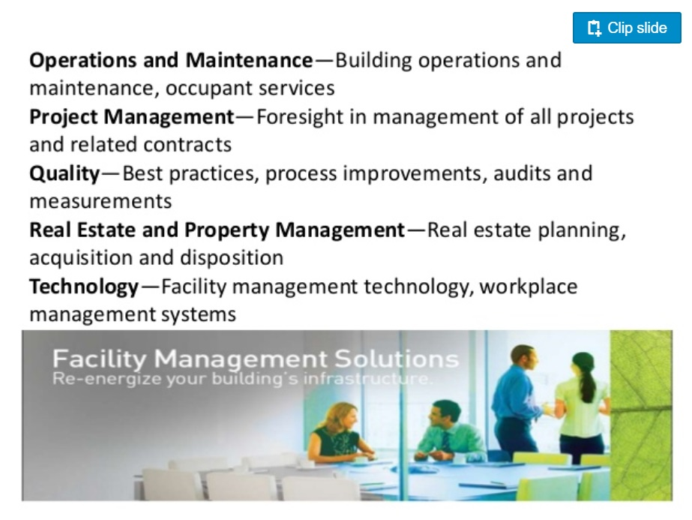

Slide 16
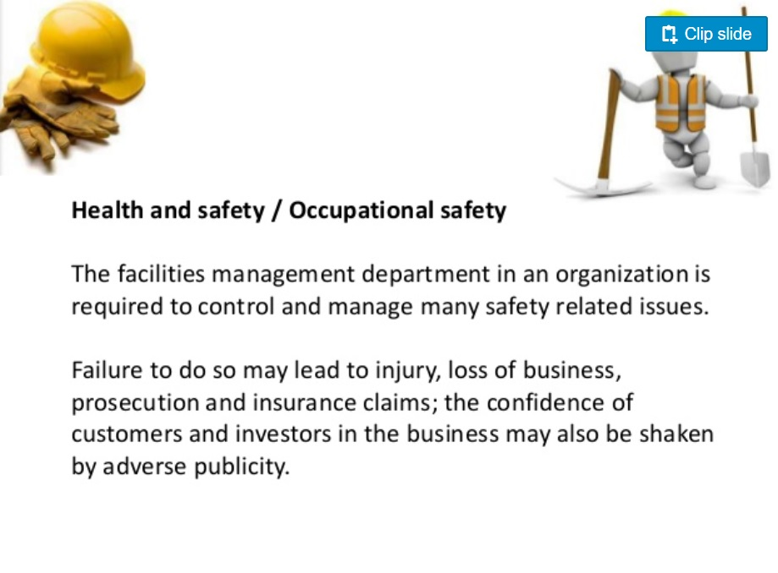

Slide 17
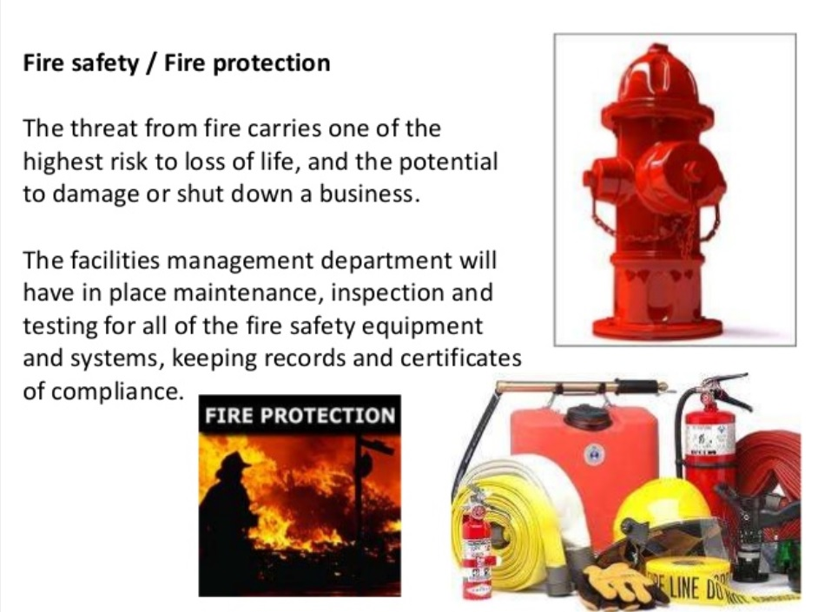

Slide 18
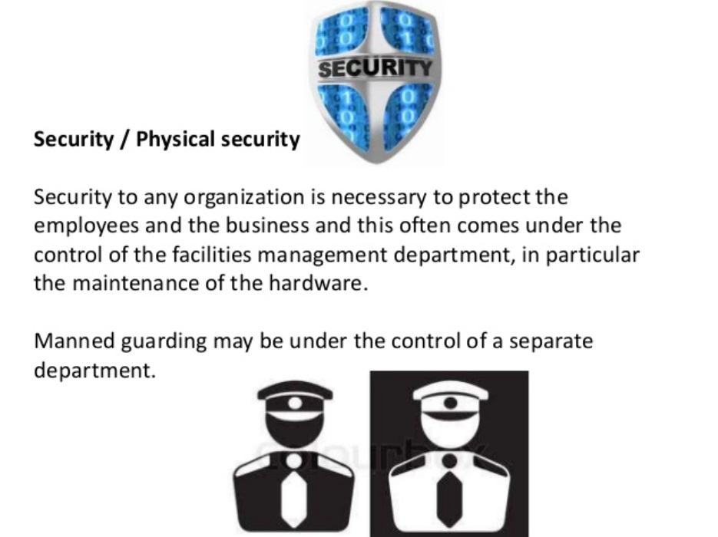

Slide 19
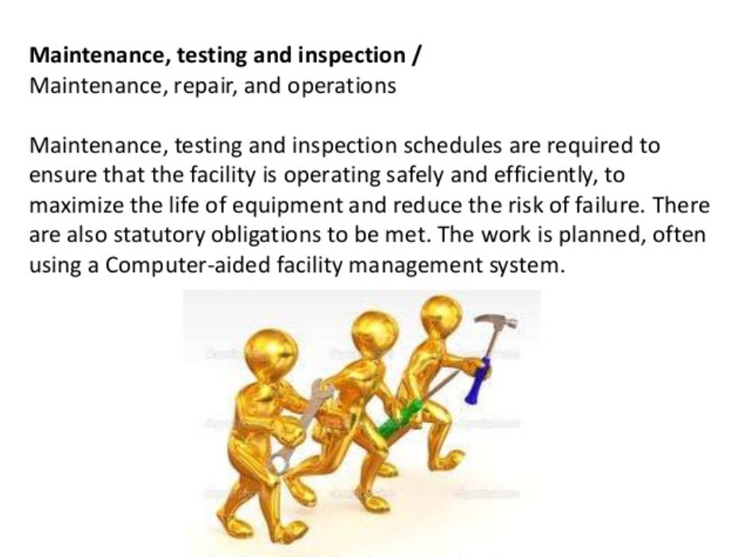

Slide 20
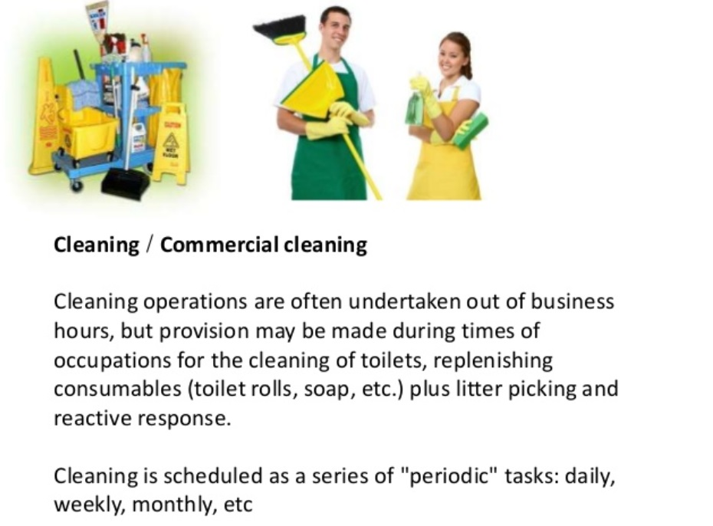

Slide 21
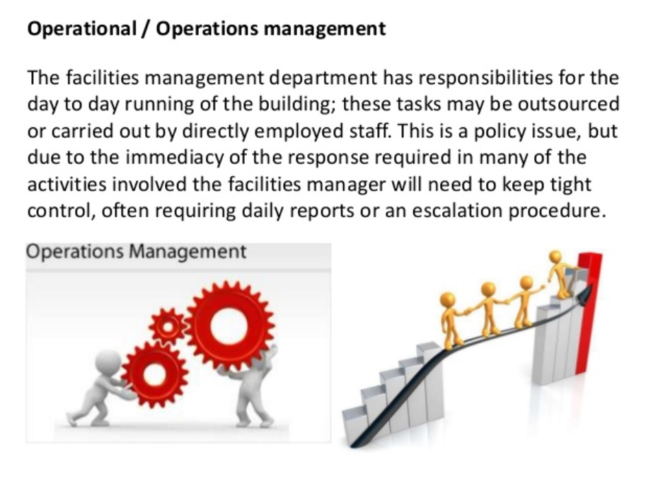

Slide 22
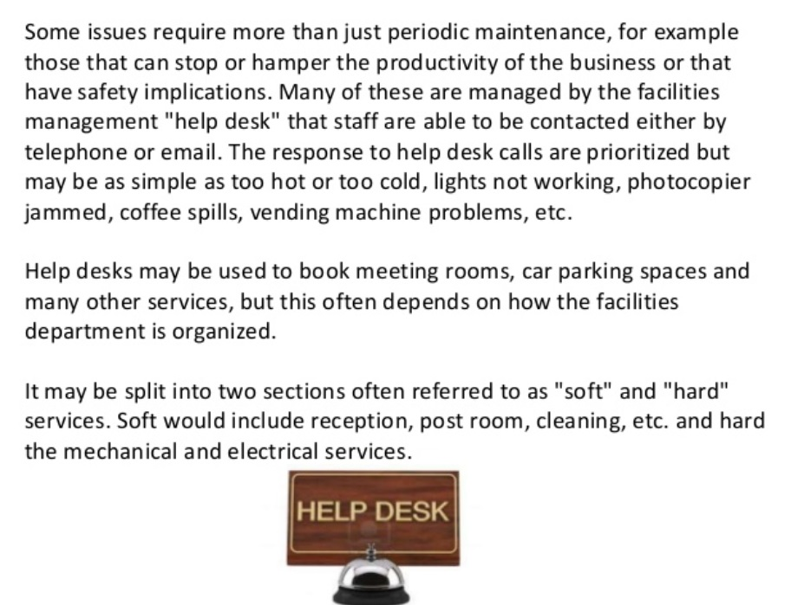

Slide 23
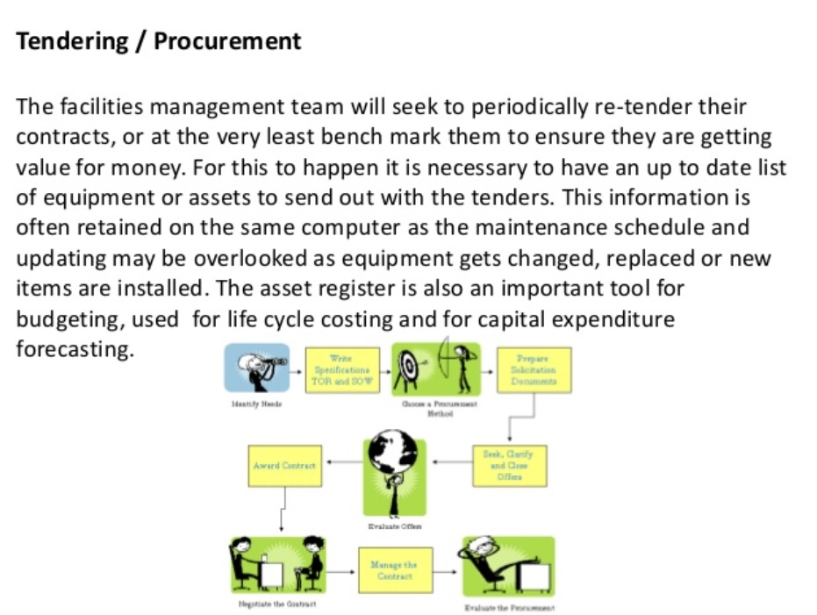

Slide 24
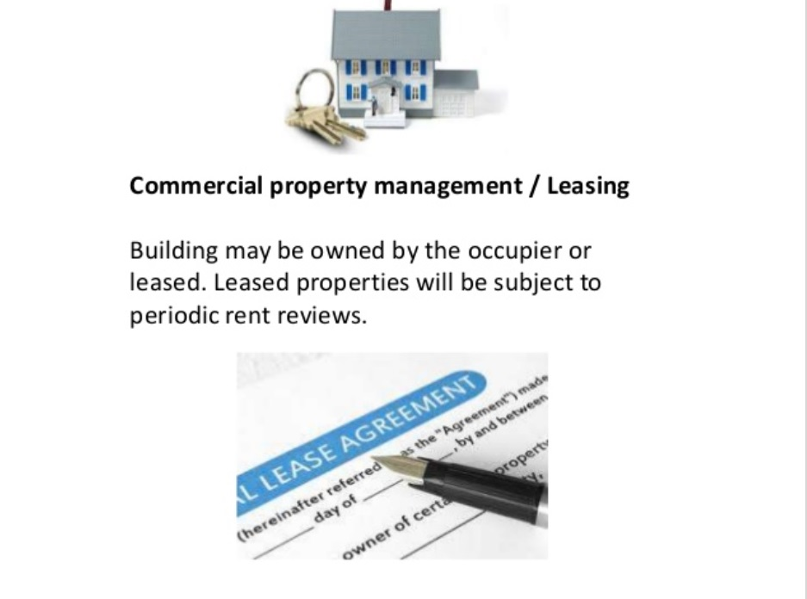

Slide 25
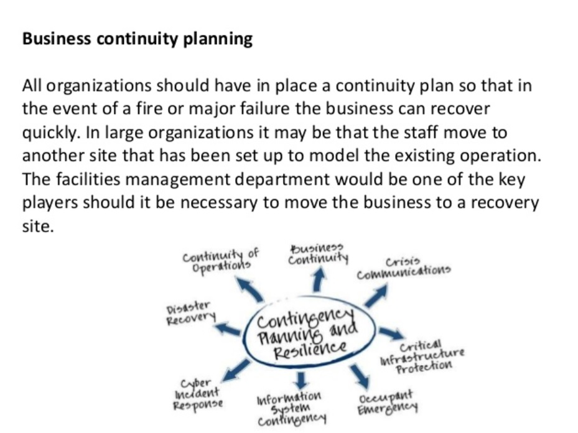

Slide 26
