Slide 1
CHAPTER 2: AC TO DC CONVERTER (RECTIFIER)
DET40073:POWER ELECTRONICS

Slide 2
Course Learning Outcome
DET40073:POWER ELECTRONICS
Upon completion of this course, students should be able to:
CLO1 : Analyze and investigate the well-defined operational behaviors, principle and basic concepts of Power Electronics by using schematics circuits.

Slide 3
2.1 Remember the principle operation of Single-Phase AC to DC Converter. 2.2 Apply the principle of Single-Phase AC to DC Converter.
DET40073:POWER ELECTRONICS

Slide 4
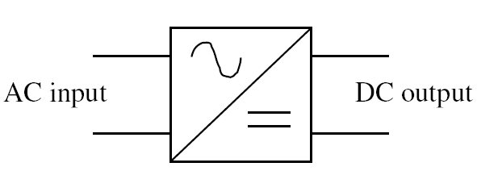
Introduction
DET40073:POWER ELECTRONICS
A rectifier is an electrical device that converts AC which periodically reverses direction, to DC which flows in only one direction.
The process is called RECTIFICATION.
Input can be single or 3-phase and output can be made fixed or variable.

Slide 5
Classification of AC-DC Converters (Rectifiers)
DET40073:POWER ELECTRONICS
Rectifiers
Single Phase
Three Phase
Uncontrolled
Half Controlled
Fully Controlled
Uncontrolled
Half Controlled
Fully Controlled
Half Wave
Full Wave
Half Wave
Full Wave
Half Wave
Full Wave
Half Wave
Full Wave
Centre-tap
Bridge
Figure 2-1: Classification of AC to DC Converters (Rectifiers)

Slide 6
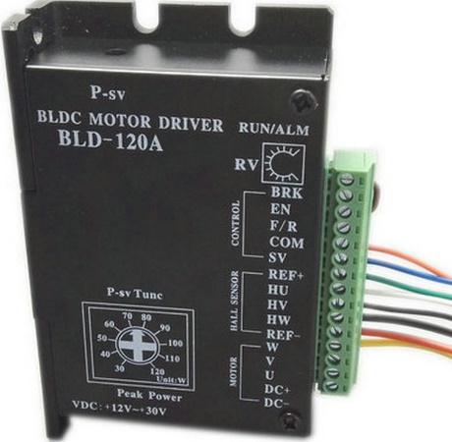
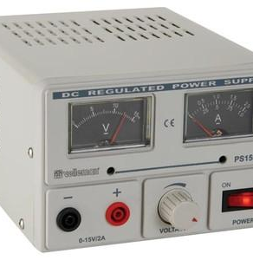
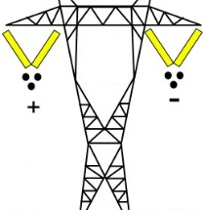
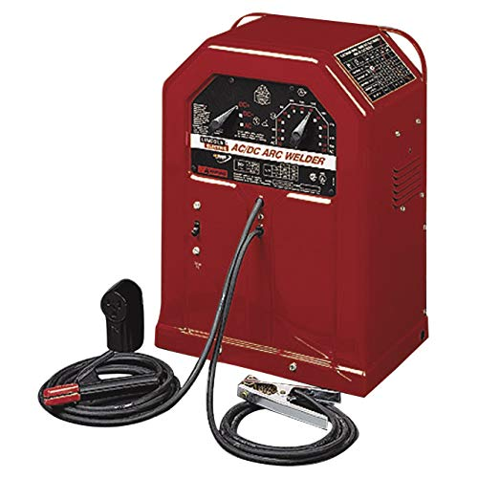
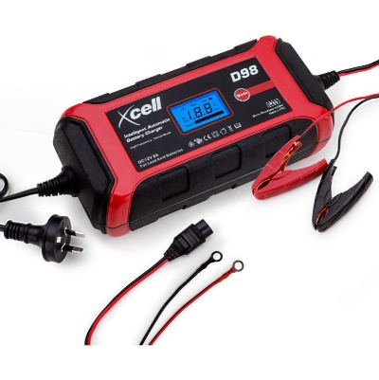
Applications
DET40073:POWER ELECTRONICS
Battery Charger
DC Welder
DC Motor Drives
DC Power Supply
HVDC

Slide 7
Single Phase Uncontrolled Rectifier
DET40073:POWER ELECTRONICS
THREE types of Single Phase Uncontrolled Rectifier:
Half Wave Rectifier
A SINGLE diode is required.
Full Wave Rectifier (Centre-tap)
TWO diodes were used
Full Wave Bridge Rectifier
FOUR diodes were used.
Allows only half cycle (either positive half cycle or negative half cycle) of the input AC signal while the another half cycle is blocked.
DIODES are connected to the centre tapped secondary winding of the transformer.
Centre tap divides the total secondary voltage into equal parts.
This bridge circuit is that it does not require a special center-tapped transformer, thereby reducing its size and cost

Slide 8
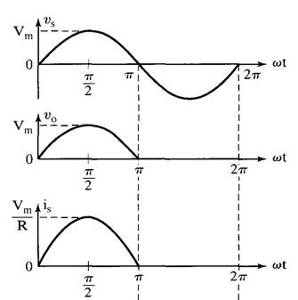
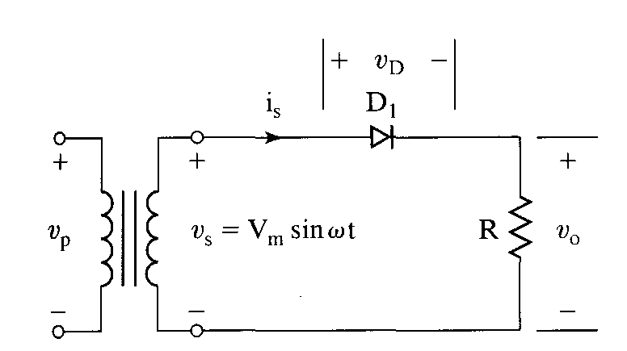
Half Wave Rectifier with Resistive Load
DET40073:POWER ELECTRONICS
Figure 2-2: Half Wave Rectifier with Resistive Load
Figure 2-3: Output Voltage and Current Waveform

Slide 9
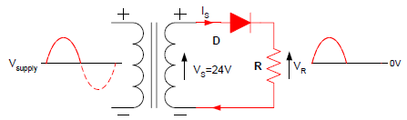
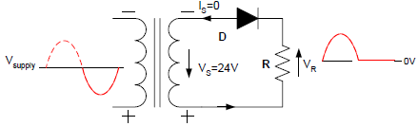
Half Wave Rectifier with Resistive Load
DET40073:POWER ELECTRONICS
Circuit operation:
During positive half cycle:
For interval 0≤ωt≤π;
Diode D₁ conducts (forward biased).
The input voltage appear across the load.
Vo = Vs
During negative half cycle:
For interval π≤ωt≤2π;
Diode D₁ in blocking condition (reverse biased).
Output voltage is zero.
Vo = 0V.

Slide 10
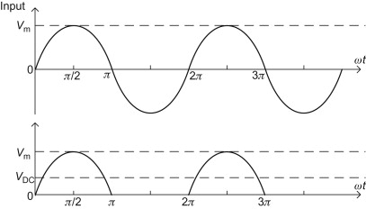
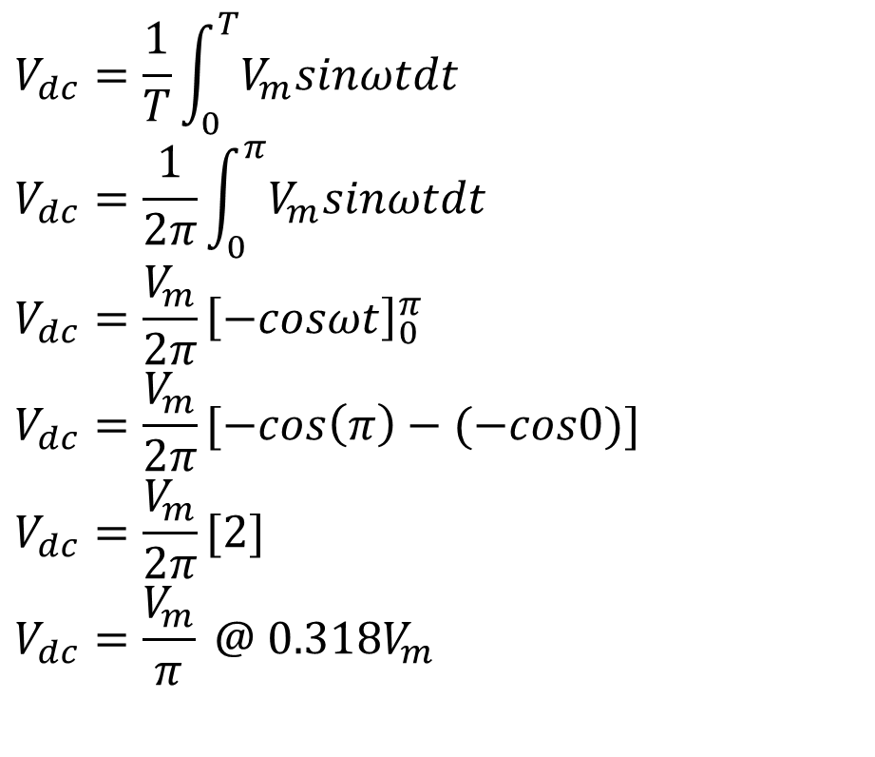
Cont. …
DET40073:POWER ELECTRONICS
Derivation for average output voltage:
$$V_{dc}=\frac{1}{T}\int_{0}^{T}{V_{m}sinωtdt}$$
$$V_{dc}=\frac{1}{2π}\int_{0}^{π}{V_{m}sinωtdt}$$
$$V_{dc}=\frac{V_{m}}{2π}{\left[−cosωt\right]}_{0}^{π}$$
$$V_{dc}=\frac{V_{m}}{2π}[−cos\left(π\right)−(−cos0)]$$
$$V_{dc}=\frac{V_{m}}{2π}[2]$$
$$V_{dc}=\frac{V_{m}}{π} @ 0.318V_{m}$$
Figure 2-4: Input and Output Voltage Waveform

Slide 11
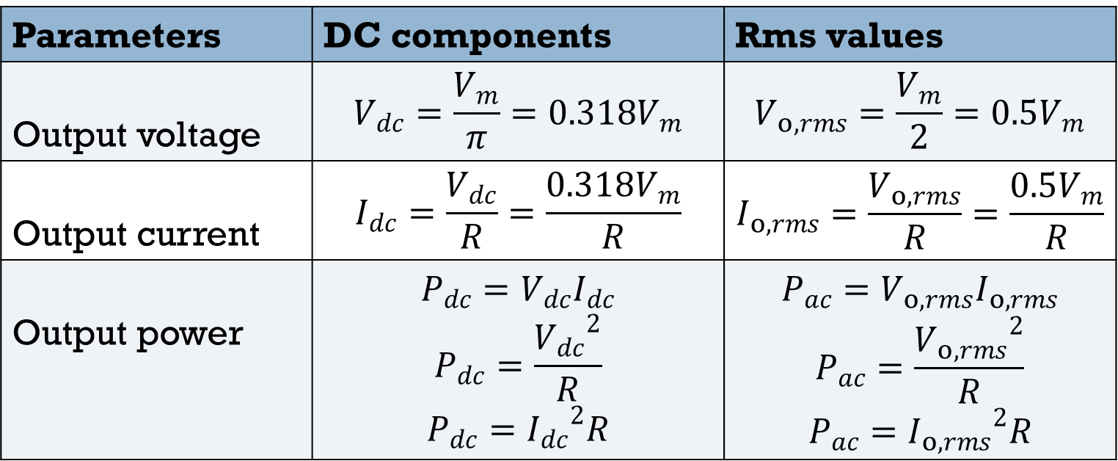
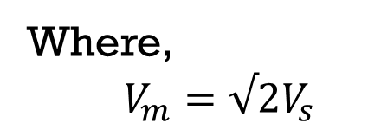

Cont. …
DET40073:POWER ELECTRONICS
Output Voltage and Current:
Parameters | DC components | Rms values
Output voltage | $$V_{dc}=\frac{V_{m}}{π}=0.318V_{m}$$ | $$V_{o,rms}=\frac{V_{m}}{2}=0.5V_{m}$$
Output current | $$I_{dc}=\frac{V_{dc}}{R}=\frac{0.318V_{m}}{R}$$ | $$I_{o,rms}=\frac{V_{o,rms}}{R}=\frac{0.5V_{m}}{R}$$
Output power | $$P_{dc}=V_{dc}I_{dc}$$ $$P_{dc}=\frac{{V_{dc}}^{2}}{R}$$ $$P_{dc}={I_{dc}}^{2}R$$ | $$P_{ac}=V_{o,rms}I_{o,rms}$$ $$P_{ac}=\frac{{V_{o,rms}}^{2}}{R}$$ $$P_{ac}={I_{o,rms}}^{2}R$$
Where,
$V_{m}=√2V_{s}$
Power factor, pf:
$$pf=\frac{P}{S}=\frac{P_{ac}}{V_{s, rms}I_{s, rms}}$$

Slide 12
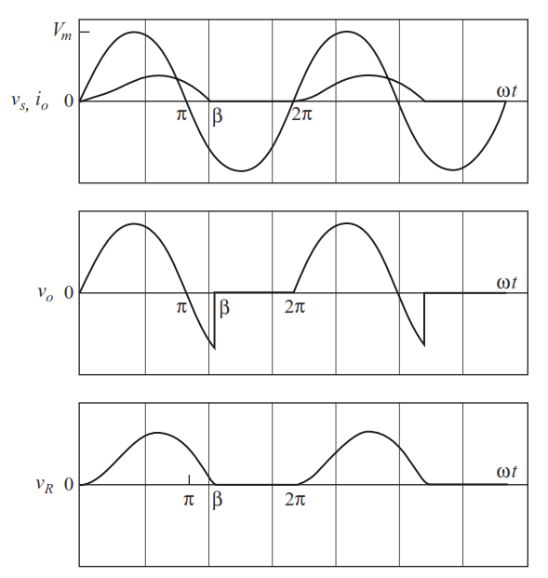
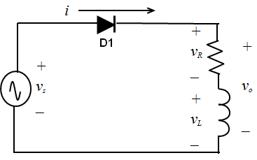
Half Wave Rectifier with Inductive Load
DET40073:POWER ELECTRONICS
Figure 2-5: Half Wave Rectifier with Inductive Load
Figure 2-6: Output Voltage and Current Waveform

Slide 13
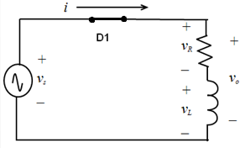
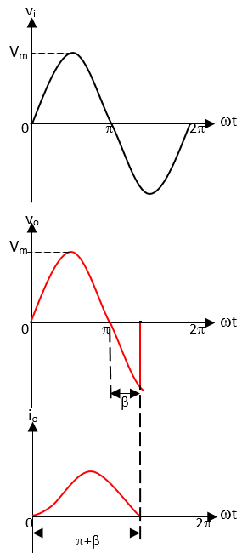
Cont. …
DET40073:POWER ELECTRONICS
Circuit operation:
During positive half cycle:
For interval 0≤ωt≤π;
Diode D₁ forward biased.
Vi increase from zero to its positive maximum value and becomes zero again at ωt=π.
For interval π≤ωt≤π+β;
Due to the inductive load, io increases slowly.
D₁ continues to conduct till the inductor currents become zero at ωt=β.
Extended angle (β) due to inductive load.

Slide 14
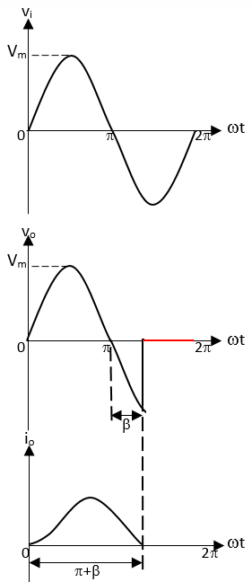
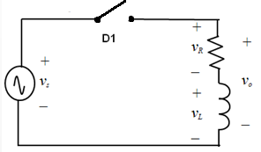
Cont. …
DET40073:POWER ELECTRONICS
Circuit operation:
During negative half cycle:
For interval π+β ≤ωt≤2π
D₁ becomes reverse biased.
Both v_{o} and i_{o} remains zero till the beginning of the next cycle.
Both Vo and io is zero.

Slide 15
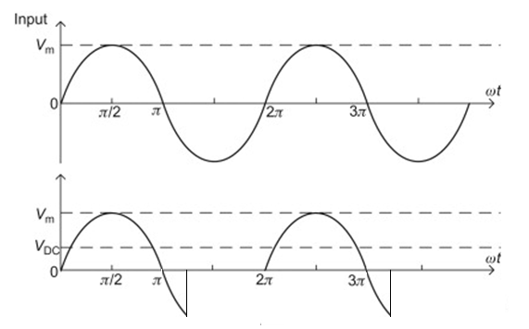
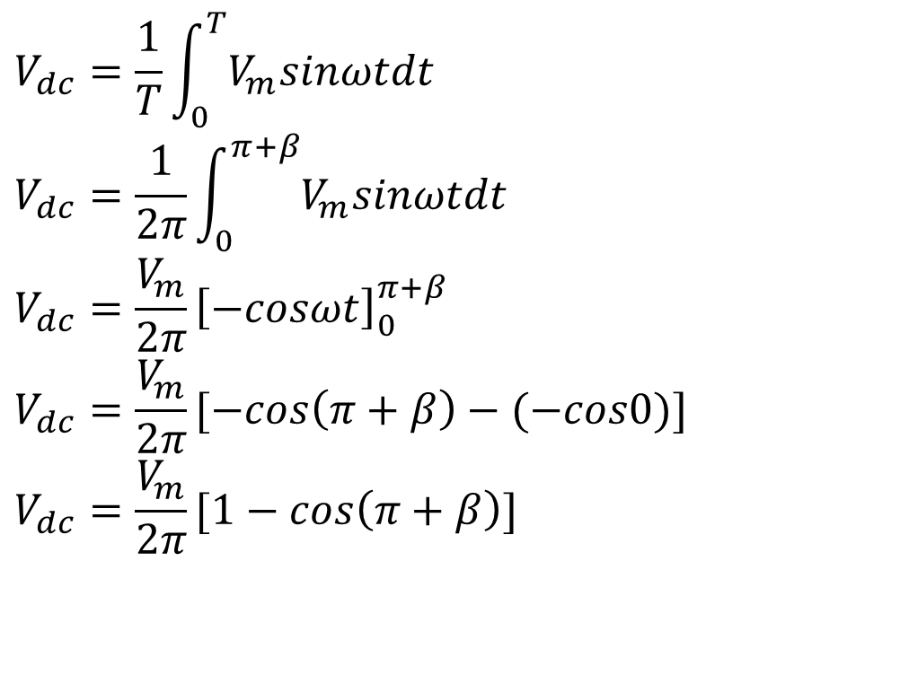


Cont. …
DET40073:POWER ELECTRONICS
Derivation for average output voltage:
$$V_{s}=V_{m}sinωt$$
$$V_{dc}=\frac{1}{T}\int_{0}^{T}{V_{m}sinωtdt}$$
$$V_{dc}=\frac{1}{2π}\int_{0}^{π+β}{V_{m}sinωtdt}$$
$$V_{dc}=\frac{V_{m}}{2π}{\left[−cosωt\right]}_{0}^{π+β}$$
$$V_{dc}=\frac{V_{m}}{2π}[−cos\left(π+β\right)−(−cos0)]$$
$$V_{dc}=\frac{V_{m}}{2π}[1−cos\left(π+β\right)]$$
π+β
$$π+$$
Figure 2-7: Input and Output Voltage Waveform

Slide 16
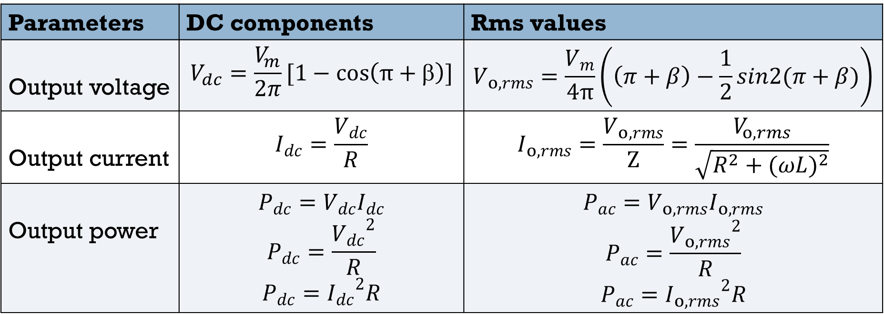
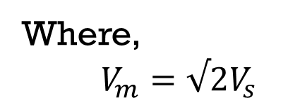

Cont. …
DET40073:POWER ELECTRONICS
Output Voltage and Current:
Parameters | DC components | Rms values
Output voltage | $$V_{dc}=\frac{V_{m}}{2π}[1−\cos\left(π+β\right)]$$ | $$V_{o,rms}=\frac{V_{m}}{4π}\left(\left(π+β\right)−\frac{1}{2}sin2(π+β)\right)$$
Output current | $$I_{dc}=\frac{V_{dc}}{R}$$ | $$I_{o,rms}=\frac{V_{o,rms}}{Z}=\frac{V_{o,rms}}{\sqrt{R^{2}+{(ωL)}^{2}}}$$
Output power | $$P_{dc}=V_{dc}I_{dc}$$ $$P_{dc}=\frac{{V_{dc}}^{2}}{R}$$ $$P_{dc}={I_{dc}}^{2}R$$ | $$P_{ac}=V_{o,rms}I_{o,rms}$$ $$P_{ac}=\frac{{V_{o,rms}}^{2}}{R}$$ $$P_{ac}={I_{o,rms}}^{2}R$$
Where,
$V_{m}=√2V_{s}$
Power factor, pf:
$$pf=\frac{P}{S}=\frac{P_{ac}}{V_{s, rms}I_{s, rms}}$$

Slide 17
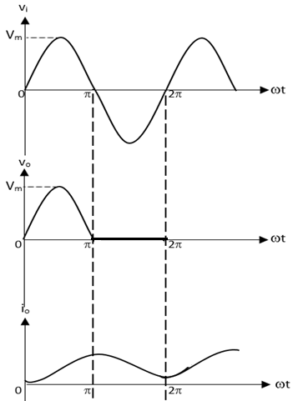
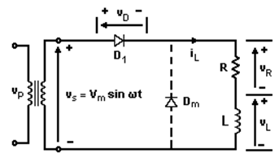
Half Wave Rectifier R-L Load with Free-Wheeling Diode
DET40073:POWER ELECTRONICS
Figure 2-8: Half Wave Rectifier with Free-Wheeling diode
Figure 2-9: Output Voltage and Current Waveform

Slide 18
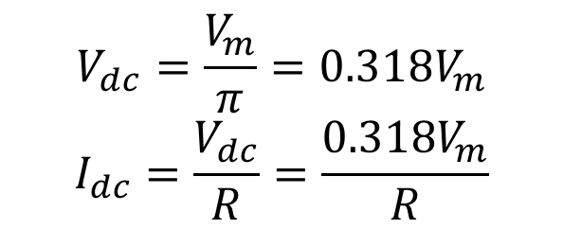
Cont. …
DET40073:POWER ELECTRONICS
Circuit operation:
Diode D_{m} will prevent negative voltage appearing across the load.
When the supply voltage goes to zero, the current from D₁ is transferred across to diode D_{m}.
This is called commutation of diodes (the charge in the inductor will be used to keep diode D_{m} on, instead of previously forcing D₁ to remain in its forward state).
This would reduce the value of the extended angle of conduction of the diode D1, β to zero.
Output Voltage and Current:
$$V_{dc}=\frac{V_{m}}{π}=0.318V_{m}$$
$$I_{dc}=\frac{V_{dc}}{R}=\frac{0.318V_{m}}{R}$$
*same as output rectifier with resistive load

Slide 19
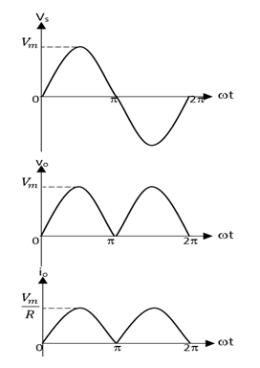
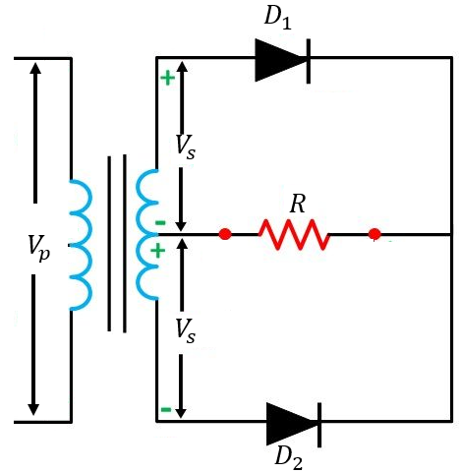
Full Wave Centre-tap Rectifier with Resistive Load
DET40073:POWER ELECTRONICS
Figure 2-10: Full Wave Centre-Tap Rectifier with Resistive Load
Figure 2-11: Output Voltage and Current Waveform

Slide 20
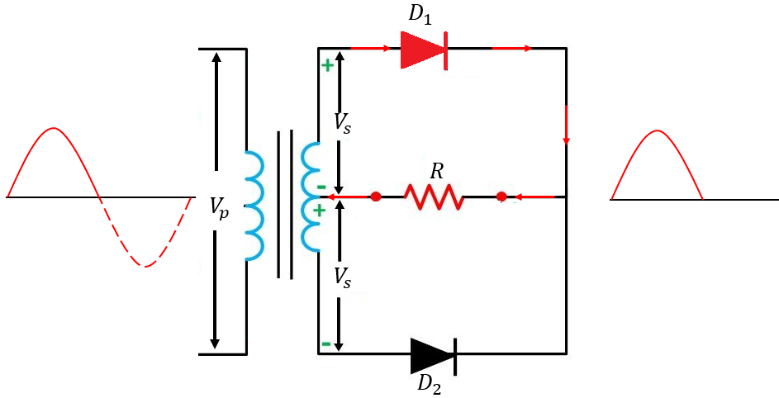
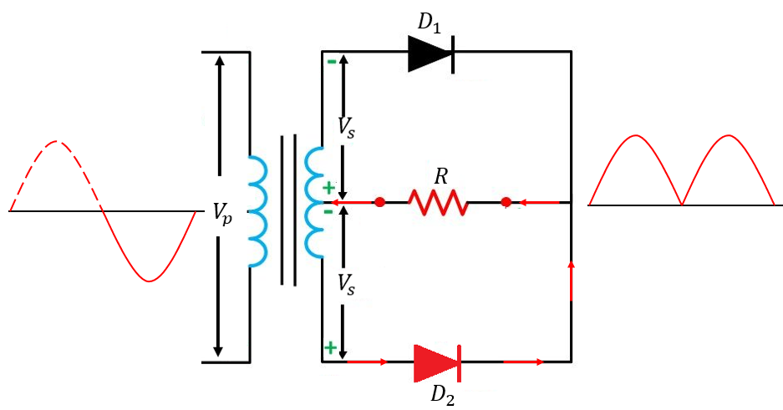
Cont. …
DET40073:POWER ELECTRONICS
Circuit operation:
During positive half cycle:
For interval 0≤ωt≤π;
Diode D₁ conducts (D₁ forward biased and D₂ reverse biased).
Vo=Vs
During negative half cycle:
For interval π≤ωt≤2π;
Diode D₂ conducts (D₂ forward biased and D₁ reverse biased).
Vo=Vs

Slide 21
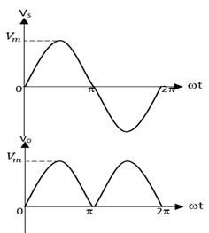
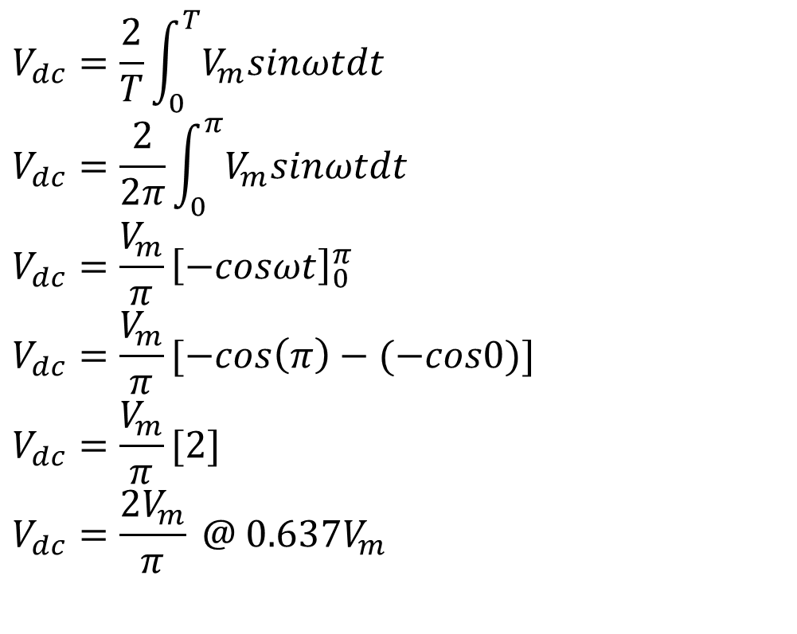
Cont. …
DET40073:POWER ELECTRONICS
Derivation for average output voltage:
$$V_{dc}=\frac{2}{T}\int_{0}^{T}{V_{m}sinωtdt}$$
$$V_{dc}=\frac{2}{2π}\int_{0}^{π}{V_{m}sinωtdt}$$
$$V_{dc}=\frac{V_{m}}{π}{\left[−cosωt\right]}_{0}^{π}$$
$$V_{dc}=\frac{V_{m}}{π}[−cos\left(π\right)−(−cos0)]$$
$$V_{dc}=\frac{V_{m}}{π}[2]$$
$$V_{dc}=\frac{{2V}_{m}}{π} @ 0.637V_{m}$$
Figure 2-12: Input and Output Voltage Waveform

Slide 22
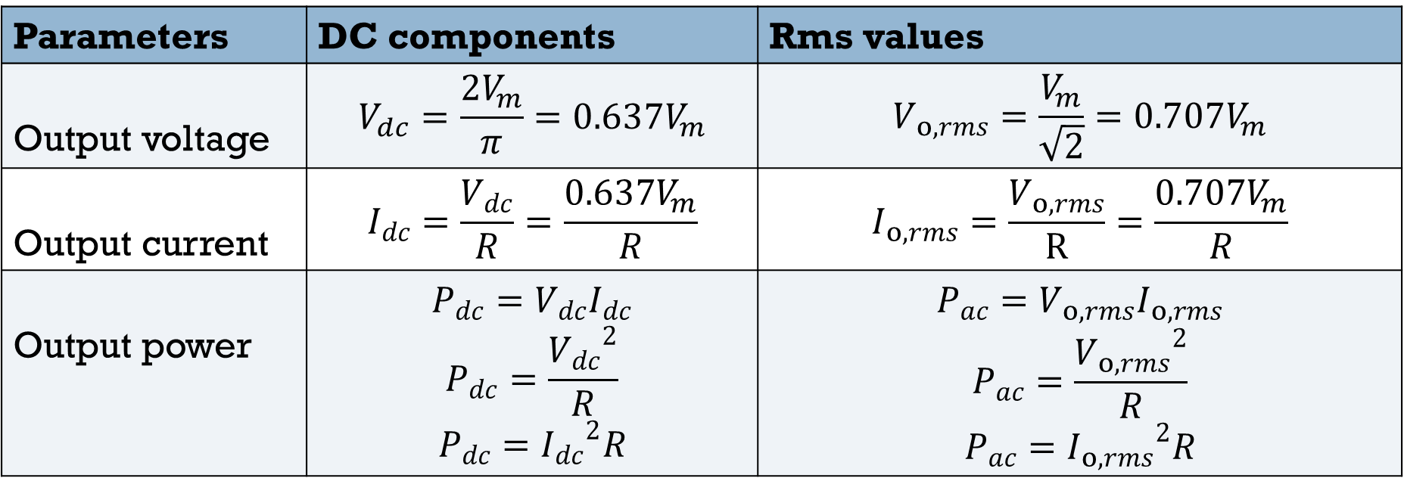
Cont. …
DET40073:POWER ELECTRONICS
Output Voltage and Current:
Parameters | DC components | Rms values
Output voltage | $$V_{dc}=\frac{{2V}_{m}}{π}=0.637V_{m}$$ | $$V_{o,rms}=\frac{V_{m}}{\sqrt{2}}=0.707V_{m}$$
Output current | $$I_{dc}=\frac{V_{dc}}{R}=\frac{0.637V_{m}}{R}$$ | $$I_{o,rms}=\frac{V_{o,rms}}{R}=\frac{0.707V_{m}}{R}$$
Output power | $$P_{dc}=V_{dc}I_{dc}$$ $$P_{dc}=\frac{{V_{dc}}^{2}}{R}$$ $$P_{dc}={I_{dc}}^{2}R$$ | $$P_{ac}=V_{o,rms}I_{o,rms}$$ $$P_{ac}=\frac{{V_{o,rms}}^{2}}{R}$$ $$P_{ac}={I_{o,rms}}^{2}R$$
Where,
$V_{m}=√2V_{s}$
Power factor, pf:
$$pf=\frac{P}{S}=\frac{P_{ac}}{V_{s, rms}I_{s, rms}}$$

Slide 23
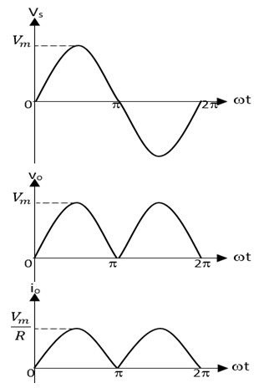
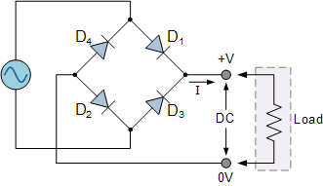
Full Wave Bridge Rectifier with Resistive Load
DET40073:POWER ELECTRONICS
Figure 2-13: Full Wave Bridge Rectifier with Resistive Load
Figure 2-14: Output Voltage and Current Waveform

Slide 24
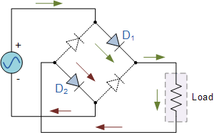
Cont. …
DET40073:POWER ELECTRONICS
Circuit operation:
During positive half cycle:
For interval 0≤ωt≤π;
Diode D₁ and D₂ conducts
The input voltage appear across the load.
Vo=Vs
During negative half cycle:
For interval π≤ωt≤2π;
Diode D₃ and D₄ conducts
The input voltage appear across the load.
Vo=Vs

Slide 25
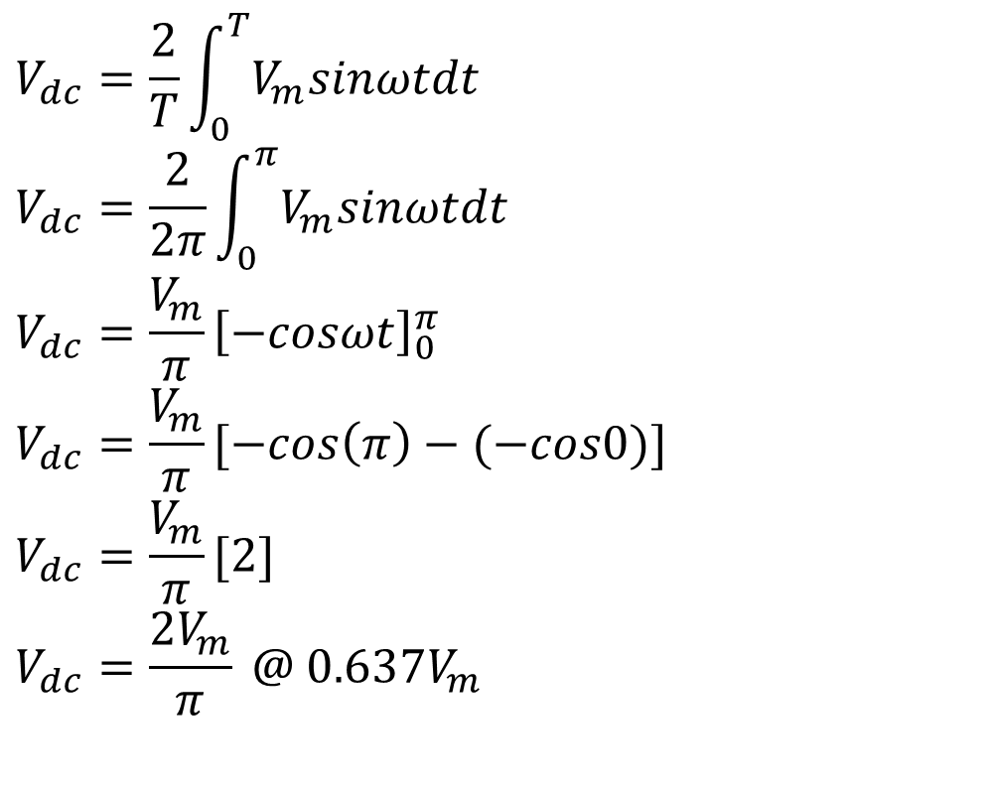
Cont. …
DET40073:POWER ELECTRONICS
Derivation for average output voltage:
$$V_{dc}=\frac{2}{T}\int_{0}^{T}{V_{m}sinωtdt}$$
$$V_{dc}=\frac{2}{2π}\int_{0}^{π}{V_{m}sinωtdt}$$
$$V_{dc}=\frac{V_{m}}{π}{\left[−cosωt\right]}_{0}^{π}$$
$$V_{dc}=\frac{V_{m}}{π}[−cos\left(π\right)−(−cos0)]$$
$$V_{dc}=\frac{V_{m}}{π}[2]$$
$$V_{dc}=\frac{{2V}_{m}}{π} @ 0.637V_{m}$$
Figure 2-15: Input and Output Voltage Waveform

Slide 26
Cont. …
DET40073:POWER ELECTRONICS
Output Voltage and Current:
Parameters | DC components | Rms values
Output voltage | $$V_{dc}=\frac{{2V}_{m}}{π}=0.637V_{m}$$ | $$V_{o, rms}=\frac{V_{m}}{\sqrt{2}}=0.707V_{m}$$
Output current | $$I_{dc}=\frac{V_{dc}}{R}=\frac{0.637V_{m}}{R}$$ | $$I_{o,rms}=\frac{V_{o,rms}}{R}=\frac{0.707V_{m}}{R}$$
Output power | $$P_{dc}=V_{dc}I_{dc}$$ $$P_{dc}=\frac{{V_{dc}}^{2}}{R}$$ $$P_{dc}={I_{dc}}^{2}R$$ | $$P_{ac}=V_{o,rms}I_{o,rms}$$ $$P_{ac}=\frac{{V_{o,rms}}^{2}}{R}$$ $$P_{ac}={I_{o,rms}}^{2}R$$
Where,
$V_{m}=√2V_{s}$
Power factor, pf:
$$pf=\frac{P}{S}=\frac{P_{ac}}{V_{s, rms}I_{s, rms}}$$

Slide 27
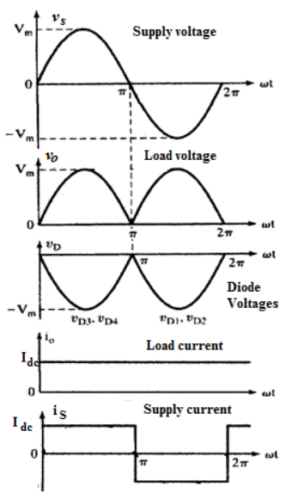
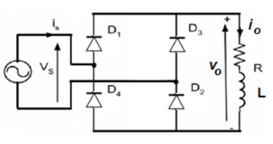
Full Wave e Rectifier with Highly Inductive Load
DET40073:POWER ELECTRONICS
Figure 2-16: Full Wave Bridge Rectifier with Highly Inductive Load
Figure 2-17: Output Voltage and Current Waveform

Slide 28

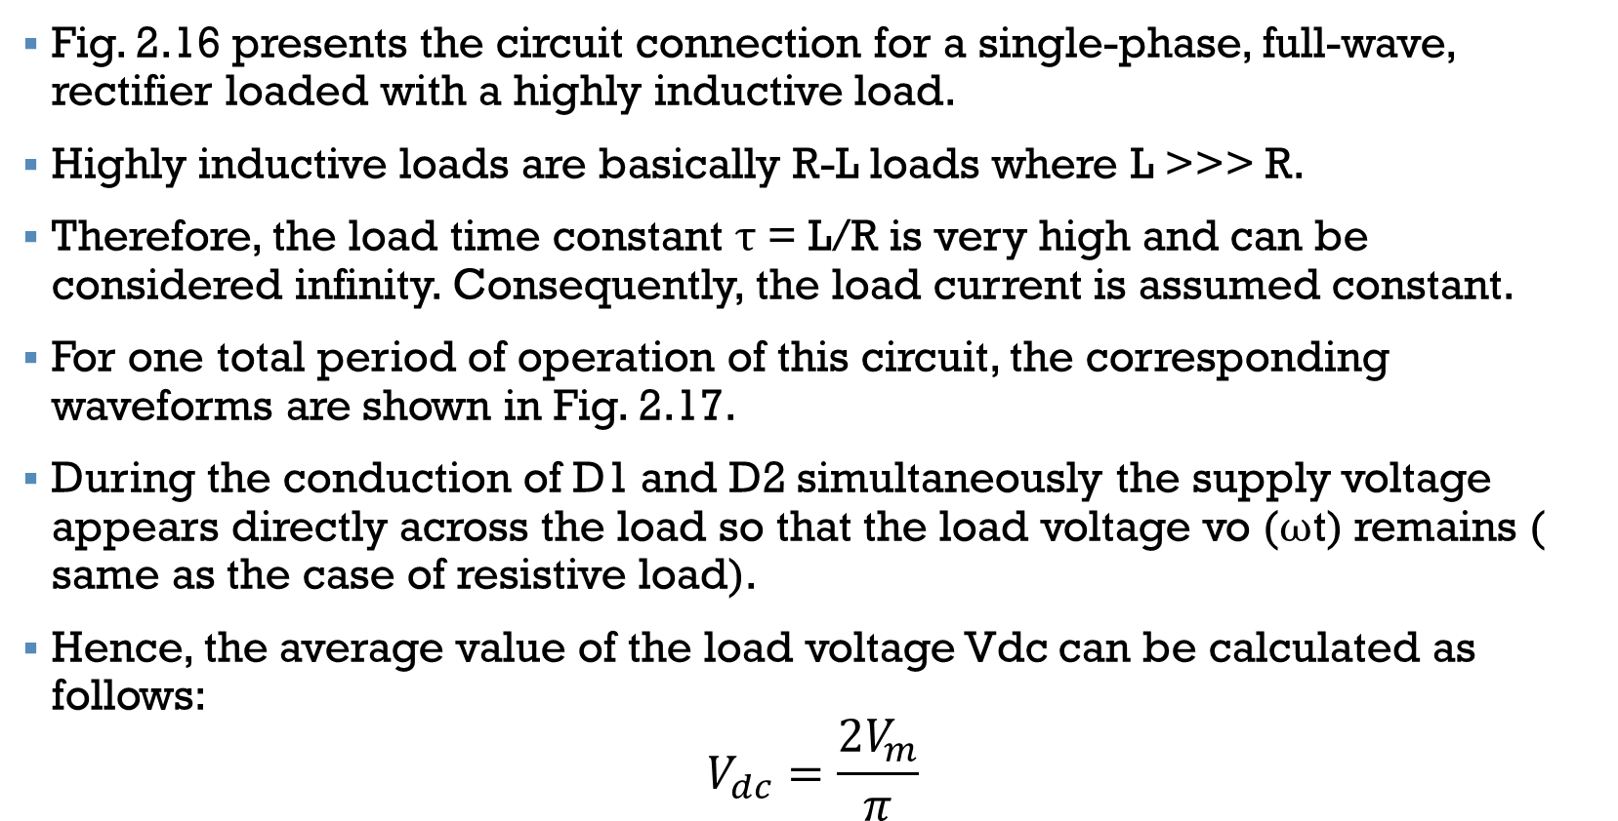
Cont. …
DET40073:POWER ELECTRONICS
Fig. 2.16 presents the circuit connection for a single-phase, full-wave, rectifier loaded with a highly inductive load.
Highly inductive loads are basically R-L loads where L >>> R.
Therefore, the load time constant τ = L/R is very high and can be considered infinity. Consequently, the load current is assumed constant.
For one total period of operation of this circuit, the corresponding waveforms are shown in Fig. 2.17.
During the conduction of D1 and D2 simultaneously the supply voltage appears directly across the load so that the load voltage vo (ωt) remains ( same as the case of resistive load).
Hence, the average value of the load voltage Vdc can be calculated as follows:
$$V_{dc}=\frac{{2V}_{m}}{π}$$

Slide 29
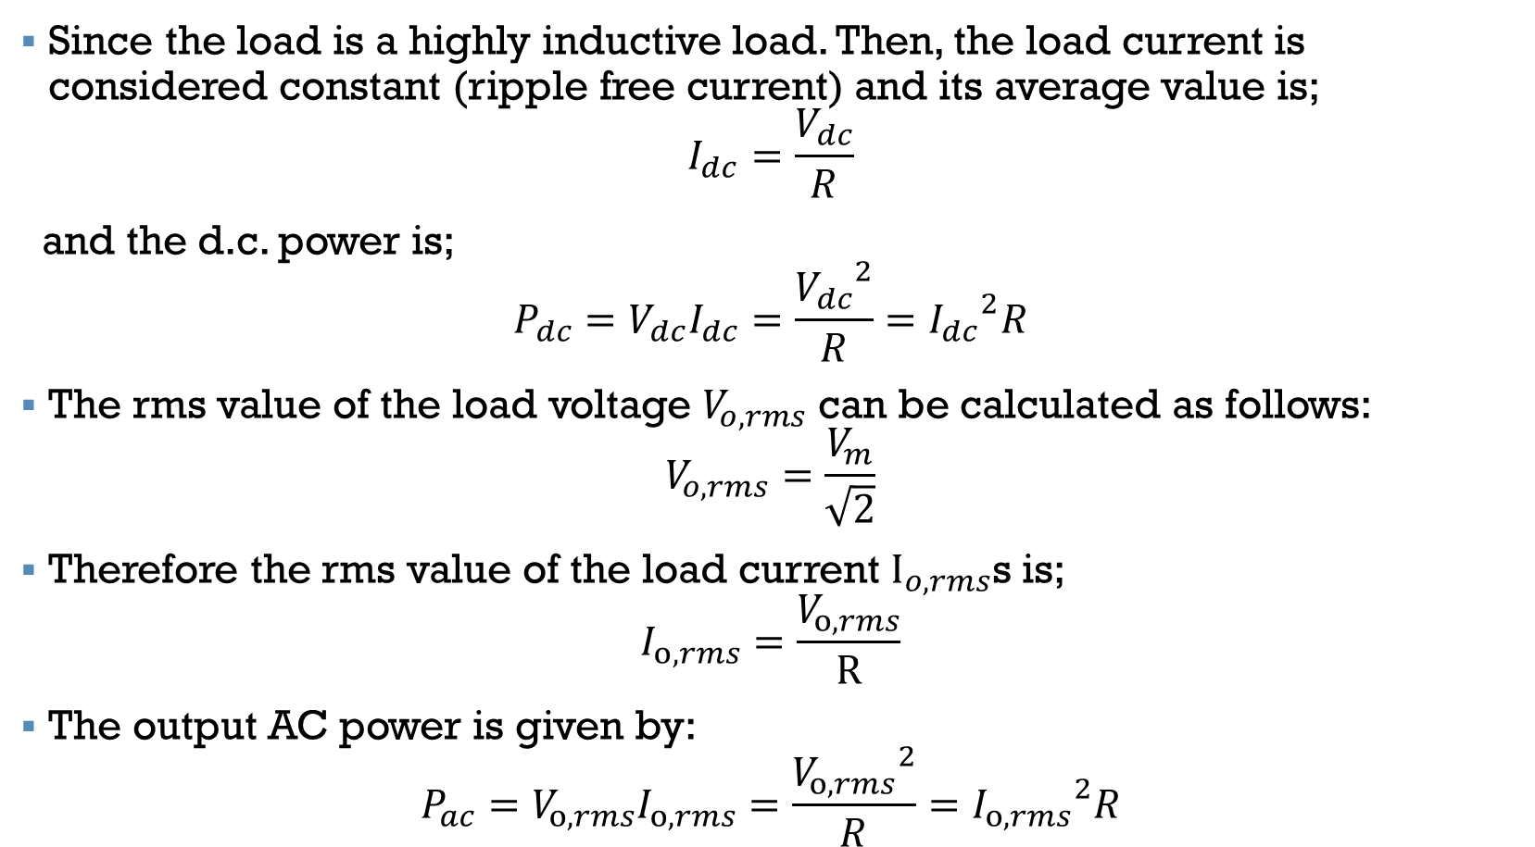
Cont. …
DET40073:POWER ELECTRONICS
Since the load is a highly inductive load. Then, the load current is considered constant (ripple free current) and its average value is;
$$I_{dc}=\frac{V_{dc}}{R}$$
and the d.c. power is;
$$P_{dc}=V_{dc}I_{dc}=\frac{{V_{dc}}^{2}}{R}={I_{dc}}^{2}R$$
The rms value of the load voltage $V_{o, rms}$ can be calculated as follows:
$$V_{o, rms}=\frac{V_{m}}{\sqrt{2}}$$
Therefore the rms value of the load current $I_{o, rms}$s is;
$$I_{o,rms}=\frac{V_{o,rms}}{R}$$
The output AC power is given by:
$$P_{ac}=V_{o,rms}I_{o,rms}=\frac{{V_{o,rms}}^{2}}{R}={I_{o,rms}}^{2}R$$

Slide 30
Example

Slide 31
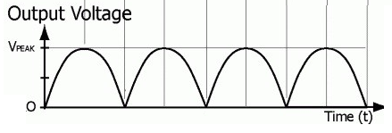
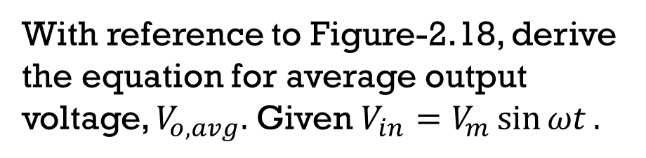
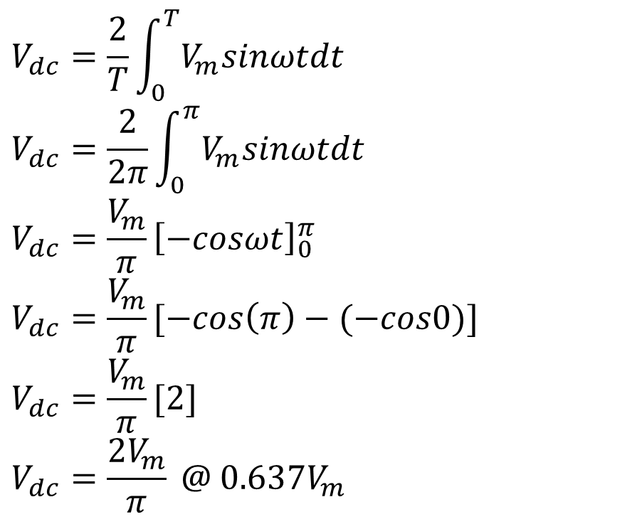
Solution:
DET40073:POWER ELECTRONICS
Example 1:
With reference to Figure-2.18, derive the equation for average output voltage, $V_{o,avg}.$ Given $V_{in}=V_{m}\sin{ωt}.$
$$V_{dc}=\frac{2}{T}\int_{0}^{T}{V_{m}sinωtdt}$$
$$V_{dc}=\frac{2}{2π}\int_{0}^{π}{V_{m}sinωtdt}$$
$$V_{dc}=\frac{V_{m}}{π}{\left[−cosωt\right]}_{0}^{π}$$
$$V_{dc}=\frac{V_{m}}{π}[−cos\left(π\right)−(−cos0)]$$
$$V_{dc}=\frac{V_{m}}{π}[2]$$
$$V_{dc}=\frac{{2V}_{m}}{π} @ 0.637V_{m}$$
π 2π 3π
Figure-2.18

Slide 32
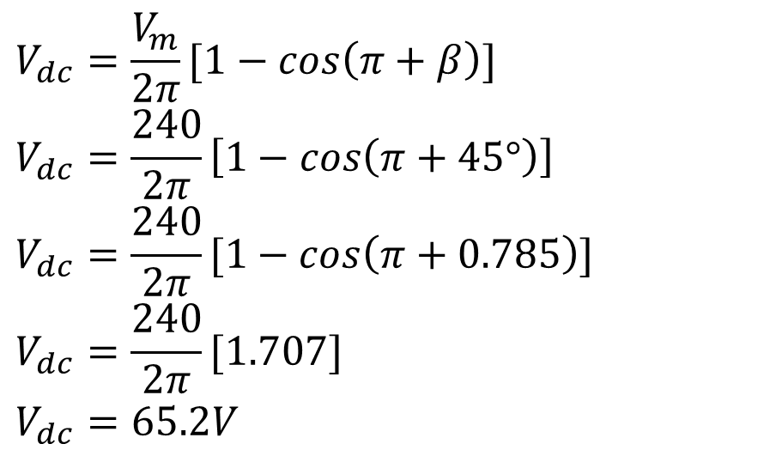
Solution:
DET40073:POWER ELECTRONICS
Example 2:
A single phase half wave uncontrolled rectifier with inductive load is connected from 240Vp, 50Hz source.
Calculate the average output voltage if given the extinction angle β=45°.
Sketch and label the input and output voltage waveform.
$$V_{dc}=\frac{V_{m}}{2π}[1−cos\left(π+β\right)]$$
$$V_{dc}=\frac{240}{2π}\left[1−cos\left(π+45°\right)\right]$$
$$V_{dc}=\frac{240}{2π}[1−cos\left(π+0.785\right)]$$
$$V_{dc}=\frac{240}{2π}[1.707]$$
$$V_{dc}=65.2V$$
Convert from deg to rad.
Calculator mode: rad

Slide 33
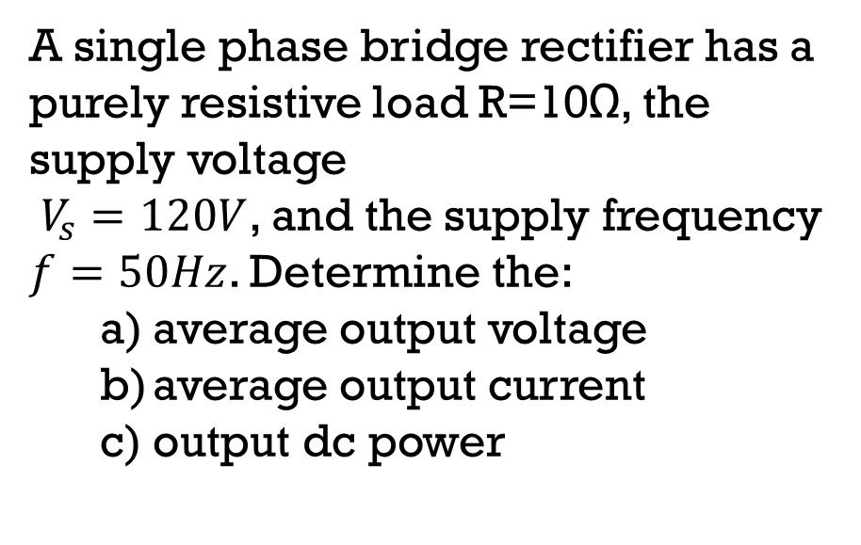
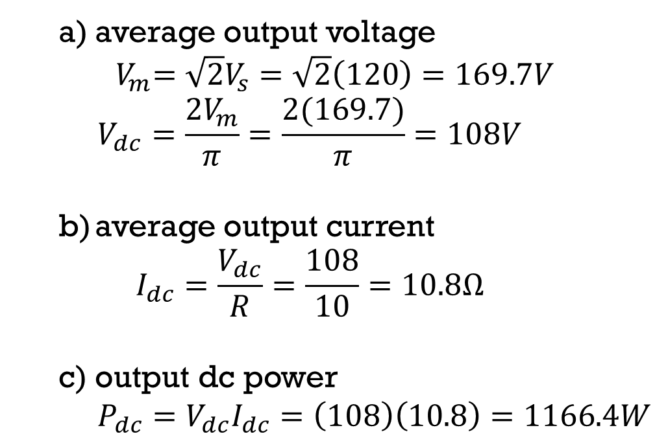
Solution:
DET40073:POWER ELECTRONICS
Example 3:
A single phase bridge rectifier has a purely resistive load R=10Ω, the supply voltage
$V_{s}=120V$, and the supply frequency $f=50Hz$. Determine the:
average output voltage
average output current
output dc power
average output voltage
${ V}_{m}=\sqrt{2}V_{s}=\sqrt{2}\left(120\right)=169.7V$
$$V_{dc}=\frac{{2V}_{m}}{π}=\frac{2(169.7)}{π}=108V$$
average output current
$$I_{dc}=\frac{V_{dc}}{R}=\frac{108}{10}=10.8Ω$$
output dc power
$P_{dc}=V_{dc}I_{dc}=\left(108\right)\left(10.8\right)=1166.4W$

Slide 34
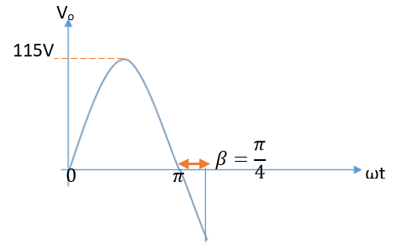
POP QUIZ
Referring to Figure-A below, calculate the average output voltage.
Figure A

Slide 35
Single Phase Controlled Rectifier
DET40073:POWER ELECTRONICS
THREE types of Single Phase Controlled Rectifier:
Half Wave Controlled Rectifier
Full Wave Controlled Centre-Tap Rectifier
Full Wave Controlled Bridge Rectifier
Controlled Rectifiers are line commutated ac to dc power converters which are used to convert a fixed voltage, fixed frequency ac power supply into variable dc output voltage.
The input supply fed to a is ac supply at a fixed rms voltage and at a fixed frequency.
By employing phase controlled thyristors in the circuits we can obtain variable dc output voltage and variable dc (average) output current by varying the trigger angle (phase angle) at which the thyristors are triggered.

Slide 36
Cont. …
DET40073:POWER ELECTRONICS
A way to control output of a rectifier is to use an SCR instead of a diode.
Two condition must be met before SCR can conduct:
SCR must be forward biased ($V_{SCR}>0).$
SCR must be forward biased (𝑽_𝑺𝑪𝑹>𝟎).
A current must be applied to the gate of SCR.
- The SCR will not begin to conduct as soon as the source becomes positive.
- Conduction is delayed until a gate current is applied.
Once SCR is conducting, the gate current can be removed and the SCR remains ON until the current goes to zero.

Slide 37
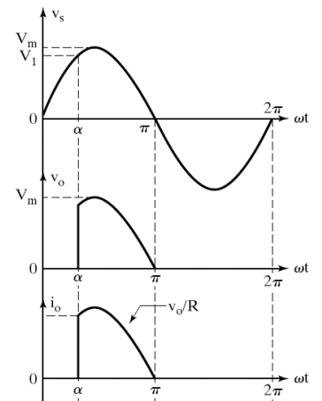

DET40073:POWER ELECTRONICS
Half Wave Controlled Rectifier with Resistive Load
Figure 2-19: Half Wave Controlled Rectifier with Resistive Load
Figure 2-20: Output Voltage and Current Waveform

Slide 38
Cont. …
DET40073:POWER ELECTRONICS
Circuit operation:
During the positive half cycle, for (0≤ωt≤ π):
The thyristor T₁ is forward biased (but not conducting at 0≤ωt≤ α)
When the thyristor is fired at ωt=α it conducts and the input voltage appears across the load (at α≤ωt≤ π).
During the negative half cycle for (π ≤ωt≤2π):
The thyristor is reversed biased and it is turned off.
Output is zero.
The delay angle α, is defined as the time the input voltage starts to go positive to the time the thyristor is fired.

Slide 39


Cont. …
DET40073:POWER ELECTRONICS
Derivation for average output voltage:
$$V_{dc}=\frac{1}{T}\int_{0}^{T}{V_{m}sinωtdt}$$
$$V_{dc}=\frac{1}{2π}\int_{α}^{π}{V_{m}sinωtdt}$$
$$V_{dc}=\frac{V_{m}}{2π}{\left[−cosωt\right]}_{α}^{π}$$
$$V_{dc}=\frac{V_{m}}{2π}[−cos\left(π\right)−(−cosα)]$$
$$V_{dc}=\frac{V_{m}}{2π}[1+cosα]$$
Figure 2-21: Input and Output Voltage Waveform

Slide 40



Cont. …
DET40073:POWER ELECTRONICS
Output Voltage and Current:
Parameters | DC components | Rms values
Output voltage | $$V_{dc}=\frac{V_{m}}{2π}[1+cosα]$$ | $$V_{o,rms}=\frac{V_{m}}{2π}\sqrt{1−\frac{α}{π}+\frac{\sin{2α}}{2π}}$$
Output current | $$I_{dc}=\frac{V_{dc}}{R}$$ | $$I_{o,rms}=\frac{V_{o,rms}}{R}$$
Output power | $$P_{dc}=V_{dc}I_{dc}$$ $$P_{dc}=\frac{{V_{dc}}^{2}}{R}$$ $$P_{dc}={I_{dc}}^{2}R$$ | $$P_{ac}=V_{o,rms}I_{o,rms}$$ $$P_{ac}=\frac{{V_{o,rms}}^{2}}{R}$$ $$P_{ac}={I_{o,rms}}^{2}R$$
Where,
$V_{m}=√2V_{s}$
Power factor, pf:
$$pf=\frac{P}{S}=\frac{P_{ac}}{V_{s, rms}I_{s, rms}}$$

Slide 41


DET40073:POWER ELECTRONICS
Half Wave Controlled Rectifier with Inductive Load
Figure 2-22: Half Wave Controlled Rectifier with Inductive Load
Figure 2-23: Output Voltage and Current Waveform

Slide 42


Cont. …
DET40073:POWER ELECTRONICS
Circuit operation:
During the positive half cycle ($0≤ωt≤π$):
At $ωt=0$, the current through the circuit is zero.
The SCR is triggered when $ωt=α$.
When $ωt=π$, the source becomes zero, but the current through the circuit is not zero and there is some energy stored in the inductor.
During the negative half cycle ($π≤ωt≤2π$):
The current through the circuit would not become zero suddenly because of the inductor.
The inductor acts as a source and keeps the SCR forward-biased till the energy stored in the inductor becomes zero.
The current through the circuit become zero at $ωt=π+β$.
For $β≤ωt≤2π$, the current through the circuit is zero

Slide 43



Cont. …
DET40073:POWER ELECTRONICS
$$V_{s}=V_{m}sinωt$$
Derivation for average output voltage:
$$V_{dc}=\frac{1}{T}\int_{α}^{T}{V_{m}sinωtdt}$$
$$V_{dc}=\frac{1}{2π}\int_{α}^{π+β}{V_{m}sinωtdt}$$
$$V_{dc}=\frac{V_{m}}{2π}{\left[−cosωt\right]}_{α}^{π+β}$$
$$V_{dc}=\frac{V_{m}}{2π}[−cos\left(π+β\right)−(−cosα)]$$
$$V_{dc}=\frac{V_{m}}{2π}[cosα−cos(π+β)]$$
Figure 2-24: Input and Output Voltage Waveform

Slide 44



Cont. …
DET40073:POWER ELECTRONICS
Output Voltage and Current:
Parameters | DC components | Rms values
Output voltage | $$V_{dc}=\frac{V_{m}}{2π}[\cos{α}−\cos\left(π+β\right)]$$ | $$V_{o,rms}=\sqrt{\frac{{V_{m}}^{2}}{4π}\left(\left(π+β\right)−α−\frac{1}{2}\sin{2\left(π+β\right)+\frac{1}{2}\sin{2α}}\right)}$$
Output current | $$I_{dc}=\frac{V_{dc}}{R}$$ | $$I_{o,rms}=\frac{V_{o,rms}}{Z}=\frac{V_{o,rms}}{\sqrt{R^{2}+{(ωL)}^{2}}}$$
Output power | $$P_{dc}=V_{dc}I_{dc}$$ $$P_{dc}=\frac{{V_{dc}}^{2}}{R}$$ $$P_{dc}={I_{dc}}^{2}R$$ | $$P_{ac}=V_{o,rms}I_{o,rms}$$ $$P_{ac}=\frac{{V_{o,rms}}^{2}}{R}$$ $$P_{ac}={I_{o,rms}}^{2}R$$
Where,
$V_{m}=√2V_{s}$
Power factor, pf:
$$pf=\frac{P}{S}=\frac{P_{ac}}{V_{s, rms}I_{s, rms}}$$

Slide 45


DET40073:POWER ELECTRONICS
Half Wave Controlled Centre-Tap Rectifier with Free-Wheeling Diode
Figure 2-25: Half Wave Controlled Rectifier with Free Wheeling Diode
Figure 2-26: Output Voltage and Current Waveform

Slide 46
Cont. …
DET40073:POWER ELECTRONICS
Function of Free Wheeling Diode:
Diode D_{m} will prevent negative voltage appearing across the load during negative cycle of input voltage.
When the supply voltage goes to zero at ωt=π, the current from inductor is transferred across diode D_{m}.
This is called commutation of SCR.
The result is the charge in the inductor will be used to keep diode D_{m} on, instead of previously forcing SCR to remain in its forward state.
This would reduce the value of the extended angle of conduction of the SCR, β to zero.

Slide 47

Cont. …
DET40073:POWER ELECTRONICS
Circuit operation:
During the positive half cycle, for interval (0≤ωt≤ π):
At wt =0, the current through the circuit is zero.
The SCR is triggered when wt=a.
The input voltage appears across the load
During negative half cycle, for interval (π ≤ωt≤ 2π):
The supply voltage goes to zero at ωt=π
The current from inductor is transferred across diode D_{m}.
Output is zero.

Slide 48

Cont. …
DET40073:POWER ELECTRONICS
Derivation for average output voltage:
$$V_{dc}=\frac{1}{T}\int_{0}^{T}{V_{m}sinωtdt}$$
$$V_{dc}=\frac{1}{2π}\int_{α}^{π}{V_{m}sinωtdt}$$
$$V_{dc}=\frac{V_{m}}{2π}{\left[−cosωt\right]}_{α}^{π}$$
$$V_{dc}=\frac{V_{m}}{2π}[−cos\left(π\right)−(−cosα)]$$
$$V_{dc}=\frac{V_{m}}{2π}[1+cosα]$$
Figure 2-27: Input and Output Voltage Waveform
*same as output rectifier with resistive load

Slide 49




DET40073:POWER ELECTRONICS
Full Wave Controlled Rectifier with Resistive Load
$$v_{s1}$$
$$v_{s2}$$
Figure 2-28: Full Wave Controlled Centre-tap Rectifier with Resistive Load
Figure 2-29: Output Voltage and Current Waveform

Slide 50

Cont. …
DET40073:POWER ELECTRONICS
Circuit operation:
During positive half cycle, for interval (0≤ωt≤π):
SCR₁ is forward biased.
When SCR₁ is fired at ωt=α, it conducts and the input voltage appears across the load (at α≤ωt≤π).
During the negative half cycle, for interval (π ≤ωt≤2π):
SCR₂ is forward biased.
When SCR₂ is fired at ωt=π+α and it conduct until 2π.
The input voltage appears across the load(at π+α≤ωt≤2π).

Slide 51


Cont. …
DET40073:POWER ELECTRONICS
Derivation for average output voltage:
$$V_{dc}=\frac{2}{T}\int_{α}^{T}{V_{m}sinωtdt}$$
$$V_{dc}=\frac{2}{2π}\int_{α}^{π}{V_{m}sinωtdt}$$
$$V_{dc}=\frac{V_{m}}{π}{\left[−cosωt\right]}_{α}^{π}$$
$$V_{dc}=\frac{V_{m}}{π}[−cos\left(π\right)−(−cosα)]$$
$$V_{dc}=\frac{V_{m}}{π}[1+cosα]$$
Figure 2-30: Input and Output Voltage Waveform

Slide 52

Cont. …
DET40073:POWER ELECTRONICS
Output Voltage and Current:
Parameters | DC components | Rms values
Output voltage | $$V_{dc}=\frac{V_{m}}{π}[1+cosα]$$ | $$V_{o,rms}=V_{m}\sqrt{\frac{1}{2}−\frac{α}{2π}+\frac{\sin{(2α)}}{4π}}$$
Output current | $$I_{dc}=\frac{V_{dc}}{R}$$ | $$I_{o,rms}=\frac{V_{o,rms}}{R}$$
Output power | $$P_{dc}=V_{dc}I_{dc}$$ $$P_{dc}=\frac{{V_{dc}}^{2}}{R}$$ $$P_{dc}={I_{dc}}^{2}R$$ | $$P_{ac}=V_{o,rms}I_{o,rms}$$ $$P_{ac}=\frac{{V_{o,rms}}^{2}}{R}$$ $$P_{ac}={I_{o,rms}}^{2}R$$
Where,
$V_{m}=√2V_{s}$
Power factor, pf:
$$pf=\frac{P}{S}=\frac{P_{ac}}{V_{s, rms}I_{s, rms}}$$

Slide 53


DET40073:POWER ELECTRONICS
Full Wave Controlled Centre-Tap Rectifier with Highly Inductive Load
Figure 2-31: Full Wave Controlled Centre-tap Rectifier with Inductive Load
Figure 2-32: Output Voltage and Current Waveform

Slide 54

Cont. …
DET40073:POWER ELECTRONICS
Highly inductive load, L>>R:
The high-load inductance generates a perfectly filtered current and the rectifier behaves like a current source.
Referring to Figure 2-31, ${SCR}_{1}$ can be fired into the on-state at any time after $v_{s1}$ goes positive. One ${SCR}_{1}$ is turned-on, current builds up in the inductive load, maintaining ${SCR}_{1}$ in the on-state up to the period when $v_{s1}$goes negative. Once $v_{s1}$goes negative, $v_{s2}$ becomes positive, and the firing ${SCR}_{2}$immediately turns on thyristor ${SCR}_{2}$ which takes up the load current, placing reverse voltage on ${SCR}_{1}$, its current being commutated (transferred) to ${SCR}_{2}$.
The load current can be continuous or discontinuous depending on the inductance value.

Slide 55

Cont. …
DET40073:POWER ELECTRONICS
Circuit operation:
During positive half cycle, for interval (0≤ωt≤π):
SCR₁ is forward biased and conduct when ωt=α.
Due to inductive load, SCR₁ continue to conduct beyond ωt=π.
During the negative half cycle, for interval (π ≤ωt≤2π):
SCR₂ is forward biased and conducts at ωt=π+α.
SCR₁ continue to conduct beyond ωt=2π.

Slide 56


Cont. …
DET40073:POWER ELECTRONICS
Derivation of average output voltage:
$$V_{dc}=\frac{2}{T}\int_{α}^{T}{V_{m}sinωtdt}$$
$$V_{dc}=\frac{2}{2π}\int_{α}^{π+α}{V_{m}sinωtdt}$$
$$V_{dc}=\frac{V_{m}}{π}{\left[−cosωt\right]}_{α}^{π+α}$$
$$V_{dc}=\frac{V_{m}}{π}[−\cos\left(π+α\right)−\left(−cosα\right)]$$
$$V_{dc}=\frac{V_{m}}{π}[cosα−\cos\left(π+α\right)]$$
@
$$V_{dc}=\frac{V_{m}}{π}[2cosα]$$
$$V_{dc}=\frac{{2V}_{m}}{π}[cosα]$$
Figure 2-33: Input and Output Voltage Waveform

Slide 57

Cont. …
DET40073:POWER ELECTRONICS
Output Voltage and Current:
Parameters | DC components | Rms values
Output voltage | $$V_{dc}=\frac{{2V}_{m}}{π}[cosα]$$ | $$V_{o,rms}=\frac{V_{m}}{\sqrt{2}}=V_{s}$$
Output current | $$I_{dc}=\frac{V_{dc}}{R}$$ | $$I_{o,rms}=\frac{V_{o,rms}}{Z}=\frac{V_{o,rms}}{\sqrt{R^{2}+{(ωL)}^{2}}}$$
Output power | $$P_{dc}=V_{dc}I_{dc}$$ $$P_{dc}=\frac{{V_{dc}}^{2}}{R}$$ $$P_{dc}={I_{dc}}^{2}R$$ | $$P_{ac}=V_{o,rms}I_{o,rms}$$ $$P_{ac}=\frac{{V_{o,rms}}^{2}}{R}$$ $$P_{ac}={I_{o,rms}}^{2}R$$
Where,
$V_{m}=√2V_{s}$
Power factor, pf:
$$pf=\frac{P}{S}=\frac{P_{ac}}{V_{s, rms}I_{s, rms}}$$

Slide 58


DET40073:POWER ELECTRONICS
Full Wave Controlled Centre-Tap Rectifier with Free-Wheeling Diode
Figure 2-34: Full Wave Controlled Centre-tap Rectifier with Free Wheeling Diode
Figure 2-35: Output Voltage and Current Waveform

Slide 59

Cont. …
DET40073:POWER ELECTRONICS
Derivation of average output voltage:
$$V_{dc}=\frac{2}{T}\int_{α}^{T}{V_{m}sinωtdt}$$
$$V_{dc}=\frac{2}{2π}\int_{α}^{π}{V_{m}sinωtdt}$$
$$V_{dc}=\frac{V_{m}}{π}{\left[−cosωt\right]}_{α}^{π}$$
$$V_{dc}=\frac{V_{m}}{π}[−cos\left(π\right)−(−cosα)]$$
$$V_{dc}=\frac{V_{m}}{π}[1+cosα]$$
Figure 2-36: Input and Output Voltage Waveform
*same as output rectifier with resistive load

Slide 60


DET40073:POWER ELECTRONICS
Full Wave Controlled Bridge Rectifier with Resistive Load
Figure 2-37: Full Wave Controlled Bridge Rectifier with Resistive Load
Figure 2-38: Output Voltage and Current Waveform

Slide 61
Cont. …
DET40073:POWER ELECTRONICS
Circuit operation:
During positive half cycle, for interval (0≤ωt≤π):
SCR₁ and SCR₄ forward biased.
When SCR₁ and SCR₄ is fired at ωt=α, it conducts and the input voltage appears across the load(at α≤ωt≤π).
During the negative half cycle, for interval (π ≤ωt≤2π):
SCR₂ and SCR₃ is forward biased.
When SCR₂ and SCR₃ is fired at ωt=π+α and it conduct until 2π.
The input voltage appears across the load(at π+α≤ωt≤2π).

Slide 62

Cont. …
DET40073:POWER ELECTRONICS
Derivation of average output voltage:
$$V_{dc}=\frac{2}{T}\int_{α}^{T}{V_{m}sinωtdt}$$
$$V_{dc}=\frac{2}{2π}\int_{α}^{π}{V_{m}sinωtdt}$$
$$V_{dc}=\frac{V_{m}}{π}{\left[−cosωt\right]}_{α}^{π}$$
$$V_{dc}=\frac{V_{m}}{π}[−cos\left(π\right)−(−cosα)]$$
$$V_{dc}=\frac{V_{m}}{π}[1+cosα]$$
Figure 2-39: Input and Output Voltage Waveform
*note that the derivation for output voltage for full wave centre-tap and full wave bridge rectifier is same because both rectifier generates the same output waveform.

Slide 63
Cont. …
DET40073:POWER ELECTRONICS
Output Voltage and Current:
Parameters | DC components | Rms values
Output voltage | $$V_{dc}=\frac{V_{m}}{π}[1+cosα]$$ | $$V_{o,rms}=V_{m}\sqrt{\frac{1}{2}−\frac{α}{2π}+\frac{\sin{(2α)}}{4π}}$$
Output current | $$I_{dc}=\frac{V_{dc}}{R}$$ | $$I_{o,rms}=\frac{V_{o,rms}}{R}$$
Output power | $$P_{dc}=V_{dc}I_{dc}$$ $$P_{dc}=\frac{{V_{dc}}^{2}}{R}$$ $$P_{dc}={I_{dc}}^{2}R$$ | $$P_{ac}=V_{o,rms}I_{o,rms}$$ $$P_{ac}=\frac{{V_{o,rms}}^{2}}{R}$$ $$P_{ac}={I_{o,rms}}^{2}R$$
Where,
$V_{m}=√2V_{s}$
Power factor, pf:
$$pf=\frac{P}{S}=\frac{P_{ac}}{V_{s, rms}I_{s, rms}}$$

Slide 64


DET40073:POWER ELECTRONICS
Full Wave Controlled Bridge Rectifier with Inductive Load
Figure 2-40: Full Wave Controlled Bridge Rectifier with Resistive Load
Figure 2-41: Output Voltage and Current Waveform

Slide 65

Cont. …
DET40073:POWER ELECTRONICS
Circuit operation:
During positive half cycle, for interval ($0≤ωt≤π$):
SCR₁ and SCR₄ is triggered when $ωt=α$.
When $ωt=π$, the source becomes zero, but the current through the circuit is not zero and there is some energy stored in the inductor.
It and keeps the SCR₁ and SCR₄ forward-biased till the energy stored in the inductor becomes zero at $ωt=π+β$.
During the negative half cycle, for interval ($0≤ωt≤2π$):
SCR₂ and SCR₃ is triggered when $ωt=π+α$
When $ωt=2π$, the source becomes zero, but the current through the circuit is not zero and there is some energy stored in the inductor.
It and keeps the SCR₂ and SCR₃ forward-biased till the energy stored in the inductor becomes zero at $ωt=2π+β$.

Slide 66


Cont. …
DET40073:POWER ELECTRONICS
Derivation of average output voltage:
$$V_{dc}=\frac{2}{T}\int_{α}^{T}{V_{m}sinωtdt}$$
$$V_{dc}=\frac{2}{2π}\int_{α}^{π+β}{V_{m}sinωtdt}$$
$$V_{dc}=\frac{V_{m}}{π}{\left[−cosωt\right]}_{α}^{π+β}$$
$$V_{dc}=\frac{V_{m}}{π}[−cos\left(π+β\right)−(−cosα)]$$
$$V_{dc}=\frac{V_{m}}{π}[cosα−cos(π+β)]$$
Figure 2-42: Input and Output Voltage Waveform

Slide 67

Cont. …
DET40073:POWER ELECTRONICS
Output Voltage and Current:
Parameters | DC components | Rms values
Output voltage | $$V_{dc}=\frac{V_{m}}{π}(\cos{α}−\cos{(π+β)}$$ | $$V_{o,rms}=\sqrt{\frac{{V_{m}}^{2}}{2π}\left[\left(π+β\right)−α−\frac{1}{2}\sin{2\left(π+β\right)+\frac{1}{2}\sin{2α}}\right]}$$
Output current | $$I_{dc}=\frac{V_{dc}}{R}$$ | $$I_{o,rms}=\frac{V_{o,rms}}{Z}=\frac{V_{o,rms}}{\sqrt{R^{2}+{(ωL)}^{2}}}$$
Output power | $$P_{dc}=V_{dc}I_{dc}$$ $$P_{dc}=\frac{{V_{dc}}^{2}}{R}$$ $$P_{dc}={I_{dc}}^{2}R$$ | $$P_{ac}=V_{o,rms}I_{o,rms}$$ $$P_{ac}=\frac{{V_{o,rms}}^{2}}{R}$$ $$P_{ac}={I_{o,rms}}^{2}R$$
Where,
$V_{m}=√2V_{s}$
Power factor, pf:
$$pf=\frac{P}{S}=\frac{P_{ac}}{V_{s, rms}I_{s, rms}}$$

Slide 68
Example

Slide 69







Solution:
DET40073:POWER ELECTRONICS
Example 4:
Based on Figure 2-44 below:
Explain the operation for interval $α≤ωt≤π+β$.
Calculate the average output voltage and current if the peak voltage is 115V and the resistive load R=25Ω.
Circuit operation:
During interval$α≤ωt≤π+β$:
The SCR is triggered when $ωt=α$.
When $ωt=π$, the source becomes zero, but the current through the circuit is not zero and there is some energy stored in the inductor.
The inductor acts as a source and keeps the SCR forward-biased till the energy stored in the inductor becomes zero.
The current through the circuit become zero at $ωt=π+β$.
average output voltage and current:
$$45°$$
$$V_{dc}=\frac{V_{m}}{2π}[1+cosα]$$
$$V_{dc}=\frac{115}{2π}[1+cos⁡(45°)]$$
$$V_{dc}=\frac{115}{2π}[1+cos⁡(0.786)]$$
$$V_{dc}=31.24V$$
$$I_{dc}=\frac{V_{dc}}{R}$$
$$I_{dc}=\frac{31.24}{25}$$
$$I_{dc}=1.25A$$
$$225°$$
Figure 2-44

Slide 70


Solution:
DET40073:POWER ELECTRONICS
Example 5:
Dc output current:
$$V_{dc}=\frac{V_{m}}{π}[1+cosα]$$
$$V_{dc}=\frac{\sqrt{2}(120)}{π}\left[1+\cos\left(40°\right)\right]$$
$$V_{dc}=\frac{169.7}{π}[1+cos⁡(0.698)]$$
$$V_{dc}=95.4V$$
$$I_{dc}=\frac{V_{dc}}{R}=\frac{95.4}{20}=4.77A$$
Dc output power:
$$P_{dc}=I_{dc}V_{dc}$$
$$P_{dc}=\left(4.77\right)\left(95.4\right)P_{dc}=455.06W$$
A full wave centre-tap rectifier has an ac input of 120$V_{rms}$ at 50Hz, and a 20Ω load resistor. The delay angle is $40°$. Determine the dc output current and power.

Slide 71


Solution:
DET40073:POWER ELECTRONICS
Example 6:
A controlled full wave bridge rectifier has a source of 120$V_{rms}$ at 60Hz, R=10Ω, L=10mH, and $α=60°$ and $β=30°$. Determine:
An expression of average output voltage
Average output voltage and current.
Sketch the output voltage and current.
An expression of average output voltage:
$$V_{dc}=\frac{2}{T}\int_{α}^{T}{V_{m}sinωtdt}$$
$$V_{dc}=\frac{2}{2π}\int_{α}^{π+β}{V_{m}sinωtdt}$$
$$V_{dc}=\frac{V_{m}}{π}{\left[−cosωt\right]}_{α}^{π+β}$$
$$V_{dc}=\frac{V_{m}}{π}[−cos\left(π+β\right)−(−cosα)]$$
$$V_{dc}=\frac{V_{m}}{π}[cosα−cos(π+β)]$$

Slide 72


Cont. …
DET40073:POWER ELECTRONICS
Average output voltage and current.
$$V_{dc}=\frac{V_{m}}{π}[cosα−cos(π+β)]$$
$$V_{dc}=\frac{\sqrt{2}V_{s}}{π}[cosα−cos(π+β)]$$
$$V_{dc}=\frac{\sqrt{2}(120)}{π}[cos⁡(60°)−cos(π+30°)]$$
$$V_{dc}=\frac{169.7}{π}\left[\cos\left(1.047\right)−\cos{(π+0.526)}\right]$$
$$V_{dc}=\frac{169.7}{π}\left[1.365\right]$$
$$V_{dc}=73.73V$$
$$I_{dc}=\frac{V_{dc}}{R}=\frac{73.73}{10}=7.373A$$
Sketch the output voltage and current.

Slide 73
2.3 Investigate the principle operation of Single Phase Half Wave Ac to Dc Converter: 2.3.1 Analyze effects of inductive load 2.3.2 Investigate method used to overcome the effects appeared due to existence of inductance loads.
DET40073:POWER ELECTRONICS

Slide 74
Cont. …
DET40073:POWER ELECTRONICS
The effect of load inductance:
Due to the presence of load inductance the output voltage reverses and becomes negative.
This reduces the dc output voltage.
Method used to overcome:
To prevent this reduction of dc output voltage due to the negative region in the output load voltage waveform, a free wheeling diode is connected across the load.
The output voltage waveform and the dc output voltage obtained would be the same as that for a rectifier with resistive load.

Slide 75
2.4 Investigate the principle operation of Single Phase Half Wave Ac to Dc Converter: 2.4.1 Analyze the differences of continuous and discontinuous output current.
DET40073:POWER ELECTRONICS

Slide 76




Cont. …
DET40073:POWER ELECTRONICS
Continuous current:
RL load of continuous current is shown in Figure 2-43(a).
In continuous current, the current at $ωt=π+α$must be greater than zero for continuous current operation.
Case of RL load with large R/L ratio.
$α=β$
$Vo=\frac{2Vm}{π}[cos α$]
Figure 2-43(a): Continuous current for RL load
Discontinuous current:
RL load of discontinuous current is shown in Figure 2-43(b).
The current remains at zero at $ωt=π+α$.
Case of RL load with small R/L ratio.
$β<α.$
Figure 2-43(b): Discontinuous current for RL load

Slide 77

2.5 Apply the principle operation of three phase half wave AC to DC Converter.
DET40073:POWER ELECTRONICS

Slide 78

Three Phase Uncontrolled Rectifier
DET40073:POWER ELECTRONICS
Three-phase diode rectifier circuits are used widely in high power applications with low output ripple.
Operate from 3 phase ac supply voltage
They provide higher dc output voltage and higher dc output power.
Higher output voltage ripple frequency
Extensively used in high power variable speed industrial dc drives.

Slide 79



Cont. …
DET40073:POWER ELECTRONICS
Figure 2-45: 3-phase Waveform
Figure 2-46: 3-phase Supply Voltage

Slide 80

DET40073:POWER ELECTRONICS
Three Phase Half Wave Rectifier
Using THREE diodes/SCRs.
Three-phase diode rectifier circuits are used widely in high power applications with low output ripple.
The advantage here is that 3-phase rectification circuits can be used to power many industrial applications such as motor control or battery charging which require higher power requirements than a single-phase rectifier circuit is able to supply.

Slide 81



DET40073:POWER ELECTRONICS
3-φ Half Wave Uncontrolled Rectifier with Resistive Load
Figure 2-47: Half Wave Rectifier with Resistive Load
Figure 2-48: Output Voltage
Waveform

Slide 82

Cont. …
DET40073:POWER ELECTRONICS
Circuit operation:
While V₁ is the most positive phase, diode D₁ conduct but directly V₂ become more positive than V₁, the load current commutates(transfers) from diode D₁ to diode D₂
Once V₃ is more positive than V₂ the load current commutates (transfers) from diode D₂ to diode D₃ and the process is repeat on the next cycle.

Slide 83







Cont. …
DET40073:POWER ELECTRONICS
Output waveform:
$$V_{CN}$$
$$V_{AN}$$
$$V_{BN}$$
$$V_{CN}$$
Period | On diode | Off diodes | Output Phase Voltage
0 - 30° | $$D_{3}$$ | $D_{1}$ & $D_{2}$ | $$V_{CN}$$
30°- 150° | $$D_{1}$$ | $D_{2}$ & $D_{3}$ | $$V_{AN}$$
150°- 270° | $$D_{2}$$ | $D_{1}$ & $D_{3}$ | $$V_{BN}$$
270°- 390° | $$D_{3}$$ | $D_{1}$ & $D_{2}$ | $$V_{CN}$$

Slide 84


Cont. …
DET40073:POWER ELECTRONICS
Output Voltage
and Current
$$Vph\left(max\right)=\sqrt{2}.Vrms$$

Slide 85




DET40073:POWER ELECTRONICS
3-φ Half Wave Controlled Rectifier with Resistive Load
Figure 2-49: Half Wave Controlled Rectifier with Resistive Load
Figure 2-50: Output Voltage Waveform

Slide 86




Cont. …
DET40073:POWER ELECTRONICS
Circuit operation:
T₁is triggered at $ωt=\left(\frac{π}{6}+α \right)=\left(30°+α\right)$and the phase voltage $v_{an}$ appears across the load until T₂ is fired.
T₂ is triggered at $ωt=\left(\frac{5π}{6}+α \right)=\left(150°+α\right)$, T₁ becomes reverse biased and the phase voltage $v_{bn}$ appears across the load until T₃ is fired.
T₃ is triggered at $ωt=\left(\frac{3π}{2}+α \right)=\left(270°+α\right)$, T₂ becomes reverse biased and the phase voltage $v_{cn}$ appears across the load until T₁ is fired for the next input cycle.

Slide 87



Cont. …
DET40073:POWER ELECTRONICS
For α < 30 :
Output Voltage
and Current
For α > 30 :
V$m=\sqrt{2}.Vrms$

Slide 88




DET40073:POWER ELECTRONICS
3-φ Half Wave Controlled Rectifier (R Load) with Different Triggering Angle, $α$.
Figure 2-51: Output Voltage Waveform with Different Triggering Angle, $α$.

Slide 90



THREE PHASE HALF WAVE CONTROLLED RECTIFIER
WITH R-L LOAD
Vin
VA VB VC
VA
VB
0°
120°
240°
VC
Vo, RL load
β
β
β
α
α
α
Va = 30° + α Vb = 150° + α Vc = 270° + α

Slide 91

THREE PHASE HALF WAVE CONTROLLED RECTIFIER WITH R-L LOAD
Output Voltage Waveform for Different Trigger Angles

Slide 92
Example

Slide 93



Solution:
DET40073:POWER ELECTRONICS
Example 7:
Input Voltage Waveform
Output Voltage /Load Voltage Waveform
Referring to Figure 2-52. Sketch:
Input voltage waveform for each phase.
Voltage waveform of the load.
Figure 2-52

Slide 94



Solution:
DET40073:POWER ELECTRONICS
Example 8:
Referring to figure 2.53, answer the following questions:
Sketch and label the input voltage, V_{in} an output voltage, V_{out} if the firing angle, α=30°.
If the input voltage, V_{in}=132sinωt, with the firing angle α=30° and resistive loadR=1kΩ, calculate the average output voltage, V_{o,avg}.
Output Voltage Waveform
Average output voltage
$$V_{o,avg}=\frac{3V_{m}}{2π}\left[1+cos\left(α+30°\right)\right]$$
$$V_{o,avg}=\frac{3(132)}{2π}\left[1+cos\left(30°+30°\right)\right]$$
$$V_{dc}=94.54V$$
Figure 2-53

Slide 95



THREE PHASE FULL WAVE UNCONTROLLED RECTIFIER
WITH R LOAD
Vin
VA VB VC
VB
VA
VC
Vo
VAB
VAC
VBC
VBA VCA VCB
𝟑 𝟑
𝑽_{𝒐} = _{𝝅} 𝑽_{𝒎}

Slide 96


THREE PHASE FULL WAVE UNCONTROLLED RECTIFIER WITH R LOAD

Slide 97



THREE PHASE FULL WAVE UNCONTROLLED RECTIFIER
WITH R LOAD
Vin Va
Vb
Vc
Vo
Full wave uncontrolled with R load

Slide 98

THREE PHASE FULL WAVE UNCONTROLLED RECTIFIER
WITH R LOAD

Slide 99
THREE PHASE FULL WAVE UNCONTROLLED RECTIFIER
WITH R LOAD
Vin
VA VB VC
Vo
VAB
VAC
VBC
VBA VCA VCB

Slide 100

THREE PHASE FULL WAVE CONTROLLED RECTIFIER
WITH R LOAD
Vin
VA VB VC
VA
VB
VC
Vo
VAB
VAC
VBC
VBA VCA VCB
𝟑 𝟑
𝑽_{𝒐} = _{𝝅} 𝑽_{𝒎} 𝐜𝐨𝐬 𝛉

Slide 101
THREE PHASE FULL WAVE CONTROLLED RECTIFIER
WITH R LOAD
Vin
Vo
Full wave controlled with R load α = 15°

Slide 102


THREE PHASE FULL WAVE CONTROLLED RECTIFIER
WITH R LOAD
Full wave controlled with R load α = 30°
Full wave controlled with R load α = 45°
Full wave controlled with R load α = 60°

Slide 103
2.6 Compare the advantages and disadvantages of three-phase over single phase AC to DC Converter.

Slide 104

Cont. …
DET40073:POWER ELECTRONICS
Advantages of 3φ Rectifiers over 1φ Rectifiers:
Higher output voltage.
Lower amplitude ripples i.e, ouput voltage is smoother.
Higher frequency ripples, simplifying filtering.
Higher overall efficiency.
Disadvantages of 3φ Rectifiers over 1φ Rectifiers:
High in cost.
It requires a 4-wire supply.
Figure 2-53: 1φ and 3φ Supply System

Slide 105

DET40073:POWER ELECTRONICS
SUCCESS IS NO ACCIDENT. IT IS A HARD WORK, PERSEVERANCE, LEARNING, STUDYING, SACRIFICE AND MOST OF ALL, LOVE OF WHAT YOU ARE DOING.

Slide 106

Thank you!

