Slide 1

FORCES ON THE MATERIALS
OUTLINE
APPLY THE FORCES ON MATERIALS

Slide 2

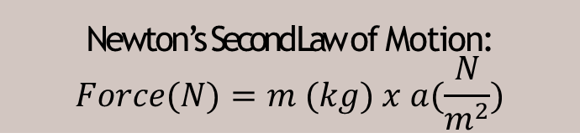
Forces and Their Effects
You cannot see a force, but you can see what it does. You can also feel the effect of a force on your body.
A force is a push or a pull
Newton’s Second Law of Motion:
$$Force(N)=m (kg) x a(\frac{N}{m^{2}})$$

Slide 3
What can a force do?
A force can make an object move.
A force can make a moving object stop
A force can change the direction of a moving object.
A force can change the shape of an object

Slide 4
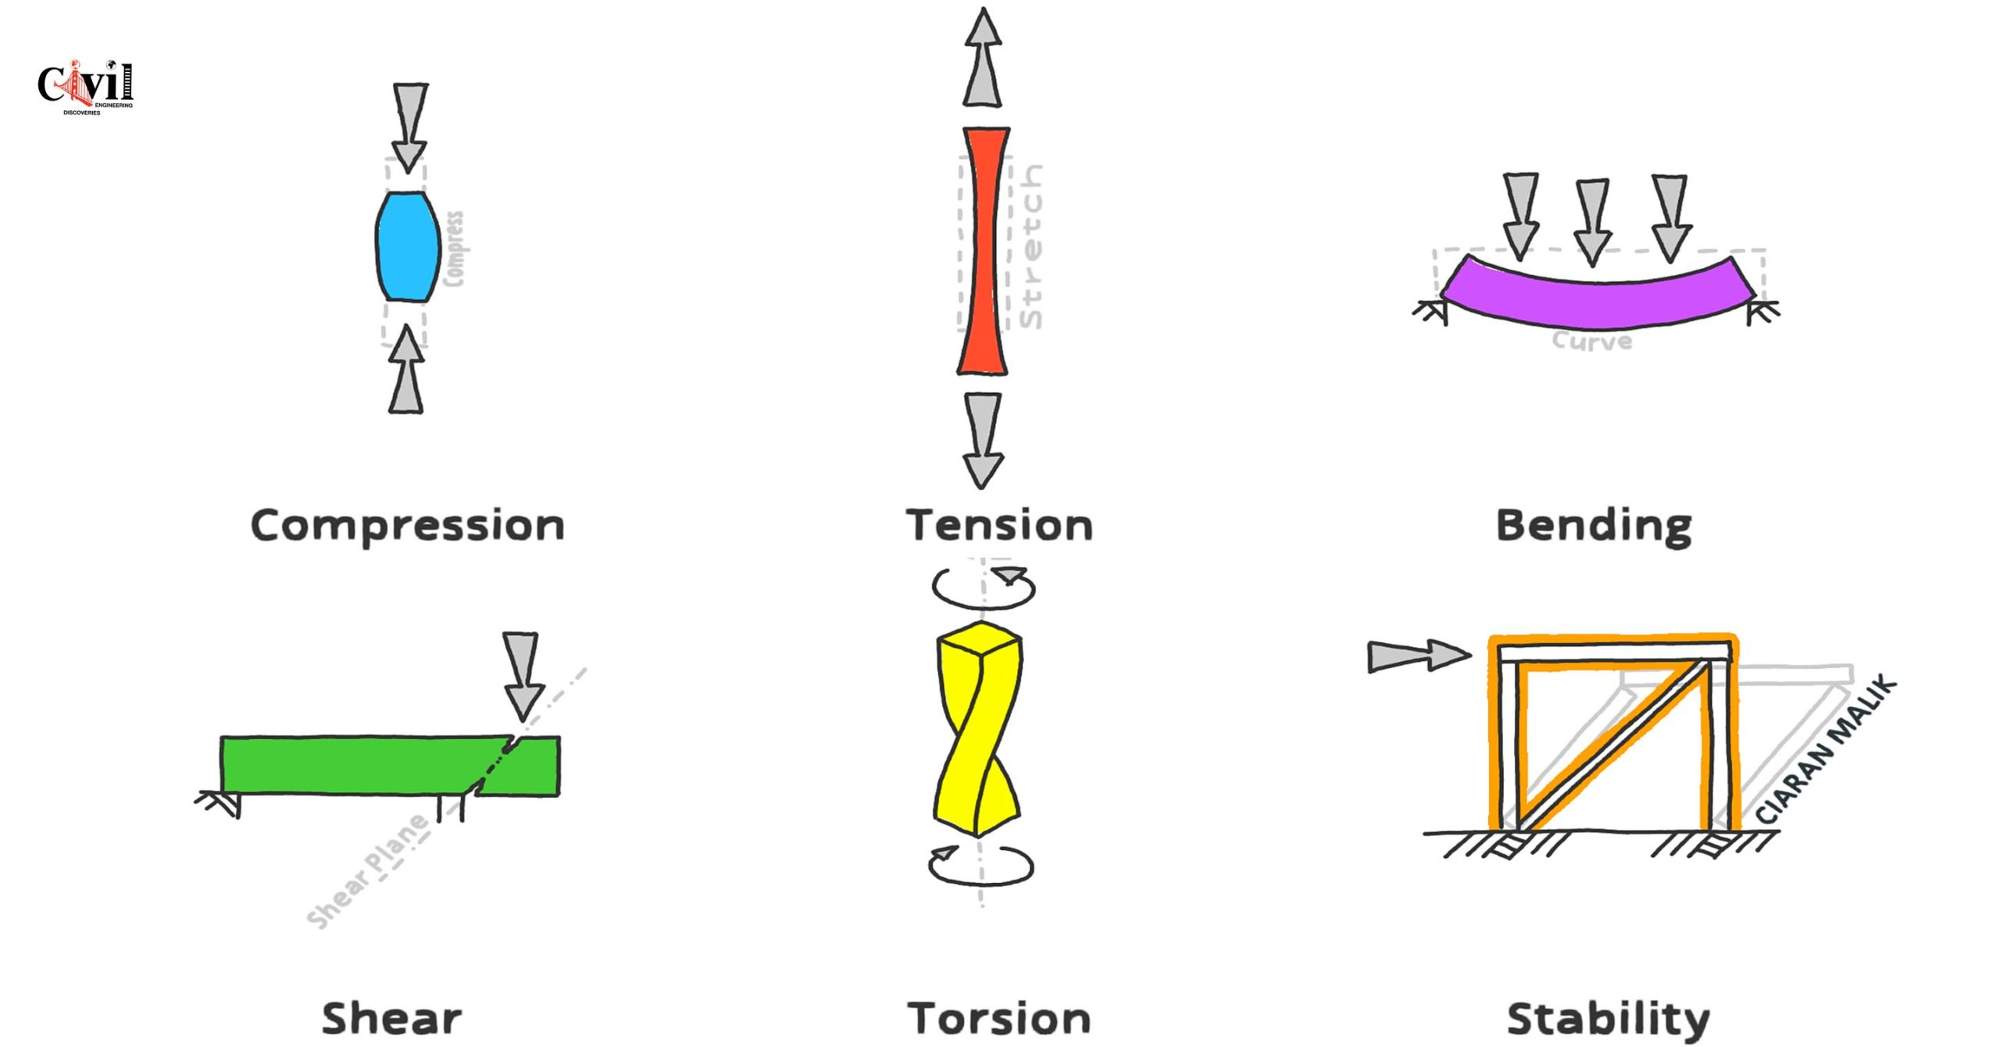
Strength of Materials
Its ability to withstand an applied stress without failure (tensile, compressive and shear)
Deals with loads, deformations and the forces acting on a material.

Slide 5

Tacoma Narrows Bridge- 7 Nov 1940 Washington
The failure did not occur due to heavy load or an earthquake, but due to an aeroelastic phenomenon known as aeroelastic flutter.
Strong wind blew along the length of the bridge
The bridge’s slim and lightweight design made it highly flexible
The wind caused the bridge to oscillate up and down (like a wave)
The vibrations grew stronger and uncontrollable — eventually leading the structure to collapse completely
Tacoma Narrow Bridge

Slide 6


Types of Load and its impact
Static loading
A load that is applied slowly and remains nearly constant. Common in buildings and bridges
Effects: Deformation, stress, or strain in materials
Dynamic loading
The forces that move or change when acting on a structure
Effects: Can lead to vibrations, resonance, or fatigue in materials due to repetitive stress

Slide 7

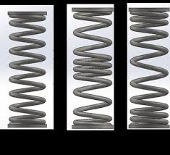
Types of Load and its impact
Impact loading
A load that is applied suddenly with high force, such as a hammer strike or vehicle crash
Effects: Causes immediate stress and may result in fractures, cracks, or catastrophic failure
Fatigue loading
A repeated load that causes stress over time and can lead to cracks or failure
Effect: Sudden Structural Failure - Once the crack becomes large enough, the structure may break or collapse suddenly, even under normal loads (aircraft wings, machine shafts, metal bridges)

Slide 8
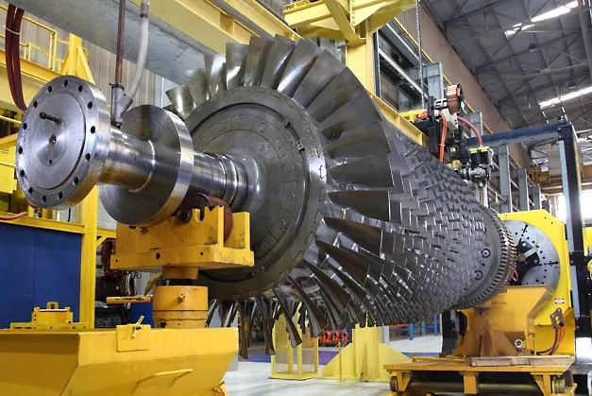
Types of Load and its impact
Alternating loading
A load that changes direction or magnitude in a repetitive pattern (e.g: rotating machinery)
Effect: Rotating shafts (Cracks form due to stress cycles), Engine pistons (Repeated load can cause fatigue)

Slide 9
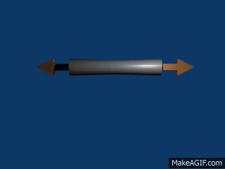
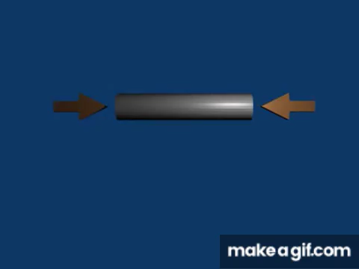
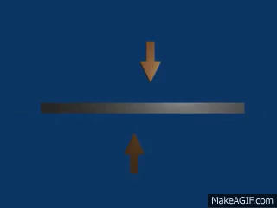
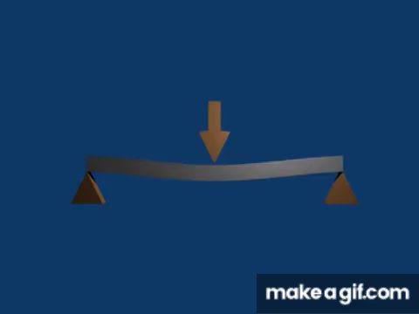
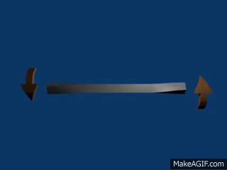
Types of force and its differences
Force | Explanation | Figure | Stress | Example
Tensile Force | A force that stretches a material by pulling it apart |  | Tensile Stress | A rope in tension during a tug-of-war.
Compressive Force | A force that compresses a material by pushing it together. |  | Compressive Stress | The load on a pillar supporting a structure
Shear Force | A force that causes layers of a material to slide against each other in opposite directions |  | Shear Stress | Scissors cutting paper
Bending Force | A force that causes a material to bend or curve |  | Bending Stress | Bridge, Wooden Plank stepped on in the middle
Torsional Force | The internal stress developed in a material when it is subjected to twisting |  | Torsional Stress | Motor shaft, Screwdriver, Pipe wrench

Slide 10
Stress
STRESS
SHEAR
COMPRESS
TENSILE
TORSION
BENDING
An applied force or system of forces that tends to strain or deform a body. “The intensity of stress is expressed in units of force divided by units of area"

Slide 11

Stress
N
P
Force applied to the material
$$σ$$
=
over
A
N/m²
the Area of contact
m²

Slide 12
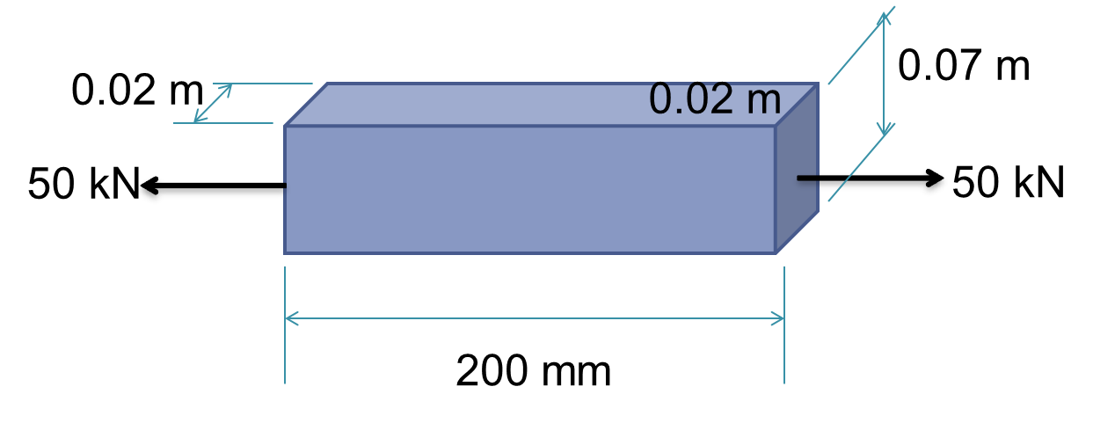


Stress
Example 1.1:
Solution:
$$σ=\frac{P}{A}$$
$$σ=\frac{50x{10}^{3}}{1.4x{10}^{−3}}$$
$$σ=34.714x{10}^{6}N/m^{2}$$
$$σ=34.714 MPa$$
$$A=0.02x0.07$$
$$A=1.4x{10}^{−3}m^{2}$$
A 50kN of extensive load act on the bar as below. Calculate the value of stress.

Slide 13

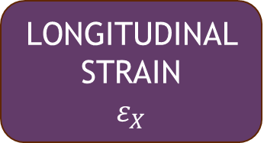
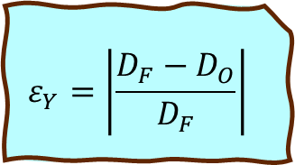
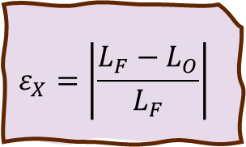
Strain
The ratio of the change in length caused by the applied force, to the original length
The change in length of an object in the direction of the applied force, divided by the original length
$$ε_{X}=\left|\frac{L_{F}−L_{O}}{L_{F}}\right|$$
LONGITUDINAL STRAIN
$$ε_{X}$$
STRAIN
LATERAL STRAIN
$$ε_{Y}$$
The change in dimension perpendicular to the applied force, divided by the original dimension
$$ε_{Y}=\left|\frac{D_{F}−D_{O}}{D_{F}}\right|$$

Slide 14



Strain
m
$$∆L$$
Change of length
$$ε$$
=
over
$$L_{O}$$
unitless
The original length
m

Slide 15

Strain
Extension- change in length
Extended length- total length with load applied
Natural length
Extended length
Force Applied
Extension

Slide 16

Stress
Example 1.3:
Solution:
$ε_{X}=\frac{∆L}{L_{O}}$
$ε_{X}=\frac{0.21−0.2}{0.2}$
$ε_{X}=0.05$
Calculate the strain value of the bar.
0.02 m
50 kN
50 kN
200 mm
210 mm

Slide 17
Thank you
PREPARED BY:
ADIANI BINTI AB RAHMAN
SITI AMELIA BINTI SHAIK PAWAN CHEE
NORZULIANA BINTI ABDUL LATIF

