Slide 1

FORCES ON THE MATERIALS
OUTLINE
APPLY HOOKE’S LAW

Slide 2

Hooke’s Law
Stress applied to the material is directly proportional to the strain provided the elastic limit of the material is not exceeded.
Applied to all elastic material including steel.
E.g., bungee jumping rope.

Slide 3

Elasticity and Plasticity
All materials will behave elastically or plastically-
For elastic behaviour – when a force is applied the change in length is proportional to the force. The object will return to its original shape when the force is taken away.
For plastic behaviour – the force and the change of length are not linked. A permanent deformation occurs when the force is taken away.

Slide 4
Elasticity and Plasticity
Force
Elastic region (any force applied below the elastic limit)
Plastic region (any force applied above the elastic limit)
2.
1.
Elastic Limit
Extension
Elastic region
Plastic region
Notes:
Similar to the graph drawn for the spring, a straight line shows the pattern of results obtained which is regarded as a direct proportion. This region of applying force is known as the ‘elastic region’.
If the force is continually added though the relationship does not stay constant. The larger the force the less the extension occurs. A permanent deformation is also observed when the force is no longer applied. This region is regarded as the ‘elastic region’.
The threshold between each region is called the elastic limit.

Slide 5

Modulus of Elasticity
The ratio of stress to strain within the elastic region of a material.
Also known as Elasticity Modulus.
Elastic value of the material.
Value of E differ depending on the material type.
E , strength of the material
e.g. E steel higher than aluminum.

Slide 6
Modulus of Elasticity
σ, stress
steel
aluminum
Δσ
Δε
ε, strain

Slide 7
Modulus of Elasticity
N/m²
P
ratio of the uniaxial stress
σ
A
E
=
over
ε
∆L
the uniaxial strain.
L
N/m² @ Pa

Slide 8
Modulus of Elasticity
P
σ
A
E
=
E=?
ε
∆L
L

Slide 9

Tensile Test
Test to measure:
Elasticity point
Maximum tension strength
Yield point
Break point
Different material different value.

Slide 10
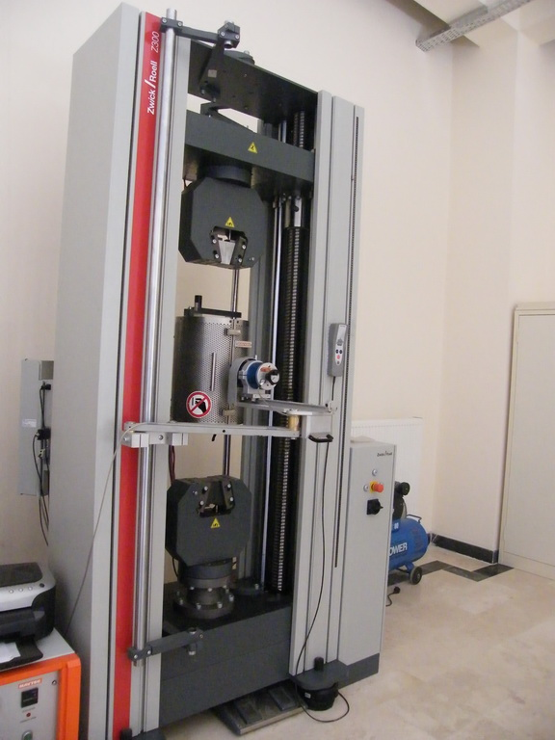

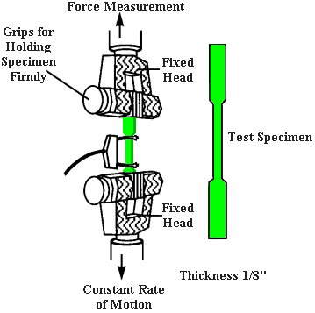
Tensile Test

Slide 11
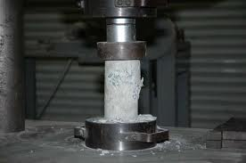
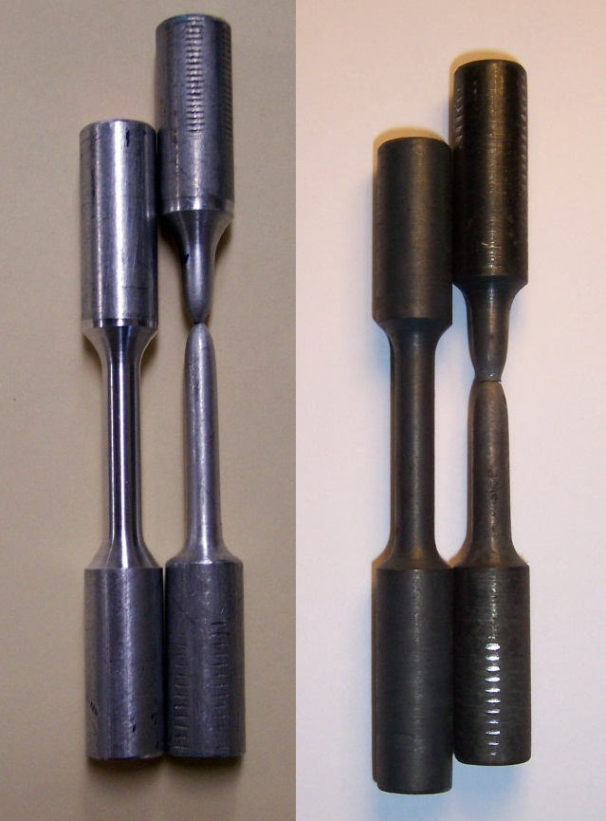
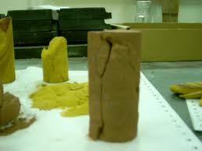
Tensile Test
after
Compression Test
neck
before
Tensile Test

Slide 12
What are these?
What should you know?
Yield stress
Max tension stress
% elongation
% area reduction
where in the world are we supposed to find these value?

Slide 13
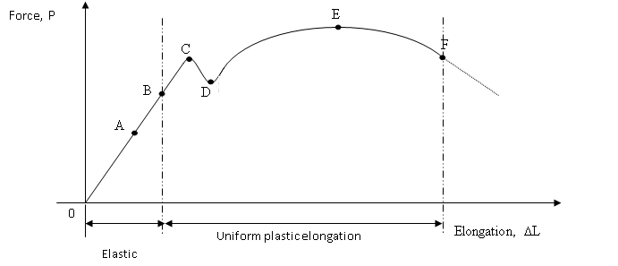
Tensile Test
A= proportional limit
B= elastic limit
C= upper yield point
D= lower yield point
E= maximum force
F= break point
So, what is the formula then?

Slide 14


Formula
→ Yield stress
$σ_{y}=\frac{upper yield point}{origin sectional area}$
→ Max tension stress
$σ_{max}=\frac{maximum force}{origin sectional area}$
→ % elongation
$=\frac{∆L}{L_{o}}×100\%$
→ % area reduction
$=\frac{∆D}{D_{o}}×100\%$

Slide 15


Formula
→ Working stress.
$σ_{w}=\frac{Proof Stress}{safety factor}$
→ Proof stress.
$σ_{p}=\frac{point near upper yield point}{origin sectional area}$
→ Factor of safety.
$S.F=\frac{maximum stress}{working stress}$
Poisson’s ratio.
$v=\frac{Lateral Strain (ε_{y})}{Longitudinal Strain (ε_{x})}$

Slide 16
Thank you
PREPARED BY:
ADIANI BINTI AB RAHMAN
SITI AMELIA BINTI SHAIK PAWAN CHEE
NORZULIANA BINTI ABDUL LATIF

