Slide 1
AVIATION INTRODUCTORY
COMMUNICATION SKILLS- PART 1

Slide 2
SUB TOPIC
Definitions of Communication
Importance of Effective Communications
Modes of Communication
Communication Process
Communication Barriers
Communication Skills
Notes:
COMMUNICATION
The ability to clearly and accurately send and acknowledge timely information, instructions, or commands, and provide useful feedback

Slide 3
Introduction to CRM skills
CRM is concerned not so much with the technical skills but rather with the cognitive and interpersonal skills needed to manage the flight.
Cognitive skills are defined as the mental processes used for gaining and maintaining situational awareness, for problem solving and decision making.
Interpersonal skills are regarded as communications and a range of behavioral activities in the teamwork
FOR EDUCATIONAL PURPOSE ONLY

Slide 4
Example
Interpersonal Skills
Communications
Teamwork
Cognitive Skills
Situational Awareness
Decision Making
4

Slide 5
Major Causes of Human Error in Aircraft Accidents
Lack of Situational Awareness
Poor Decision Making
Lack of Communication
Lack of Teamwork
Lack of Resources
Lack of Knowledge
Lack of Assertiveness
Distraction
Pressure & Stress
Crew Fatigue

Slide 6
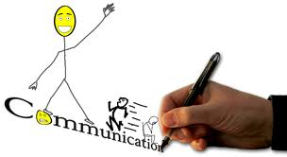
Definition of Communication
Communications: is the transfer of information from a speaker (transmitter) to a listener (receiver)
The objective of the communication is to ensure the process of transferring information is successful.
Notes:
FIRST IT WOULD BE HELPFUL TO DEFINE WHAT WE PLAN TO TALK ABOUT.
COMMUNICATIONS IS THE TRANSFER OF INFORMATION FROM A SPEAKER TO A LISTENER SOMETIMES CALLED A RECEIVER.
GOOD COMMUNICATIONS IS ACHIEVING THE DESIRED RESPONSE IN THE LISTENER.

Slide 7
Communication in Flight Operation
communicate
Cockpit Crew
Cabin Crew
aware
aware
Environmental factors
Internal factors
Recognition of threats
& danger.
communicate
communicate
aware
Ground and Maintenance Crew
ATC Tower

Slide 8
Function of Communication
Send information
(e.g. “ATC have instructed us to…”)
Get the feedback/ response (e.g. “checked”, “set” or “roger”)
Explain ideas/ proposals/ counter proposals/ suggestion
(e.g. “I disagree. What about XX instead )
Express feelings (e.g. “I’m not happy with”)

Slide 9

What IS the effective communication
FOR TRAINING PURPOSE ONLY

Slide 10
Importance of Effective Communication
To pass information from one person to another (avoid miscommunication)
To conduct effective missions
To avoid mishaps (unlucky aircraft accident)
To maintain group situational awareness

Slide 11
THINK!
Failure in Communication = Failure in Response
Inadequate Communication
AIRCRAFT ACCIDENT
Loss of Situational Awareness
Breakdown in Teamwork
Wrong Decision

Slide 12
Is there any other way of communication beside verbal communication?
Can we communicate without speaking to each other?
YES!
But how?

Slide 13
Communication Achievements
VERBAL
7 %
7% of all communication is accomplished Verbally (using words orally or writing)
55% of all communication is achieved through Non-Verbal (body language)
38% of communication is achieved by tone or sound of voice
NON-VERBAL
55 %
TONE OR SOUND OF VOICE
38%
Notes:
Verbal - verbal communication occurs when words are used to communicate, either orally or in writing
Non-Verbal - non-verbal communication occurs when body language, eye contact, posture, gestures, touch, silence - anything other than words - is used to communicate
Symbolic - symbolic communication occurs as a result of our appearance - clothes, hair, jewelry, make of car, etc.

Slide 14
“it is not what you say, but how you say it”
"It's not what you say, but how you say it" shows the importance of nonverbal communication .
Of all communication modes, nonverbal is the most important because it shows the communicator's *credibility (knowledge & sincerity on about what he say).
Generally, nonverbal factors fit into four categories:
Eye contact,
Facial expressions,
Gestures,
Posture
Use of this information(non-verbal) can be important to a communicator because receivers interpret specific actions as having specific meanings.

Slide 15
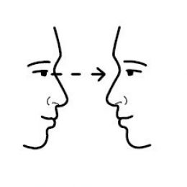

1. Eye contact

Slide 16
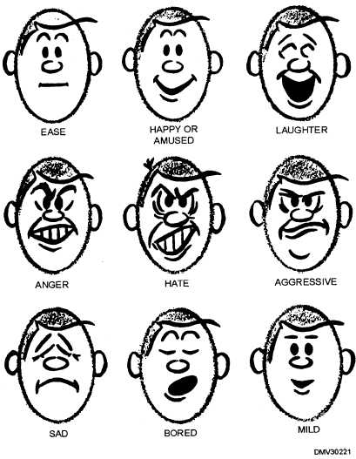
2. Facial Expression

Slide 17
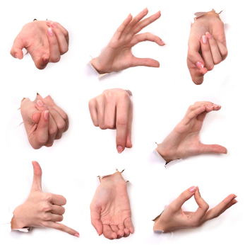
3. Gesture

Slide 18
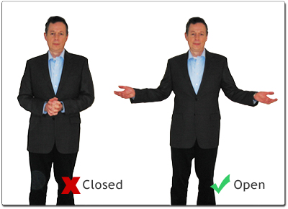
4. Posture

Slide 19
Eye Contact
Studies on eye contact and its effect on communication find that maintaining eye contact while communicating is beneficial to credibility.
*Credibility is the believability of a person. Our credibility is measured by the people with whom we interact (receiver).
Through the use of beneficial eye contact , a communicator can raise his or her credibility with the receiver.

Slide 20
2. Facial Expression
The overall facial expression is important to a receiver’s perception of credibility.
A speaker's face must show interest and attention.

Slide 21
3. Gestures (hand & head movements)
A speaker simply standing and talking with no motion is dull.
Beneficial gestures usually are performed with the hands, arms and head. These should be used to emphasise a point.
In short, using gestures to show participation is beneficial to improve communication.
There is no "correct" gesture for any given situation, but one of the keys to using good gestures is the appearance of spontaneity and naturalness.
In other words, gestures should be performed without nervousness.
Unnatural gestures, such as touching the body and playing with objects such as clothing or pens, are not good.

Slide 22
4. Posture
The difference between gesture and posture is that a gesture conveys a message by using one part of the body.
Whereas a posture involves the movement of the body as a whole.
Closed postures, with features such as folded arms and crossed legs, indicate a closed personality and a lack of confidence.
Open posture, with arms spread in a relaxed manner, is a much more confident .
Like gestures, postural movements should flow with the conversation so that they look natural.

Slide 23
Communication Process
Communication is an art of
making yourself understood.

Slide 24
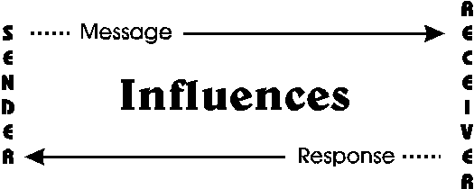
Communication Process
There are four elements in the communication process:
sender (speaker),
message,
receiver (listener)
feedback.

Slide 25
Both sender and listener have their responsibilities to ensure the successful of communication process.
Moreover, anyone acting as the sender or receiver are also influenced by many factors - their perceptions, attitudes, values, knowledge, expectations, language skills, experience and their relationship to "the other person."
These influences act like filters and can impact on the process of sending and receiving messages.

Slide 26
Sender’s responsibilities | Receiver’s responsibilities
communicating information Clearly, Correctly, Completely (3C). communicate in a timely manner requesting verification or feedback | acknowledge communication repeat information provide feedback

Slide 27
3 C’s of communication
Be Correct – standard part names
Be Complete – Enough Information
Be Clear – Say what you mean say.

Slide 28
Communication Levels
EFFECTIVE: The message is not only received, but it has resulted in the action you wanted (have response).
3 LEVELS OF
COMMUNICATIONS
GOOD: You have sending your message across, but the receiver has not responded with the desired action
POOR:
the message is not even received, resulting in confusion
Notes:
3 LEVELS OF COMMUNICATIONS
POOR: the message is not even received, resulting in confusion
GOOD: You have gotten your message across, but the receiver has not responded with the desired action
EFFECTIVE: The message is not only received, but it has resulted in the action you wanted.
TEST EFFECTIVENESS OF YOUR COMMUNICATIONS:
GET FEEDBACK
APPROACHES THAT WORK:
Don’t get personal--deal with behavior
Focus on objective ideas--advice will sound like personal opinion and is likely to be rejected
Focus on WHAT is said, not why. “Why” starts to get personal, and causes rejection
Limit your ideas to what can be used right now--stay off the lecturer’s soap box.
Section 4:
Communications

Slide 29
Communication Barriers
Barriers
Communication Barriers: Anything that distorts or interferes with communications
Notes:
Barriers: anything that distorts, confines or interferes with communications
Physical/mental barriers:
Noise or static
Multiple communications
Fatigue or stress
Distractions
Incomplete message
Ambiguous wording
Technical words
Non-standard phraseology
Insufficient information
Overly complex message
Interpersonal

Slide 30
What is the barrier of communication??
Type of Barriers that block the effective communication:
1. Physical Barriers
2. Mental Barriers
3. Language Barriers
e.g. noise, hearing loss, confusion, fatigue, poor radio equipment.
e.g. strong negative feelings in the cockpit can lead to a total lack of communication.
Notes:
There are many factors which block effective communication. They are organized into three distinct categories:
1. Physical Barriers
The physical barriers are normally barriers that prevents the communication from being received - items such as noise, hearing loss, confusion, fatigue, poor radio equipment. The pilot has some control over these barriers.
2. Mental
The mental barriers are much harder to detect and control; stemming from inside an individual, they encompass attitudes, feeling, bias and prejudice. For example, strong negative feelings in the cockpit can lead to a total lack of communication. Hostile environments create a safety hazard. Pilots must maintain a professional attitude to help to overcome the psycho-social barrier.
3. Technique-related
The technique employed to process information can be a barrier in itself. The professional who processes information does it the same way every time. The individual answers two questions before responding or acting on any information:
What is the literal meaning?
What is the contextual meaning?
If these questions cannot be answered to the receiver's satisfaction, then clarification should be sought. After this, the next question should be:
What action is appropriate in response to this communication?
This type of controlled response creates a professional atmosphere and no matter what the feelings are between the crew members this professionalism cuts through much of the personality problems.

Slide 31
Results of Language Barriers (Case Study)
In 1977, at Tenerife in the Canary Islands, heavy accents and improper terminology among a Dutch KLM crew, an American Pan Am crew and a Spanish air traffic controller led to the worst aviation disaster in history, in which 583 passengers perished.
In 1980, another Spanish air traffic controller at Tenerife gave a holding pattern clearance to a Dan Air flight by saying "turn to the left" when he should have said "turns to the left" - resulting in the aircraft making a single left turn rather than making circles using left turns. The jet hit a mountain killing 146 people.

Slide 32
In 1995, an American Airlines jet crashed into a mountain in Colombia after the captain instructed the autopilot to steer towards the wrong beacon. A controller later stated that he suspected from the pilot's communications that the jet was in trouble, but that the controller's English was not sufficient for him to understand and articulate the problem.
On November 13, 1996, a Saudi Arabian airliner and a Kazakhstan plane collided in mid-air near New Delhi, India. While an investigation is still pending, early indications are that the Kazak pilot may not have been sufficiently fluent in English and was consequently unable to understand an Indian controller giving instructions in English.

Slide 33
OVERCOMING THE BARRIER
Use active listening techniques (*LISTEN)
Require feedback
E.g. asking back if you don’t understand the instruction or saying ‘roger’ if you understand.
Use appropriate mode of communication
Verbal or non-verbal. Which one the most effective.
Use standard terminology
Use the word/code that are easy to understand depends on the level of knowledge.
Notes:
The active listener attends to the words and projects their mind into that of the speaker, so that they can align their thoughts and feelings more closely to those of the speaker. Active listening consists of the following two skills:
Non-Verbal - Attending
Face the speaker, smile, look relaxed
Maintain eye contact
Encourage the other to speak
Verbal – Questions
Active listener not:
Passive or token
Advice given
Agreement or disagreement
Judgmental or critical
Argumentative
Active Listening is:
The genuine desire to understand another person's perception
Listening and expressing - understanding of what another person has said
Sensitivity to another's thoughts and feelings

Slide 34
*Active Listening Techniques (LISTEN)
Look Interested
Inquire with questions
Stay on target (focus)
Test Understanding
Evaluate the message
Neutralize your thoughts, feelings an opinions
Avoid biasness, prejudice etc.

Slide 35
Communication Skills
Most people don’t want to tell someone off as the don’t like conflict. But in airline, by not telling the other crew of the potential danger, you might meet an accident.
How you could communicate without creating a *conflict?
*Conflict means a serious disagreement or argument. It can have a serious effect on decision making quality.

Slide 36
Communication Skills:
Opening or attract listener- Address the individual.
E.g: "Hey Chief," or "Captain Smith," or "Bob," or whatever name or title will get the person's attention.
State your concern - State what you see in a direct manner while owning your emotions about it.
E.g. "We're low on fuel,“-direct
“I think our aircraft got the problem,“-indirect
36

Slide 37
3. State the problem as you see it
E.g. "I don't think we have enough fuel to fly around this storm system,"
4. State a solution
E.g. "Let's divert to another airport and refuel,"
5. Obtain agreement
E.g. "Does that sound good to you, Captain?"
37

