Slide 1
Aviation Introductory
Aviation Legislation

Slide 2

What is the important of air law, regulation and Legislation?

Slide 3

Course Objective
~~To provide the students with overview of the law and regulations that can be applicable to Malaysia Civil Aviation Environment and International Aviation. ~~

Slide 4

Course Outcomes
By the end of this subject, student should be able to:
1)Students should be able to understand some of the major law and regulations related to aviation industry.
2) Students will have optimum understanding about the function and purposes of all the fundamental included in the International Air Law

Slide 5


Reminder!
In my class:
Please be punctual and not late than 15 minutes.
Please wearing proper attire for the class session.
Please pay attention during the class.
You may eat sweetie, candy, chocolate but not heavy food.
Set a goal in your life:
Know your goal and plan properly.
Do revision/study before and after class time.
Eager to do research.
Put interest in the subject.
Discipline (e.g. always be punctual!!).
Always put academic as your priority.
Keeping good mental and physical health.
Spend some time for meditation (pray).
Train to have strong imagination.

Slide 6

ARE YOUR READY???????

Slide 7
definition
Air
Atmosphere (air space/traffic), ambiance, circumstances that connect organism.
Legislation
a law or set of laws suggested by a government and made official by a parliament
Law
The principle and regulation established in a community by some authority and applicable to its people.
Regulations
Any adjustment, modification, modulation or act or controlling the set (community, materials, conditions etc). Usually in small package, and for particular item.

Slide 8
REGULATORY FRAMEWORK
1.1 ROLE OF
INTERNATIONAL
CIVIL AVIATION
1.2 ROLE OF EASA
1.3 ROLE OF
THE MEMBER
STATES
1.4 RELATIONSHIP
BETWEEN
PART - 145
PART - 66
PART - 147
PART - M
FOR TRAINING PURPOSES ONLY

Slide 9
CH 7: Aviation Legislation
HAGUE CONFERENCE-1899
2ND HAGUE PEACE CONFERENCE -1907
CONVENTION of PARIS-1919
PAN-AMERICAN AVIATION CONVENTION IN HAVANA-1928
WARSAW- CONVENTION -1929
*CHICAGO CONFERENCE(ICAO)-1944
*ANNEX(1-18) ,*ARTICLE(1-97),*NINE FREEDOM(1-9)-ICAO
*CAA (1969),*MCAR 1996
DCAM (Current)

Slide 10

CH 7: Aviation Legislation
How and when history air law begin?
Early flight (1783), first aircraft-hot air balloons
Used for what?
Aerial transport
Carriage of mails
Military purpose
Meteorology purpose
In 1785 ,balloon crossed the English channel (between England and Atlantic ocean) without permit!!
* The first regulation for safety in aerial navigation was made in 1819.*

Slide 11


CH 7: Aviation Legislation
How and why Hague conference(1899) establish?
~~Made a declaration prohibiting the discharge of projectiles from balloons or other new methods of a similar nature~~
*in 1902 ,International air law was prepared in draft.

Slide 12
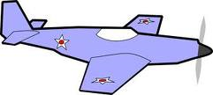

CH 7: Aviation Legislation
Why the second Hague peace conference(1907) establish?
~~Due to aero planes were flown in Europe(German, Russia , Portugal..etc)
~~But many power refused to renew their pious resolution of 1899(oath)

Slide 13

CH 7: Aviation Legislation
What is the Convention of Paris (1919)???
~~Occur after war 1!!(1914),WW2(1939)
~~It contained and establish the system
~~System comprised a series of rules governing the use & flight of aircraft over the territories of and between different states but US and south American did not adopt it!!!!
*Then in 1928,PAN-american aviation convention was signed in Havana which pari materia to Paris convention.
*Pari materia-Upon the same matter or subject. Statutes in pari materia are to be construct together.

Slide 14


CH 7: Aviation Legislation
In 1929,Warsaw convention
~~contains rules governing international carriage of goods & passenger * baggage and personal effect by air principal nations of the world~~

Slide 15

CH 7: Aviation Legislation
HAGUE CONFERENCE-1899
2ND HAGUE PEACE CONFERENCE -1907
CONVENTION of PARIS-1919
PAN-AMERICAN AVIATION CONVENTION IN HAVANA-1928
WARSAW- CONVENTION -1929
*CHICAGO CONFERENCE(ICAO)-1944
*ANNEX(1-18) ,*ARTICLE(1-97),*NINE FREEDOM(1-9)-ICAO
*CAA (1969),*MCAR 1966
Hot balloon not permit
Aero plane flown in Europe
Rules of flight over territories
Pari Materia
Rules of carriage

Slide 16

Ok???
Clear ??
Any question???

Slide 17
CH 7: Aviation Legislation
INTERNATIONAL AIR LEGISLATION:
resents in microcosm all the fundamental problem of international law as a whole:
SOVEREIGNTY,
TERRITORY,
THE RELATIONSHIP OF STATES AND OTHER INTERNATIONAL LEGAL ENTITIES, NATIONALITY, UNIFICATION .
~it purpose are to provide a system of international regulation of international civil aviation and to eliminate conflicts or inconsistencies~
INTERNATIONAL LAW:
~is the body of legal rules which apply between sovereign states & such other entities as have been granted international personality~~

Slide 18

CH 7: Aviation Legislation
International Civil Aviation Organization (ICAO)-Montreal , CANADA
-provide general rules and mediates international concerns to an extent regarding aviation law.
ICAO major rules include:
concerning air navigation,
its infrastructure, Flight inspection,
prevention of unlawful interference
Etc….

Slide 19


INTERNATIONAL AIR TRANSPORT ASSOCIATION (IATA)
Headquartered in Montreal,CANADA.
IATA’s stated mission:
~~to represent, lead and serve the airline industry and to provide safe and secure transportation to its passengers.~~
Membership: 230 airlines!!!!

Slide 20






For Malaysia we have :
Civil aviation act 1969 (CAA 1969)
Malaysia civil aviation & regulation 1996 (MCAR 1996)
Department of Civil Aviation Malaysia (DCAM)

Slide 21
Ok???
Clear ??
Any question???

Slide 22
1.1 ROLE OF INTERNATIONAL CIVIL AVIATION

Slide 23
CONTENT
CHICAGO CONVENTION
INTERNATIONAL CIVIL AVIATION ORGANISATION ( ICAO )
CONTRACTING STATES
NATIONAL AVIATION AUTHORITIES
ICAO ANNEXES

Slide 24

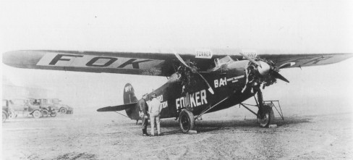
REGULATORY FRAMEWORK
First International Aviation Agreement:
INTERNATIONAL COMMISSION OF AIR NAVIGATION (ICAN)
Formed in 1922
Participated by 38 states
HQ in Paris
Fostered Civil Aviation 1922-1939
VIDEO
AVIATION
HISTORY

Slide 25
CHICAGO CONVENTION
In 1943, United States initiated the study of post-war Civil Aviation problems. Most of the countries closed their airspace to all foreign a/c
In Nov 1944, United States invited 55 countries to attend an International Civil Aviation Conference in Chicago. This conference was to start to standardize civil aviation all over the world.
FOR TRAINING PURPOSES ONLY

Slide 26
CHICAGO CONVENTION
On 7 Dec 1944 – A Convention was signed by 52 countries and known as Chicago Convention.
Multi-lateral agreement regarding to Freedom of Air
Superseded the
International Air Convention
Replace ICAN
Signatories are CONTRACTING STATES
FOR TRAINING PURPOSES ONLY

Slide 27
CHICAGO CONVENTION : ARTICLES & PARTS
CHICAGO CONVENTION
The Chicago Convention, which was signed on 7 December 1944, consists of 96 Articles and is divided into 4 Parts.
FOR TRAINING PURPOSES ONLY

Slide 28
CHICAGO CONVENTION
The 96 articles:
Establish the privileges and restrictions of all contracting States;
Set-up International Civil Aviation Organisation (ICAO).
Provide for the adoption of International Standards and Recommended Practices regulating international air transport.

Slide 29


INTERNATIONAL CIVIL AVIATION ORGANIZATION (ICAO)
Formed in 4th April 1947
Governing body for international aviation
HQ in Montreal
Specialized agency under United Nation (UN)
Members are called CONTRACTING STATES
FOR TRAINING PURPOSES ONLY

Slide 30
CONTRACTING STATES
Signatories of Chicago Convention
Currently 188 contracting states (2003)
Automatic members of ICAO
Adopt Annexes
NATIONAL
AVIATION
AUTHORITIES
(NAA)
REPRESENTED BY
CONTRACTING
STATES
(countries)
FOR TRAINING PURPOSES ONLY

Slide 31
ROLE OF CONTRACTING STATE
Contracting states agreed that the requirements laid down by ICAO should become the law in their country and should be automatically accepted
The annexes- lay down the basis of aviation legislation worldwide
All national and international legislation is created in addition to the ICAO standard
FOR TRAINING PURPOSES ONLY

Slide 32
International Civil Aviation Organization (ICAO)
Role of ICAO:
To develop and set up common guidelines on:
Principles, techniques and arrangements
Technical standards and recommended practices
To foster planning and development of international air transport
To apply principles globally
FOR TRAINING PURPOSES ONLY

Slide 33
ICAO : OBJECTIVES
To ensure the safe and orderly growth of international civil aviation throughout the world
To encourage the arts of aircraft design and operation for peaceful purposes
FOR TRAINING PURPOSES ONLY
Notes:
Ref: Chicago Convention 1944 Chapter VII Article 44
http://www.aviation.go.th/airtrans/airlaw/chicago.html

Slide 34
ICAO : OBJECTIVES
To encourage the development of airways, airports, and air navigation facilities for international civil aviation
To meet the needs of the peoples of the world for
safe, regular, efficient and economical air transport
FOR TRAINING PURPOSES ONLY

Slide 35
ICAO : OBJECTIVES
To prevent economic waste caused by unreasonable competition;
To ensure that the rights of contracting states are fully respected and that every contracting states has a fair opportunity to operate international airlines;
FOR TRAINING PURPOSES ONLY

Slide 36
ICAO : OBJECTIVES
To avoid discrimination between contracting states
Promote safety of flight in international air navigation
Promote generally the development of all aspects of international civil aeronautics
FOR TRAINING PURPOSES ONLY

Slide 37
ICAO ANNEXES
Contains guidelines to be followed
Forms basis of signatories law
Enforcement: States sovereign right
Has 18 Annexes
Important Annexes:
Annex 1 – Personnel Licensing
Annex 6 – Operation of Aircraft
Annex 8 – Airworthiness of Aircraft
FOR TRAINING PURPOSES ONLY
Notes:
ICAO adopts international standards and recommended practices and procedures dealing with civil aviation matters concerning with safety, regularity and efficiency of air navigation.
For convenience, ICAO designate them as Annexes.
Each contracting States shall undertake to collaborate in securing the highest practicable degree of uniformity in regulations, procedures, and organisation in relation to aircraft, personnel, airways and auxiliary services.
Normally the laws of the contracting States make provisions to apply Annexes into their regulations or requirements so as to conform with Chicago Convention.

Slide 38
ICAO ANNEXES
Annex 1 – Personnel licensing
Annex 2 – Rules of the Air
Annex 3 - Metrological service for International Air Navigation
Annex 4 - Aeronautical Charts
Annex 5 - Unit of measurement to be used in air and ground operation
Annex 6 - operations of aircraft
Annex 7 - Aircraft nationality and registration mark
Annex 8 - Airworthiness of aircraft
Annex 9 - Facilitation
Annex 10 - Aeronoutical telecommunications
Annex 11 - Air Traffic Services
Annex 12 - Search and rescue
Annex 13 - Aircraft accident investigation
Annex 14 - Aerodromes
Annex 15 - Aeronautical information services
Annex 16 - Environmental protection
Annex 17 - Security
Annex 18 - The safe transport and dangerous goods by air
FOR TRAINING PURPOSES ONLY

Slide 39

DIPLOMA ENGINEERING IN AIRCRAFT MAINTENANCE WM 110: AVIATION LEGISLATION
SOME IMPORTANT NAAs
NATIONAL AVIATION AUTHORITIES
(NAA)
Department of Civil Aviation of Malaysia
(DCA Malaysia)
Government of Malaysia ratifies the Chicago Convention
Laws of Malaysia, Civil Aviation Act (Amendment) 2003
Original is Civil Aviation Act 1969
FOR TRAINING PURPOSES ONLY JPP/WM110/TP01/REV00

Slide 40

NATIONAL AVIATION AUTHORITIES
(NAA)
CIVIL AVIATION AUTHORITY OF UNITED KINGDOM
( CAA UK )
AUTHORITY BODY FOR THE UK
FOR TRAINING PURPOSES ONLY

Slide 41

NATIONAL AVIATION AUTHORITIES(NAA)
FEDERAL AVIATION ADMINISTRATION FOR THE UNITED STATES OF AMERICA
( FAA USA )
AUTHORITY BODY FOR THE U.S.A.
HAS GLOBAL INFLUENCE
FOR TRAINING PURPOSES ONLY

Slide 42

NATIONAL AVIATION AUTHORITIES (NAA)
JOINT AVIATION AUTHORITIES ( JAA )
of the European countries Started in 1970
objective to produce common certification
requirement for large aeroplanes and for
engine to meet the needs of European industry
and international consortia.
1987 - work was extended to operation , maintenance, licensing and certification/ design standard for all classes of a/c
Consists of 37 members. Some of them are :
Austria, Belgium, Denmark, Finland, France, Germany,
Greece, Iceland, Ireland, Italy, Luxembourg, Netherland, Norway, Portugal, Spain, Sweden, Switzerland, Turkey, UK,
Yugoslavia
FOR TRAINING PURPOSES ONLY

Slide 43
NATIONAL AVIATION AUTHORITIES(NAA)
EASA is the National Aviation Authority of European Union.
At present, there are JAA and EASA. Sooner or later, JAA will be replaced by EASA.
In future, EASA will represent all 41 European countries ( EU members & Non-EU members ).
EASA is equivalent to FAA.
FOR TRAINING PURPOSES ONLY

Slide 44
CHAPTER 2 - AIRWORTHINESS CODES
AIRWORTHINESS CODES
BRITISH CIVIL AIRWORTHINESS REQUIREMENTS (BCAR)
JOINT AIRWORTHINESS REQUIREMENTS (JAR)
FEDERAL AVIATION REGULATIONS (FAR)
EASA RULES
DCA MCAR
FOR TRAINING PURPOSES ONLY

Slide 45
AIRWORTHINESS CODES
ICAO Annexes- provide standard and recommendation
Interpreted into requirement by National Av. Authorities (contracting state)
Requirements
Published as
AIRWORTHINESS CODES
FOR TRAINING PURPOSES ONLY

Slide 46
Airworthiness Codes
AIRWORTHINESS CODES
British Civil Airworthiness Requirements (BCAR)
Published by CAA, UK and comprise the minimum requirements for the airworthiness of Civil Aircraft and constitute the basis for the issue of approvals and certificates required by the UK.
FOR TRAINING PURPOSES ONLY

Slide 47
AIRWORTHINESS CODES
Airworthiness Codes
Joint Airworthiness Requirements (JAR)
Published by JAA, Europe and comprise the requirements which are common to all member countries for obtaining type certificates of Civil Aircraft.

Slide 48
AIRWORTHINESS CODES
Federal Aviation Regulations ( FAR )
These are airworthiness codes of the United States of America issued by FAA. FAR governs the conduct of maintenance and flight operation and technical rules of the civil aviation activities of the US and its territories.

Slide 49
AIRWORTHINESS CODES
Title 14 : Aeronautics and Space
Chapter I : Federal Aviation Administration,
Department of
TransportationSubchapters : A, B, C, D, E, F, G, H, I, J, K, L, M, N
Parts ( Examples : FAR43, FAR65, FAR145 )
Sub-parts
FOR TRAINING PURPOSES ONLY

Slide 50
AIRWORTHINESS CODES
EASA Rules
Published by European Aviation Safety Agency and comprise the requirements which are common to all member of European Union countries in the area of Civil Aviation Safety and environmental sustainability.
Consists of Implementing Rules (Parts) and Certification Specifications for obtaining type certificates and continuing airworthiness of the Civil Aircraft.
FOR TRAINING PURPOSES ONLY

Slide 51
AIRWORTHINESS CODES
the DCA’s interpretation of certain airworthiness matters.
MALAYSIAN CIVIL AVIATION REGULATION (MCAR)
MCAR make provisions for the adoption of internationally recognised airworthiness codes for airworthiness certification and procedural requirements.
FOR TRAINING PURPOSES ONLY

Slide 52
AIRWORTHINESS CODES
Airworthiness Notices
2 most important Airworthiness Notices for LAE
NOTICE NO. 3,
CERTIFICATION RESPONSIBILITIES FOR LAE WITH TR & MEMBERS OF APP ORG
NOTICE NO. 10
AMEL TYPE RATINGS
FOR TRAINING PURPOSES ONLY

Slide 53
EASA REGULATORY FRAMEWORK
&
1.2 ROLE OF EASA
FOR TRAINING PURPOSES ONLY

Slide 54
EASA REGULATORY FRAMEWORK
EUROPEAN UNION (EU)
WHAT IS EASA?
MEMBER STATE
MANAGEMENT COMMITTEE
HOW EASA AND RULES WERE ESTABLISHED?
ARTICLES
ANNEXES
FOR TRAINING PURPOSES ONLY

Slide 55
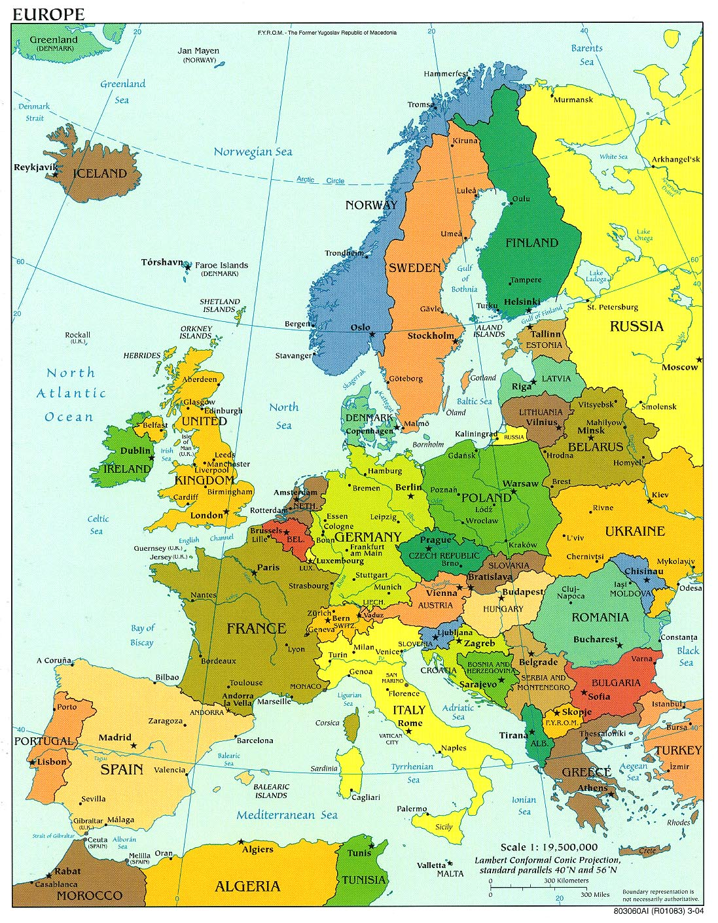

EUROPEAN
UNION (EU)
Notes:
EU is made of a group of European countries.
It has its own government, parliamentary areas and Parliament.

Slide 56
EUROPEAN UNION (EU)
The purpose of EU is to attempt to facilitate easy exchange of product and services between member state and to have common standard in most political and economic issues.
Additionally, there is some standardisation of laws across the state of EU.
FOR TRAINING PURPOSES ONLY

Slide 57
GENERAL
An agency of European Union (UN) and is charged with administration of air safety in the EU area
Set up by an act of secondary legislation (the basic regulation). The agency was established by EC regulation No1592/2002 and is responsible for the creation and monitoring of aviation legislation in EU countries
Defined responsibilities and task with respect to Civil Aviation Safety and environmental sustainability
FOR TRAINING PURPOSES ONLY

Slide 58
What is EASA?
Given specific regulatory and executive tasks in the field of aviation safety
The big difference between the JAA and EASA is that the rules laid down by EASA are immediately law in all countries of the EU whereas the JAA regulation had to be ratified by each member state
Commenced operation on 28th September 2003
The agency is based in Cologne in germany on the 2nd of Nov 2004
FOR TRAINING PURPOSES ONLY

Slide 59
Member State - Consists of European Union countries.
Belgium, France, Germany, Italy, Luxembourg,
The Netherlands………………………………………….…1950s
Denmark, Ireland, the United Kingdom……………....…1973
Greece……………………………………………………...….1981
Portugal, Spain…………………………………….…………1986
Austria, Finland, Sweden…………………………………...1995
Cyprus, Czech Republic, Estonia, Hungary, Latvia,
Lithuania, Malta, Poland, Slovak Republic, Slovenia….2004
Romania, Bulgaria…………………………………………....2007
Turkey………………………………………………….... ?
1st June 2005 Norway and Iceland (NON-EU)
have participated in the Agency

Slide 60
MANAGEMENT COMMITTEE
EXECUTIVE DIRECTOR
Patrick Goudou
Policy Officers
Lea Bodossian
Simon Brain
Peter Sorensen
Safety analysis & research
Communication Manager
Communication Officer
Helene Barbier
Q&S DIRECTOR
Francesco Banal
ADMINISTRATIVE DIRECTOR
Markku Junkkari
RULEMAKING DIRECTOR
Claude Probst
CERTIFICATION DIRECTOR
Norbert Lohl
Iceland & Norway are
Members without voting
rights
Members
Observers

Slide 61
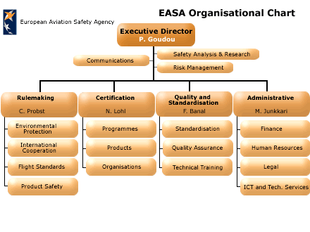
member
observers

Slide 62
HOW EASA AND RULES WERE ESTABLISHED?
Council Regulation (EC) 1592/2002
(Basic Regulation)
Adopted by
The European Parliament
Commission Regulation 1702/2003
(Implementing Rule Certification)
Part 21,34,36,39
Commission Regulation 2042/2003
(Implementing Rule Maintenance
Parts M,145,66,147
Adopted by
The European
Commission
FOR TRAINING PURPOSES ONLY
Notes:
Council Regulation (EC) 1592/2002: Basic Regulation
Establish objectives & essential requirements
Commission Regulation 2042/2003
Detailed of Basic Regulation – establish Implementing Rules:
Parts M,145,66,147
Commission Regulation 1702/2003:
Detailed of Basic Regulation - establish Implementing Rules:
Parts 21 and Certification Specification CS- 34,36,39 etc
The basic Regulation establishes common essential requirements to provide for a high uniform level of civil aviation safety and environmental protection; it requires the Commission to adopt the necessary implementing rules to ensure their uniform application; it establishes the ‘EASA’ to assist the Commission in the development of such implementing rules.

Slide 63
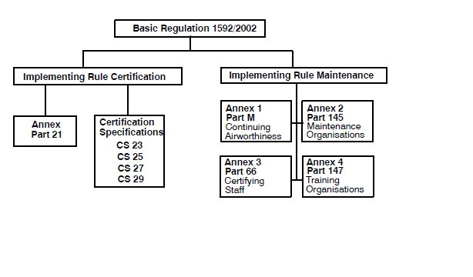

Slide 64
Regulation (EC) 1592/2002 Basic Regulation
This regulation establishes EASA and detail the function of EASA and how it will do it’s job
Regulation 1702/2003 Implementing rules (IR) Certification
1702/2003 is the relation governing the airworthiness and certification of aircraft and aircraft product. The annex to this regulation is Part-21 and this details the requirement to be met by an organisation who wish to cary out the design or product or aircraft component.
FOR TRAINING PURPOSES ONLY

Slide 65
Also included under this regulation are the Certification Spesification(CS). regulation consists of 5 articles and 1 annex that is Part-21. These detail the standard which the design and manufacture of aircraft and aircraft component must meet.
There are many CSs a few of which listed below
Part-21 deal with the certification of design organisation For aircraft, aircraft product and modification
CS23 deals with certification specification for small aeroplane
CS25 deals with certification specification for large aeroplane
CS27 and 29 deals with small and large helicopter
FOR TRAINING PURPOSES ONLY

Slide 66
Regulation (EC) NO 2042/2003 Implemeting Rule (IR) Maintenance 2042/2003 is concerned with the continued airworthiness of aircraft and their component as well as the aproval of organisation and personel involved in aircraft maintenance.
Commission Regulation 2042/2003 consist of 7 articles + 4 Annexes
Article 1: Objective and Scope
Article 2: Definitions
Article 3: Continuing Airworthiness Requirements
Article 4: Maintenance Organisation Approvals
Article 5: Certifying Staff
Article 6: Training Organisation Requirements
Article 7: Entry into Force
ARTICLES
FOR TRAINING PURPOSES ONLY

Slide 67
Annex 1 - Part M : Continuing Airworthiness Requirements
Annex 2 - Part 145 : Approval of Maintenance Organisations -Commercial Air Transport & Large Aircraft (details the requirement that must be met by an organisation to carry out and certify the maintenance of aircraft
Annex 3 - Part 66 : Certifying Staff – Aircraft Maintenance License (deal with the qualification of certifying staff to work in Part-145 )
Annex 4 - Part 147 : Training Organisation Requirements (deals with the requirement which must be met by an organisation wishing to carry out approved training of aicraft maintenance engineers.
FOR TRAINING PURPOSES ONLY

Slide 68
Requirement Structure
Structural Of Individual Part
The individual part are each divided into section
Section A lay down the requirement with which the organisation or individual must comply and gives guidance on how these requirement can be satisfied.
Section B lay down the procedures for the authorities to follow in order to regulate the approved companies and individuals .
The content of section A and Section B do not necessarily correspond.
The appendies give extra information, mainly about relevant forms to be used but also other information relevant to the requirement
Supporting document
The requirement in each part sometimes need clarification so for each part there is:
Acceptable Means Compliance (AMC)
Guidance Material (GM)
FOR TRAINING PURPOSES ONLY

Slide 69
Requirement Structure
Acceptable Means Compliance (AMC)- will lay down one acceptable method for complying with the requirements. This method is acceptable to the authority but is not the only which may be used. A different method could be used providing that the authority will accept it.
Guidance Material (GM) – give some explanation of the content of a requirement and helps to clarify what the requirement are saying
FOR TRAINING PURPOSES ONLY

Slide 70
ROLE OF EASA
Assist the European Commission in preparing EU legislation, and overseeing its application and its uniform understanding
Issue Certificates: Type Certificate(TCs), Supplemental Type Certificate(STCs), EASA Technical Standard Order(ETSOs)
Issue Airworthiness Directives
Issue Design Organisation Approvals
Competent Authority for NON-EU Organisations.
FOR TRAINING PURPOSES ONLY
Notes:
ROLE OF EASA
To assist the European Commission in preparing EU legislation on civil aviation safety and environmental compatibility.
The Agency took over responsibility for the airworthiness and environmental certification of all aeronautical products, parts, and appliances designed, manufactured, maintained or used by persons under the regulatory oversight of EU Member States.
Where Community law is implemented at Member State level, the Agency assists the Commission in overseeing its effective application and its uniform understanding.
The Agency became the competent authority to approve and oversee the organisations involved in the design of aeronautical products, parts and appliances.
It also carries out the same role for foreign organisations involved in the manufacture or maintenance of such products.
TC – Type Certificate STC – Supplemental Type Certificate
ETSO – EASA Technical Standard Order

Slide 71
1.3 ROLE OF MEMBER STATES
FOR TRAINING PURPOSES ONLY

Slide 72
ROLE OF MEMBER STATES
Issue Maintenance Organisation Approval (MOA) for EU organisations
Issue Product Organisation Approval (POA) for EU organisations
Issue Part 147 approvals and licences
Issue Part 66 licences
Issue Certificate of Airworthiness (C of A)
Competent Authority for local organisations
FOR TRAINING PURPOSES ONLY
Notes:
The Member States are still in charge of Maintenance and Production Organisation Approval, maintenance training, individual certificates and certificates of airworthiness for each individual aircraft.

Slide 73
1.3 RELATIONSHIP BETWEEN PART
FOR TRAINING PURPOSES ONLY

Slide 74
PART 66
CERTIFYING
STAFF
MAINTENANCE
PART 145
APPROVED
MAINTENANCE
ORGANISATION
PART 147
APPROVED
TRAINING
ORGANISATION
PART 21
CERTIFICATION OF
AIRCRAFT COMPONENT
PART M
CONTINUING
AIRWORTHINESS

Slide 75
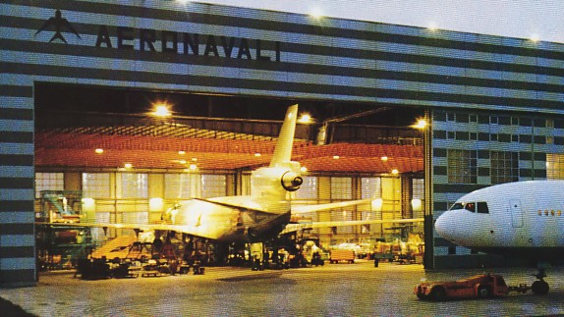

RELATIONSHIP BETWEEN PARTS
Maintenance of large aircraft/
aicraft used for commercial air
transport shall be carried out by
PART-145
Maintenance
Organisation
PART-M
(Subpart G)
Shall have
Appropriate
Aircraft type-
rated
Certifying
Staff
Qualified per
PART-147
Training Organisation
PART- 66
Certifying staff
Must passed examination
conducted / completed training
conducted by
Notes:
Part-M Para M.A.201(g):
Maintenance of large aircraft, aircraft used for commercial air transport and components thereof shall be carried out by a Part-145 approved maintenance organisation.
145.A.30 para (g), (h), (i)
Certifying staff for line, base or component: appropriate aircraft type rated certifying staff qualified as category B1 and B2 in accordance with Part-66 and 145.A.35
Part 66.A.25 Basic knowledge requirements
An applicant for an aircraft maintenance licence or the addition of a category or subcategory to such an aircraft maintenance licence shall demonstrate, by examination, a level of knowledge in the appropriate subject modules in accordance with Appendix I to this Part.
The basic knowledge examinations shall be conducted by a training organisation appropriately approved under Part- 147 or by the competent authority.

Slide 76
RELATIONSHIP WITH OTHER AVIATION AUTHORITIES
JAA & FAA Harmonization since 1992
These harmonization and safety enhancement activities are continued by EASA through meeting, seminar and conferences
Design, manufacture,
Operation & maintenance
Noise emissions
Crew Licensing
JAA
FAA
FOR TRAINING PURPOSES ONLY
Notes:
Administrative
FAR / JAR 21: Certification procedures for Aircraft, Products and Parts
Airframe
FAR/ JAR 23: Normal, Aerobatic and Commuter Airplane
FAR/ JAR 25: Transport Category Airplane
FAR/ JAR 27: Small Rotorcraft
FAR/ JAR 29: Transport category Rotorcraft
FAR 31: Manned Free Balloons JAR APU: Auxiliary Power Units
JAR VLA: Very Light Aircraft
Power plant
FAR 33/ JAR E: Aircraft Engines
FAR 35/ JAR P: Propellers
Environment
FAR 34:Fuel Venting and Emission Requirements for Turbine Powered A/craft
FAR/ JAR 36: Aircraft Noise
Under Approved Maintenance Standards the following applies
JAR OPS1 Subpart M: Airplane Maintenance
FAR/JAR145: Approved Maintenance Organization
FAR65/JAR 66: Certifying Staff Maintenance

Slide 77
RELATIONSHIP WITH OTHER
AVIATION AUTHORITIES
JAA official assisted EASA in
setting up of EASA & Rules
Handing over responsibilities
progressively
JAA
EASA
Oversight EU members
& Non-EU who abide by
EASA regulations
Retain its consultative role for non-EU States
Responsible for all its members in the area of
operations and flight crew licensing
FOR TRAINING PURPOSES ONLY
Notes:
In such a context, common standards are more rapidly and consistently implemented throughout the EU, It is also worth remembering that since 'Europe' is not limited to the 'European Union', those other European countries, provided they abide by the Agency's decisions, will be closely associated with the Agency's work. For example, this is already the case for Norway, Iceland and soon Switzerland. However, the JAA will retain its consultative role for non-EU States, as well as for all its members in the area of operations and flight crew licensing, until those matters are incorporated into the basic EASA regulation.
It is clear that the JAA is in the process of handing over responsibilities to the Agency, with both organisations working hand in hand to accomplish this by 2006-2007.
The successful setting up of EASA was due largely to the support of
the member States,
their national aviation authorities and of course
(c) JAA

Slide 78
RELATIONSHIP WITH OTHER
AVIATION AUTHORITIES
JAA
JAR-145
JAR-66
JAR-147
JAR-OPS
JAR-OPS 1 & 3
( Subpart M )
EASA
PART-145
PART-66
PART-147
EU-OPS
PART M ( Subpart G )
Notes:
In such a context, common standards are more rapidly and consistently implemented throughout the EU, It is also worth remembering that since 'Europe' is not limited to the 'European Union', those other European countries, provided they abide by the Agency's decisions, will be closely associated with the Agency's work. For example, this is already the case for Norway, Iceland and soon Switzerland. However, the JAA will retain its consultative role for non-EU States, as well as for all its members in the area of operations and flight crew licensing, until those matters are incorporated into the basic EASA regulation.

Slide 79
RELATIONSHIP WITH OTHER AVIATION AUTHORITIES
Technical agreement or
Working arrangement on
Acceptance of certification
finding or
implementation procedure
Other authorities
China
Israel
Russia
USA
Brazil
Canada
JAA
EASA
Notes:
CHINA :Technical Agreement – China & the Agency on Diamond A/craft product certification
ISRAEL: Working agreement – EASA & the CA Administration of Israel
RUSSIA: Working agreement on airworthiness Implementation procedure for:
design approvals of a/craft, engine & propeller from CIS
certification and continue airworthiness of SaM146 engines
USA ( ED Decision 2004/04/CF)
The acceptance of certification findings made by the FAA for products designed in the USA
BRAZIL (ED Decision 2004/03/CF): Administrative Arrangement with Brazillian authorities DAC/CTA – The acceptance of certification findings made by DAC/CTA for products designed in Brazil
CANADA: Administrative Arrangement – EASA & Transport Canada on Certification and Maintenance
ED Decision 2004/02/CF The acceptance of certification findings made by TCCA for products designed in Canada
JAA: Working Arrangement on transfer of certain Standardisation Co-ordination Activities from JAA to EASA & acceptance of certification findings made by FOCA (Swiss aviation authority)

